Slide 1
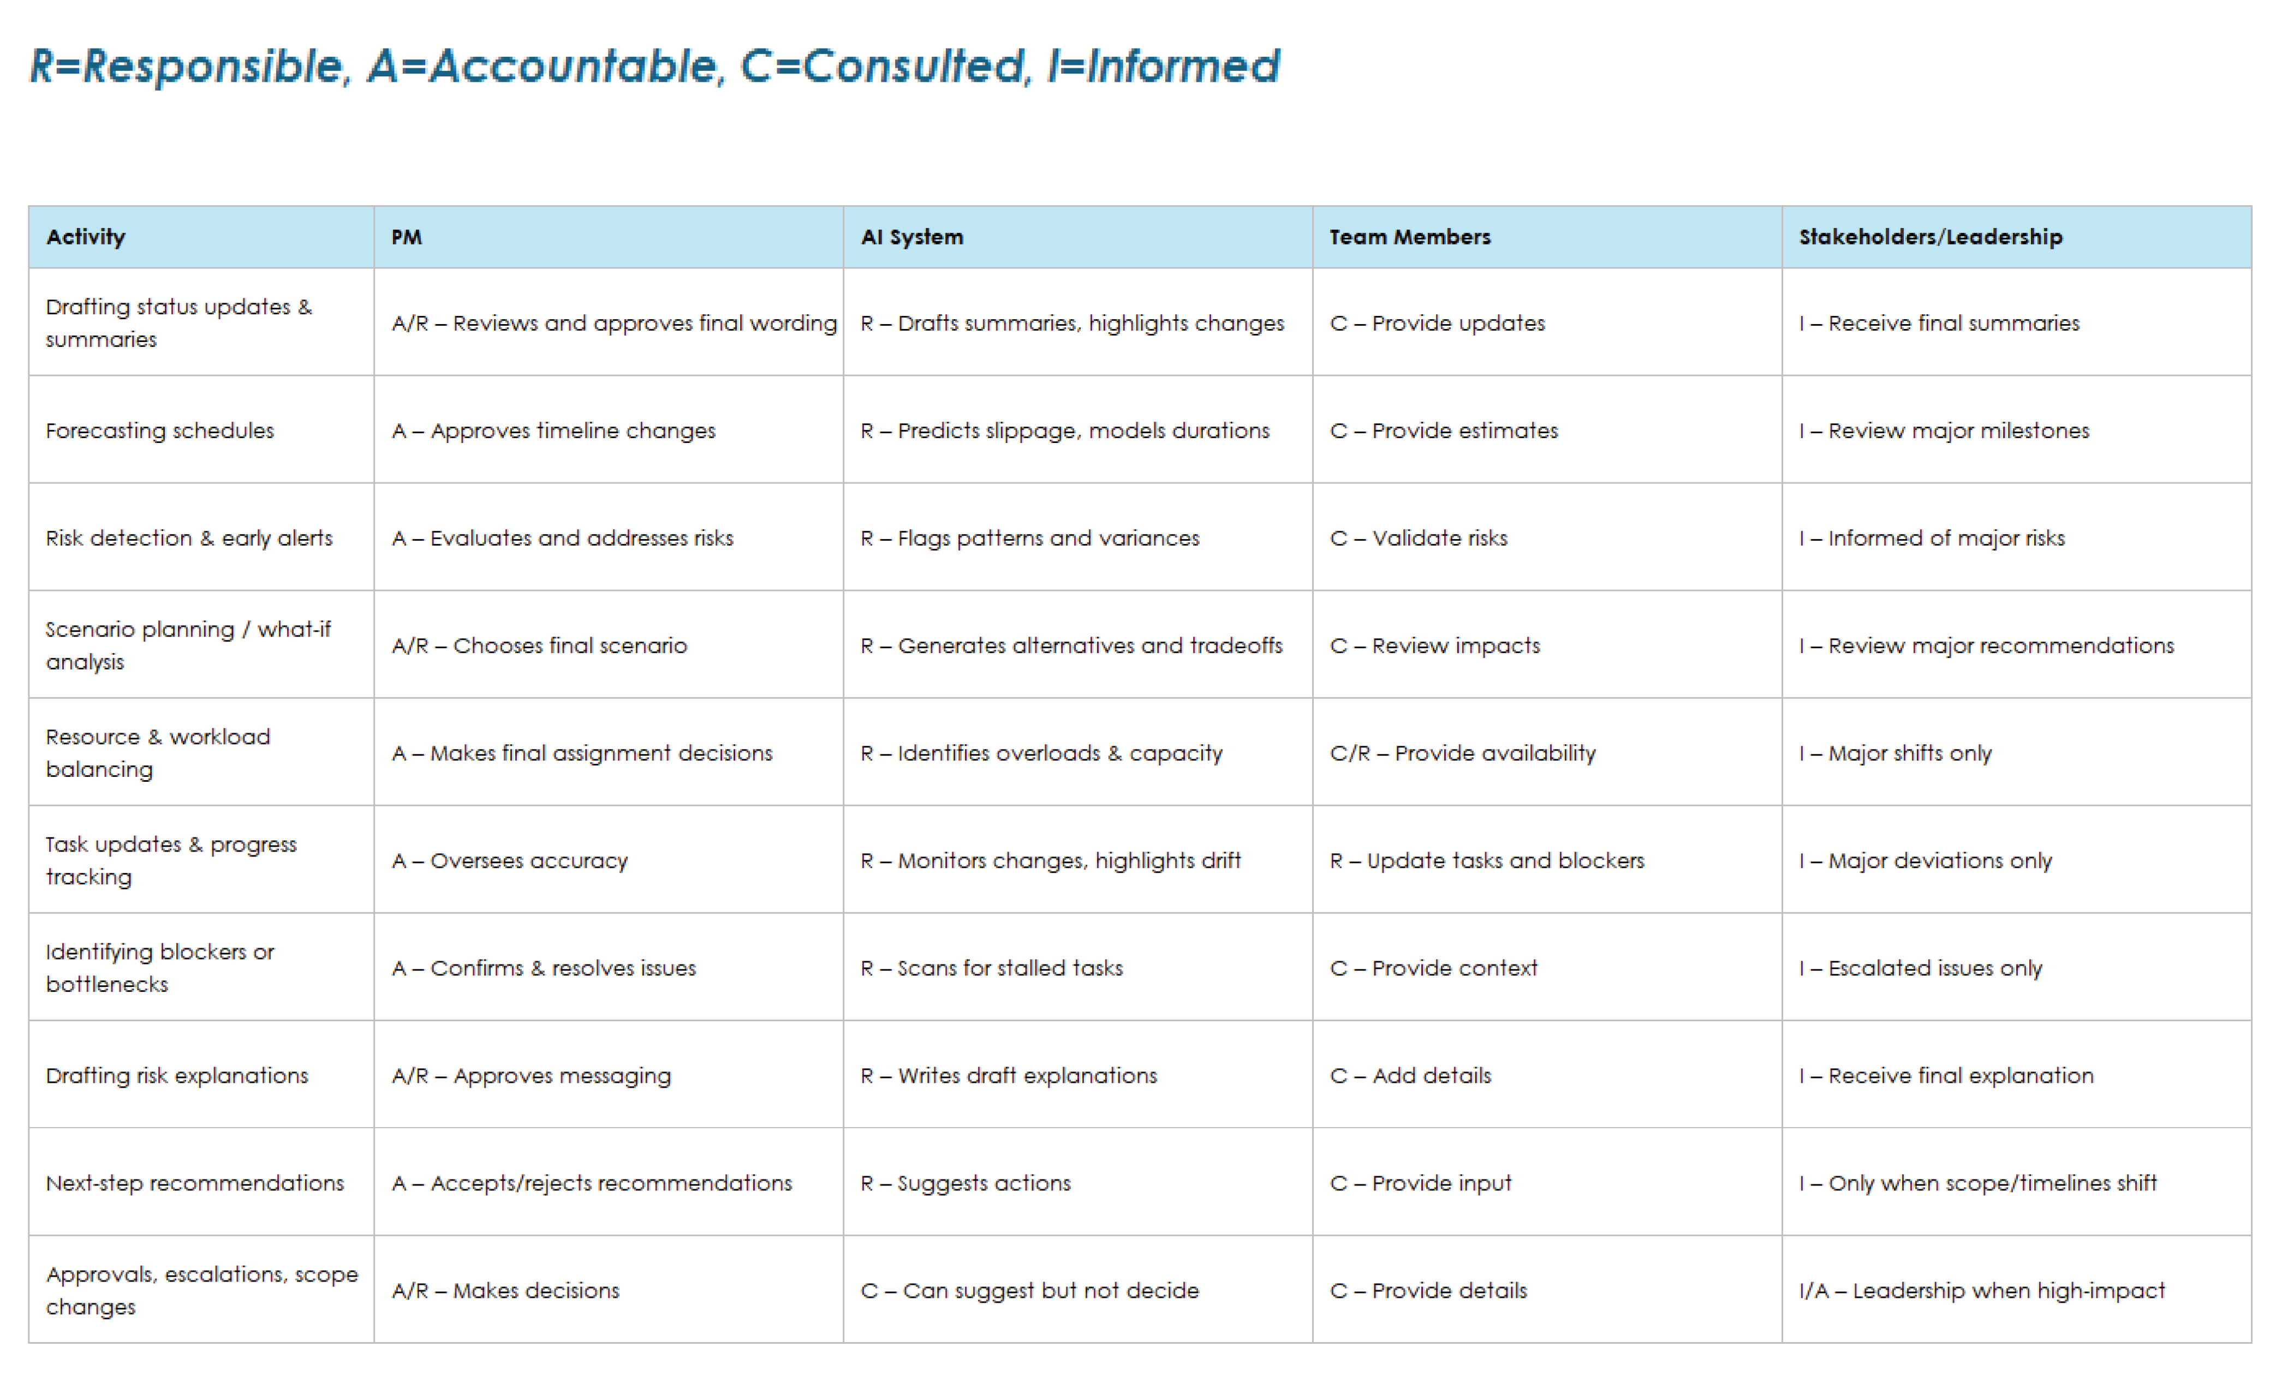
AI RACI Chart for Project Managers

Slide 2
RACI Chart for AI in Project Management
R=Responsible, A=Accountable, C=Consulted, I=Informed
Activity | PM | AI System | Team Members | Stakeholders/Leadership
Drafting status updates & summaries | A/R – Reviews and approves final wording | R – Drafts summaries, highlights changes | C – Provide updates | I – Receive final summaries
Forecasting schedules | A – Approves timeline changes | R – Predicts slippage, models durations | C – Provide estimates | I – Review major milestones
Risk detection & early alerts | A – Evaluates and addresses risks | R – Flags patterns and variances | C – Validate risks | I – Informed of major risks
Scenario planning / what-if analysis | A/R – Chooses final scenario | R – Generates alternatives and tradeoffs | C – Review impacts | I – Review major recommendations
Resource & workload balancing | A – Makes final assignment decisions | R – Identifies overloads & capacity | C/R – Provide availability | I – Major shifts only
Task updates & progress tracking | A – Oversees accuracy | R – Monitors changes, highlights drift | R – Update tasks and blockers | I – Major deviations only
Identifying blockers or bottlenecks | A – Confirms & resolves issues | R – Scans for stalled tasks | C – Provide context | I – Escalated issues only
Drafting risk explanations | A/R – Approves messaging | R – Writes draft explanations | C – Add details | I – Receive final explanation
Next-step recommendations | A – Accepts/rejects recommendations | R – Suggests actions | C – Provide input | I – Only when scope/timelines shift
Approvals, escalations, scope changes | A/R – Makes decisions | C – Can suggest but not decide | C – Provide details | I/A – Leadership when high‑impact
Provided by Smartsheet, Inc.

Slide 3
DISCLAIMER Any articles, templates, or information provided by Smartsheet on the website are for reference only. While we strive to keep the information up to date and correct, we make no representations or warranties of any kind, express or implied, about the completeness, accuracy, reliability, suitability, or availability with respect to the website or the information, articles, templates, or related graphics contained on the website. Any reliance you place on such information is therefore strictly at your own risk.

