Slide 1


ORGANIZATIONAL MATURITY MODEL DISCUSSION TEMPLATE
Use the provided text as a basis for your discussion. Adapt it as necessary and add your own comments and notes.
ORGANIZATIONAL MATURITY MODEL DISCUSSION TEMPLATE

Slide 2

Introduction to Organizational Maturity Models & Assessments
Discussion Subtitle
00/00/0000
ORGANIZATIONAL MATURITY MODEL DISCUSSION

Slide 3

Table of Contents
What Is Organizational Maturity?
What Is an Organizational Maturity Model?
What Is an Organizational Maturity Assessment?
MESA Manufacturing Operations Management Assessment Tool
Baldrige Excellence Framework
Rapid Plant Assessment (RPA)
Maturity Grid or Matrix Assessments
Your Notes and Discussion
PROJECT REPORT
Table of Contents

Slide 4

What Is Organizational Maturity?
Organizational maturity predicts how well a company can reach its goals. Maturity is a gradual process that emphasizes self-improvement. Companies with a high maturity level can reliably turn challenges and roadblocks into opportunities.
Process repeatability, transparency, accountability, and quality
Incremental improvements
PROJECT REPORT
What Is Organizational Maturity?

Slide 5
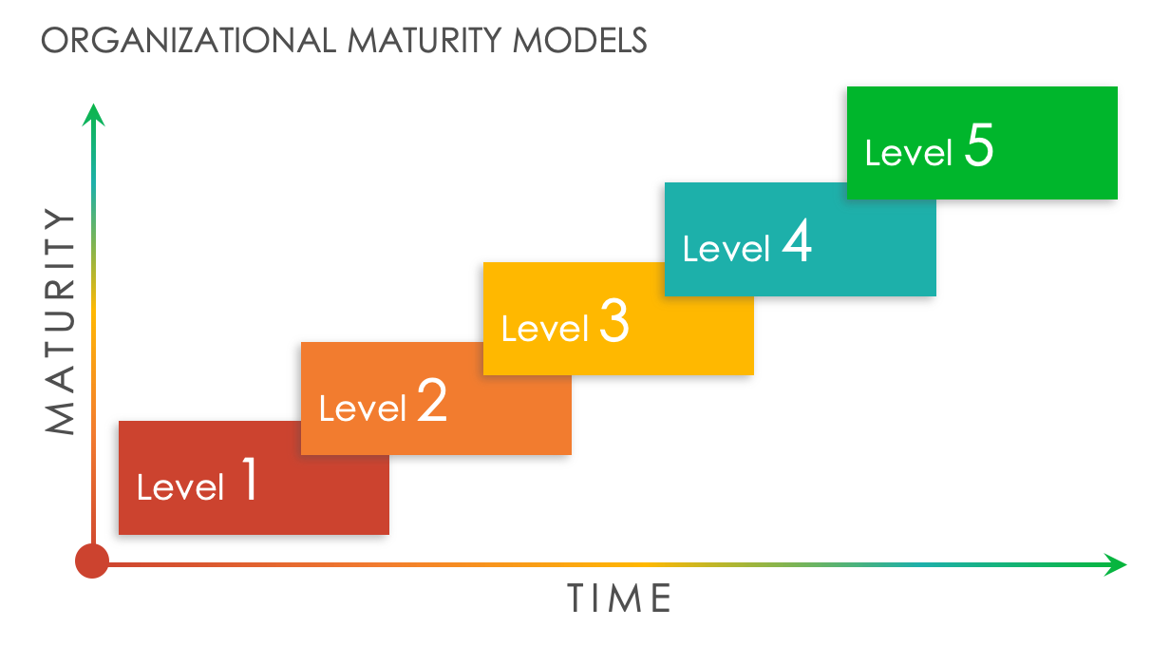
What Is an Organizational Maturity Model?
Organizational maturity models provide a framework for assessing capabilities.
They include four or five maturity levels.
Low maturity levels indicate lack of repeatable processes. Teams operate in functional silos.
High maturity levels indicate streamlined processes. Strong cooperation exists among teams.
Many models also describe the actions needed to advance to the next maturity level.
Most models use questionnaires and other assessment tools to determine maturity.
PROJECT REPORT
What Is an Organizational Maturity Model?

Slide 6

What Is an Organizational Maturity Assessment?
An organizational maturity assessment is a tool for gauging a company’s maturity.
Some assessments are multiple choice or yes-no questionnaires, while others come in a grid or matrix format.
An outside consultant can administer the assessment. It can also be self-administered.
PROJECT REPORT
What Is an Organizational Maturity Assessment?

Slide 7
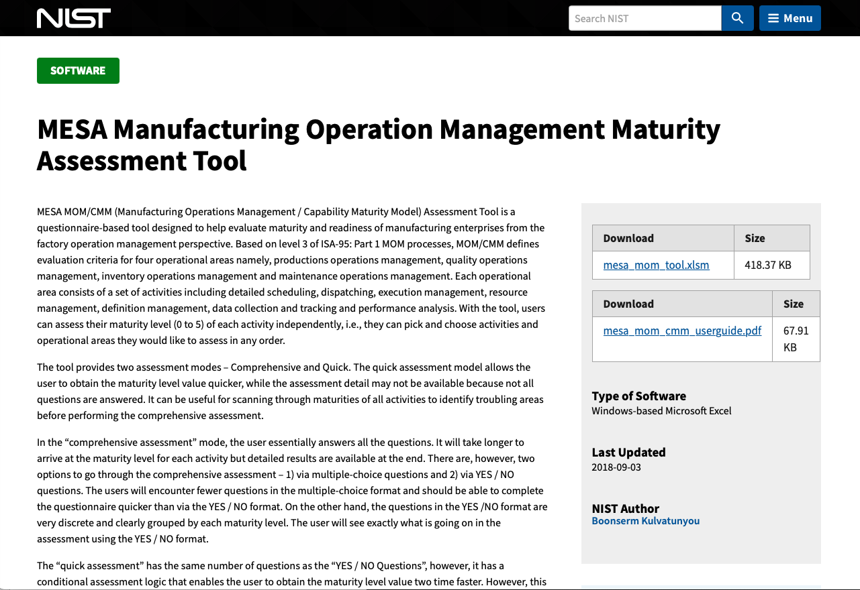
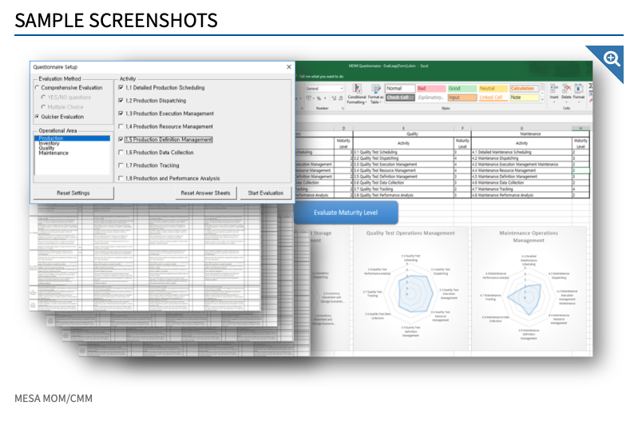
MESA Manufacturing Operations Management Assessment Tool
This maturity model is an Excel-based questionnaire, with a user guide included.
Download either the comprehensive or the quick-mode format.
Use this tool to assess maturity in operations management, quality control, inventory, and maintenance.
https://www.nist.gov/services-resources/software/mesa-manufacturing-operation-management-maturity-assessment-tool
PROJECT REPORT
MESA Manufacturing Operations Management Assessment Tool

Slide 8
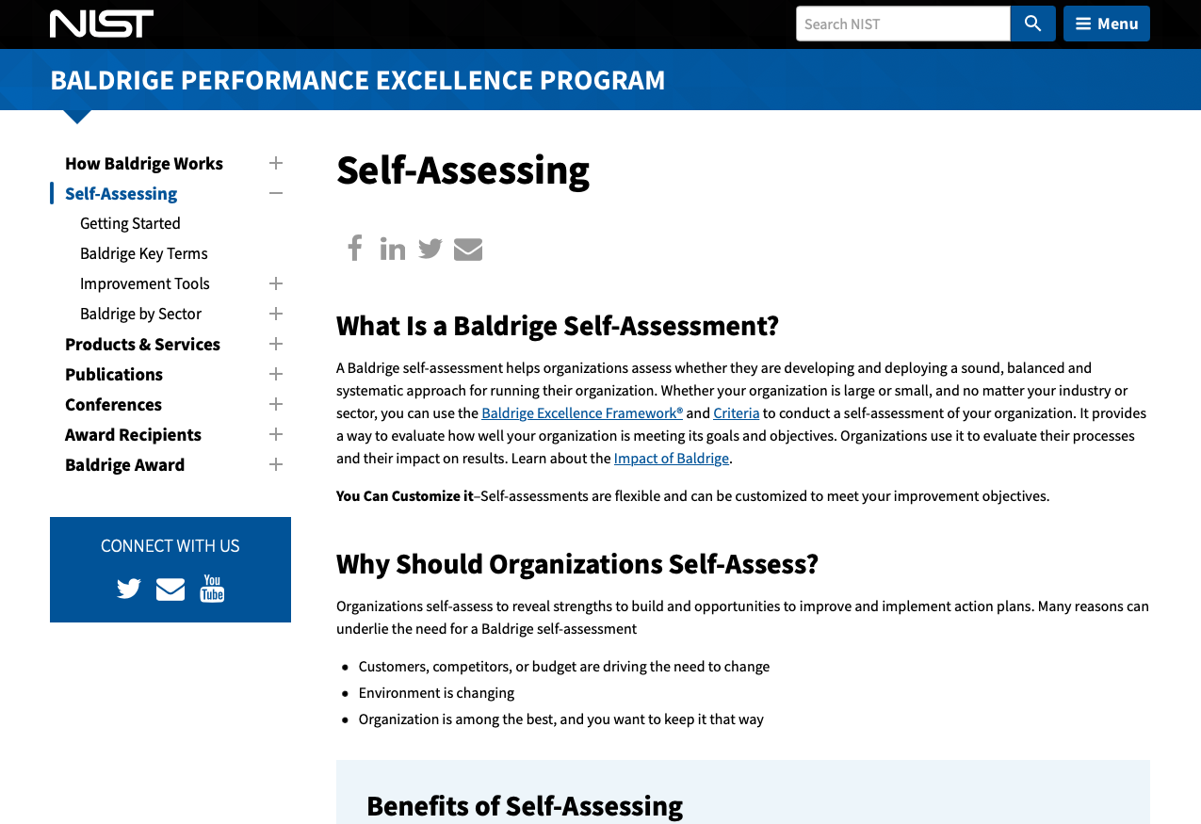
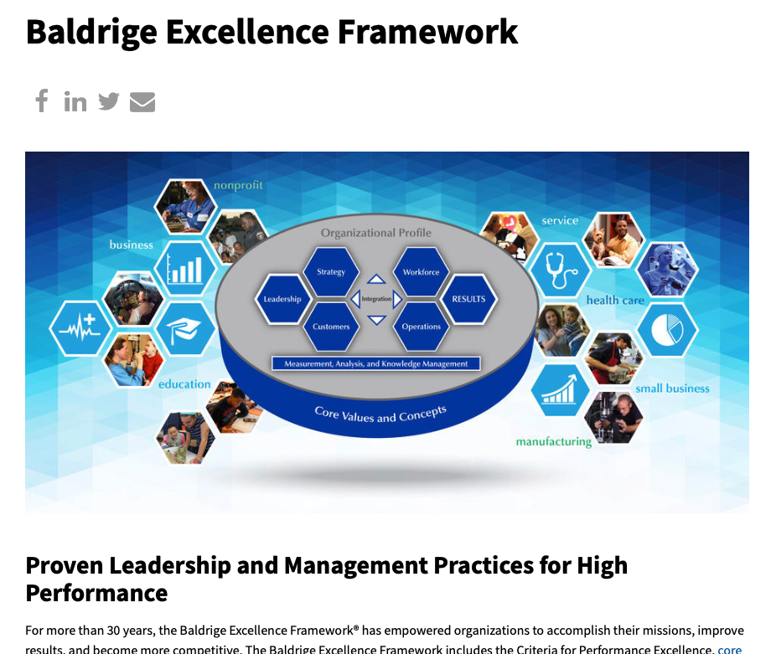
Baldridge Excellence Framework
This maturity model assesses how well you execute your company mission and vision.
Assess maturity for the seven Baldrige categories for performance excellence: leadership, strategy, customers, measurement, analysis and knowledge, management, and workforce, operations, and results.
Determine the maturity level for each category: reactive, early, mature, or role model.
Start with a free quick-start version, or purchase the advanced version.
https://www.nist.gov/baldrige/self-assessing
PROJECT REPORT
Baldridge Excellence Framework

Slide 9
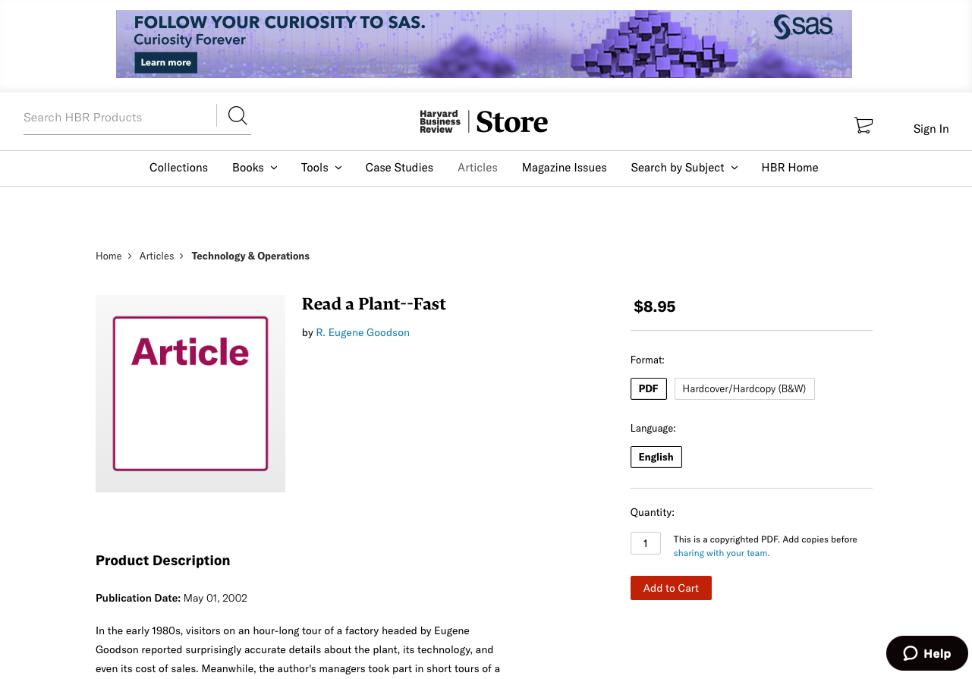


Rapid Plant Assessment (RPA)
Use simple, observational techniques of the rapid plant assessment to determine maturity levels.
In this maturity model, team members choose an observation area and conduct a 30-minute tour of a company or department.
The RPA model discourages note-taking. Stay alert and aware during the tour.
After the tour, the team reconvenes to complete a questionnaire on either Lean capabilities or adherence to best practices.
https://store.hbr.org/product/read-a-plant-fast/R0205H
PROJECT REPORT
Rapid Plant Assessment (RPA)

Slide 10
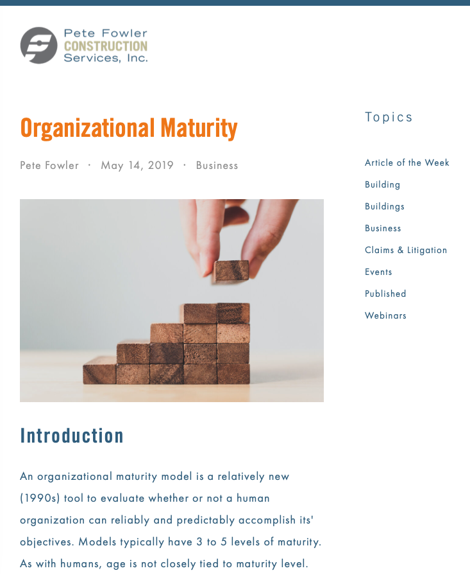
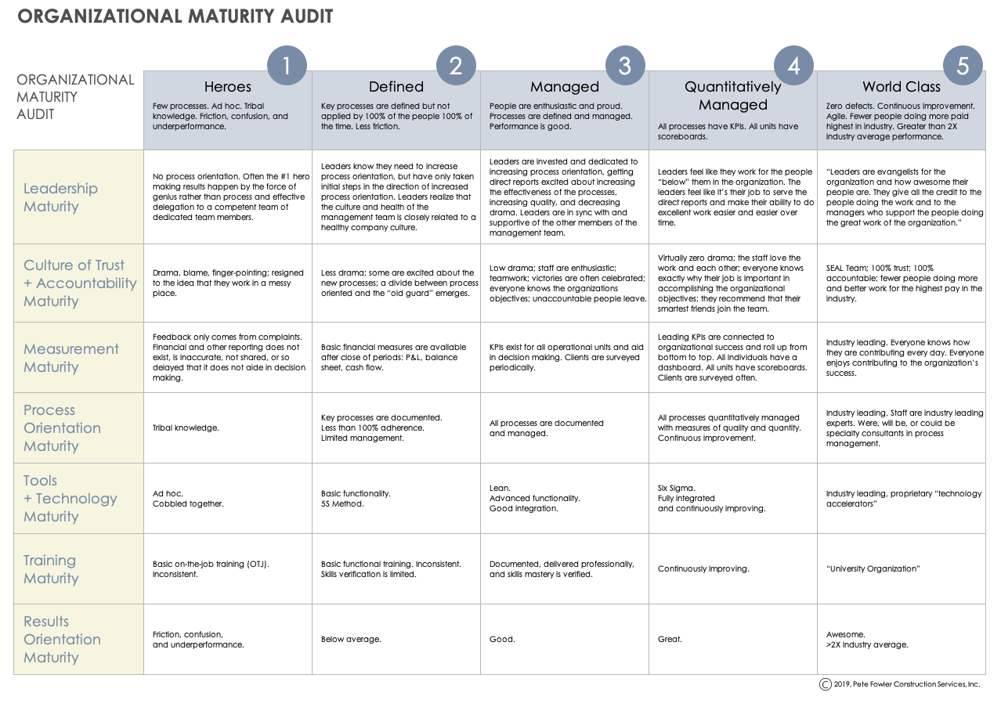
Organizational Maturity Grid and Matrix Assessments
Maturity grids and matrices Include details of the characteristics that typify each maturity level.
Users select the boxes they believe apply to their organization.
These assessment tools provide a quick analysis, with visual results.
Many maturity grids are freely available on the Internet (https://www.petefowler.com/blog/2019/5/1/maturity-model).
PROJECT REPORT
Organizational Maturity Grid and Matrix Assessments

Slide 11

Your Notes and Discussion
Notes
Discussion
PROJECT REPORT
Your Notes and Discussion

Slide 12
DISCLAIMER Any articles, templates, or information provided by Smartsheet on the website are for reference only. While we strive to keep the information up to date and correct, we make no representations or warranties of any kind, express or implied, about the completeness, accuracy, reliability, suitability, or availability with respect to the website or the information, articles, templates, or related graphics contained on the website. Any reliance you place on such information is therefore strictly at your own risk.

