Slide 1


YEARLY SALES COMPARISON REPORT TEMPLATE
Use the Yearly Sales Comparison Report Template in Excel to enter data that will populate the charts and graphs. Place screenshots of each element on the following slides to build out your Yearly Sales Comparison Report Presentation.
YEARLY SALES COMPARISON REPORT PRESENTATION

Slide 2
REPORTING PERIOD
CURRENT YEAR | VS | PREVIOUS YEAR
2028 | VS | 2027
YEARLY SALES COMPARISON REPORT PRESENTATION

Slide 3
TABLE OF CONTENTS
1
2
Summary by Category
Product Category Sales per Year
YEARLY SALES COMPARISON REPORT PRESENTATION | TABLE OF CONTENTS
PROJECT REPORT

Slide 4
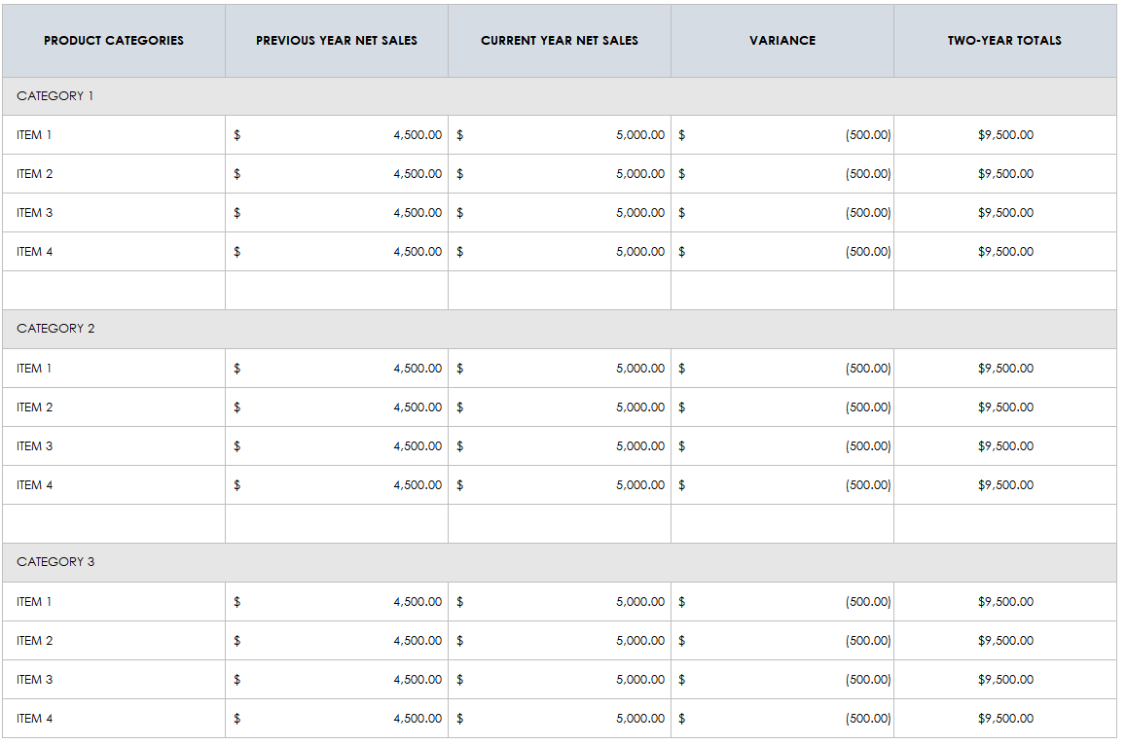
1. SUMMARY BY CATEGORY
PROJECT REPORT
SUMMARY

Slide 5
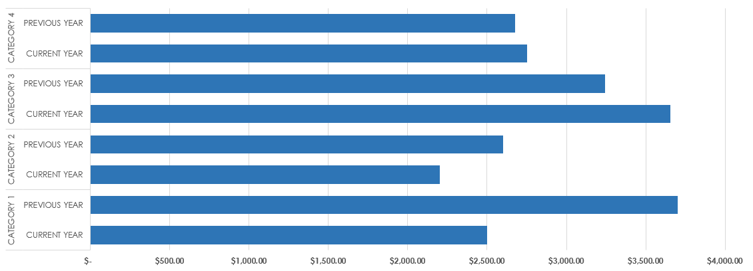
2. PRODUCT CATEGORY SALES PER YEAR
PROJECT REPORT
PRODUCT CATEGORY SALES PER YEAR

Slide 6
DISCLAIMER Any articles, templates, or information provided by Smartsheet on the website are for reference only. While we strive to keep the information up to date and correct, we make no representations or warranties of any kind, express or implied, about the completeness, accuracy, reliability, suitability, or availability with respect to the website or the information, articles, templates, or related graphics contained on the website. Any reliance you place on such information is therefore strictly at your own risk.

