Slide 1

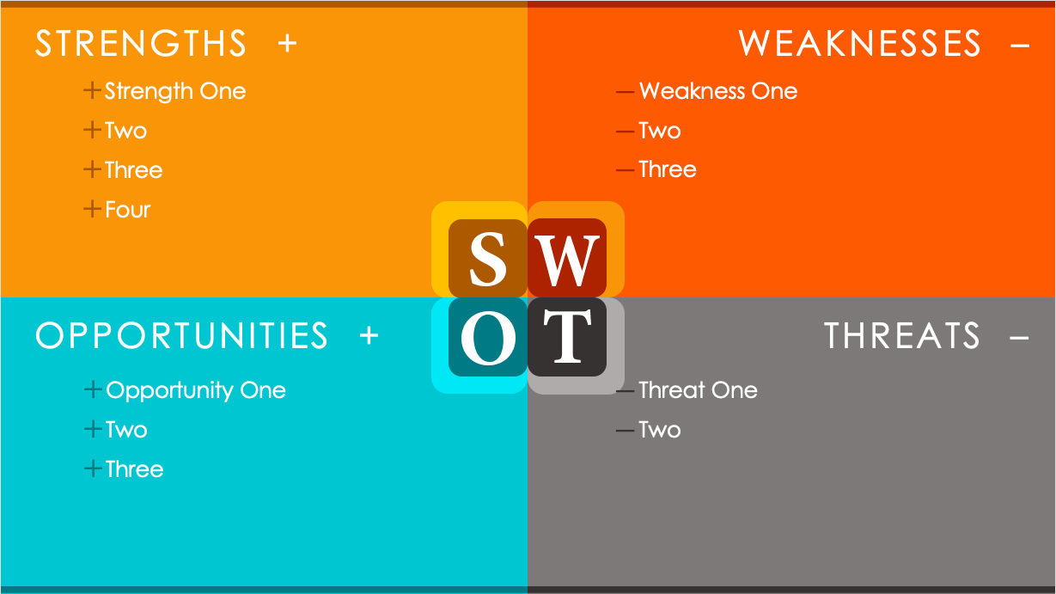
ANIMATED TECHNOLOGY COMPANY SWOT ANALYSIS TEMPLATE

Slide 2
BLANK ANIMATED SWOT ANALYSIS TEMPLATE Static slide; not animated. For animation, use slide 5.
STRENGTHS +
WEAKNESSES –
Strength One
Two
Three
Four
Weakness One
Two
Three
OPPORTUNITIES +
THREATS –
Opportunity One
Two
Three
Threat One
Two

Slide 3
STRENGTHS +
WEAKNESSES –
Strength One
Two
Three
Four
Weakness One
Two
Three
OPPORTUNITIES +
THREATS –
Opportunity One
Two
Three
Threat One
Two

Slide 4
Static slide; not animated. For animation, use slide 3.
ANIMATED TECHNOLOGY COMPANY SWOT ANALYSIS EXAMPLE
STRENGTHS +
WEAKNESSES –
We have a global market presence, with offices and employees in 16 countries.
We are consistently growing our customer base, with average growth of 1.2 percent per month.
Our company is an industry leader.
We have strong global brand recognition.
Localization is becoming more expensive and necessary.
Employee retention in some departments is below industry standards.
OPPORTUNITIES +
THREATS –
Global regulations require standardized hardware inputs.
The outsourcing of labor and manufacturing may cause a potential backlash at home.
Cybersecurity experts have singled out our product as vulnerable to emerging threats.
Public adoption of our tracking and advertising software has been slow.
We continue to expand into new countries and markets.
We are rolling out a new product version in Q2.
A number of emerging markets have more affordable labor costs.

Slide 5
STRENGTHS +
WEAKNESSES –
We have a global market presence, with offices and employees in 16 countries.
We are consistently growing our customer base, with average growth of 1.2 percent per month.
Our company is an industry leader.
We have strong global brand recognition.
Localization is becoming more expensive and necessary.
Employee retention in some departments is below industry standards.
OPPORTUNITIES +
THREATS –
We continue to expand into new countries and markets.
We are rolling out a new product version in Q2.
A number of emerging markets have more affordable labor costs.
Global regulations require standardized hardware inputs.
The outsourcing of labor and manufacturing may cause a potential backlash at home.
Cybersecurity experts have singled out our product as vulnerable to emerging threats.
Public adoption of our tracking and advertising software has been slow.

Slide 6
DISCLAIMER Any articles, templates, or information provided by Smartsheet on the website are for reference only. While we strive to keep the information up to date and correct, we make no representations or warranties of any kind, express or implied, about the completeness, accuracy, reliability, suitability, or availability with respect to the website or the information, articles, templates, or related graphics contained on the website. Any reliance you place on such information is therefore strictly at your own risk.

