Slide 1

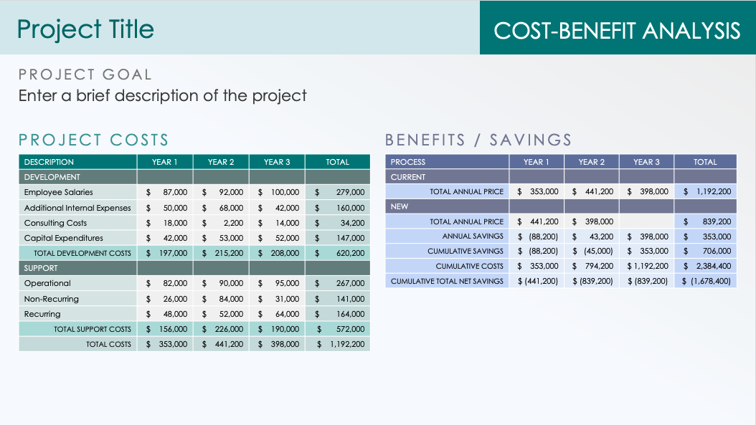
Cost-Benefit Analysis Table Template for PowerPoint
If you are a project manager who needs to show the financial implications of a proposed project, this template with its table format is the perfect tool. Enter and add the values for the project costs and benefits/savings over a three-year timeline. The projections shown on the completed template offer an easy way for stakeholders to understand the project’s financial risks and rewards quickly.

Slide 2
Project Title
COST-BENEFIT ANALYSIS
PROJECT GOAL
Enter a brief description of the project
PROJECT COSTS
BENEFITS / SAVINGS
DESCRIPTION | YEAR 1 | YEAR 2 | YEAR 3 | TOTAL
DEVELOPMENT
Employee Salaries | $ 87,000 | $ 92,000 | $ 100,000 | $ 279,000
Additional Internal Expenses | $ 50,000 | $ 68,000 | $ 42,000 | $ 160,000
Consulting Costs | $ 18,000 | $ 2,200 | $ 14,000 | $ 34,200
Capital Expenditures | $ 42,000 | $ 53,000 | $ 52,000 | $ 147,000
TOTAL DEVELOPMENT COSTS | $ 197,000 | $ 215,200 | $ 208,000 | $ 620,200
SUPPORT
Operational | $ 82,000 | $ 90,000 | $ 95,000 | $ 267,000
Non-Recurring | $ 26,000 | $ 84,000 | $ 31,000 | $ 141,000
Recurring | $ 48,000 | $ 52,000 | $ 64,000 | $ 164,000
TOTAL SUPPORT COSTS | $ 156,000 | $ 226,000 | $ 190,000 | $ 572,000
TOTAL COSTS | $ 353,000 | $ 441,200 | $ 398,000 | $ 1,192,200
PROCESS | YEAR 1 | YEAR 2 | YEAR 3 | TOTAL
CURRENT
TOTAL ANNUAL PRICE | $ 353,000 | $ 441,200 | $ 398,000 | $ 1,192,200
NEW
TOTAL ANNUAL PRICE | $ 441,200 | $ 398,000 |  | $ 839,200
ANNUAL SAVINGS | $ (88,200) | $ 43,200 | $ 398,000 | $ 353,000
CUMULATIVE SAVINGS | $ (88,200) | $ (45,000) | $ 353,000 | $ 706,000
CUMULATIVE COSTS | $ 353,000 | $ 794,200 | $ 1,192,200 | $ 2,384,400
CUMULATIVE TOTAL NET SAVINGS | $ (441,200) | $ (839,200) | $ (839,200) | $ (1,678,400)

Slide 3
Project Title
COST-BENEFIT ANALYSIS
PROJECT GOAL
Enter a brief description of the project
PROJECT COSTS
BENEFITS / SAVINGS
DESCRIPTION | YEAR 1 | YEAR 2 | YEAR 3 | TOTAL
DEVELOPMENT
Employee Salaries
Additional Internal Expenses
Consulting Costs
Capital Expenditures
TOTAL DEVELOPMENT COSTS
SUPPORT
Operational
Non-Recurring
Recurring
TOTAL SUPPORT COSTS
TOTAL COSTS
PROCESS | YEAR 1 | YEAR 2 | YEAR 3 | TOTAL
CURRENT
TOTAL ANNUAL PRICE
NEW
TOTAL ANNUAL PRICE
ANNUAL SAVINGS
CUMULATIVE SAVINGS
CUMULATIVE COSTS
CUMULATIVE TOTAL NET SAVINGS

Slide 4
DISCLAIMER Any articles, templates, or information provided by Smartsheet on the website are for reference only. While we strive to keep the information up to date and correct, we make no representations or warranties of any kind, express or implied, about the completeness, accuracy, reliability, suitability, or availability with respect to the website or the information, articles, templates, or related graphics contained on the website. Any reliance you place on such information is therefore strictly at your own risk.

