Slide 1



SOCIAL MEDIA WEEKLY REPORT TEMPLATE
COMPANY NAME | Name
ADDRESS | Address
PHONE | Phone
EMAIL | Email Address
REPORT WEEK OF | MM/DD/YY
REPORT PREPARED BY | Name
SOCIAL MEDIA WEEKLY REPORT PRESENTATION
PROJECT REPORT

Slide 2
WEEKLY SOCIAL MEDIA REPORT SUMMARY
FACEBOOK | $0 |  | YOUTUBE | $0 |  | INSTAGRAM | $0 |  | Twitter | $0
0 | Up 0% |  | 0 | Up 0% |  | 0 | Up 0% |  | 0 | Up 0%
clicks | this week |  | clicks | this week |  | clicks | this week |  | clicks | this week
0 | Up 0% |  | 0 | Up 0% |  | 0 | Up 0% |  | 0 | Up 0%
Impressions | this week |  | Impressions | this week |  | Impressions | this week |  | Impressions | this week
0 | Up 0% |  | 0 | Up 0% |  | 0 | Up 0% |  | 0 | Up 0%
subscribers | this week |  | subscribers | this week |  | subscribers | this week |  | subscribers | this week
0 | Up 0% |  | 0 | Up 0% |  | 0 | Up 0% |  | 0 | Up 0%
likes | this week |  | likes | this week |  | likes | this week |  | likes | this week
WEEKLY SOCIAL MEDIA REPORT SUMMARY
PROJECT REPORT

Slide 3
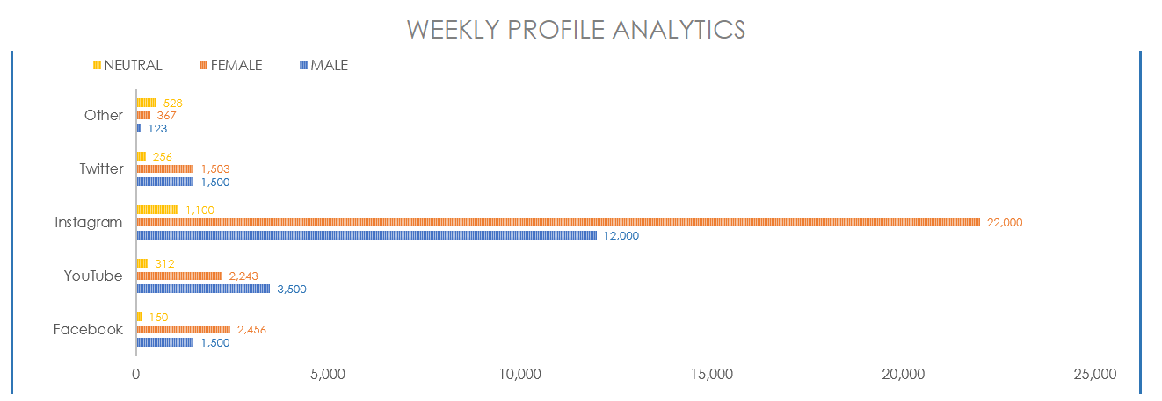
WEEKLY PROFILE ANALYTICS
Users are to take a screenshot of the Weekly Social Media Profile Analytics chart in the Excel version of this template to illustrate this slide.
PROJECT REPORT
WEEKLY SOCIAL MEDIA PROFILE ANALYTICS

Slide 4
PROFILE DATA
PROJECT REPORT
PROFILE DATA

Slide 5
DISCLAIMER Any articles, templates, or information provided by Smartsheet on the website are for reference only. While we strive to keep the information up to date and correct, we make no representations or warranties of any kind, express or implied, about the completeness, accuracy, reliability, suitability, or availability with respect to the website or the information, articles, templates, or related graphics contained on the website. Any reliance you place on such information is therefore strictly at your own risk.
PROJECT REPORT

