Slide 1

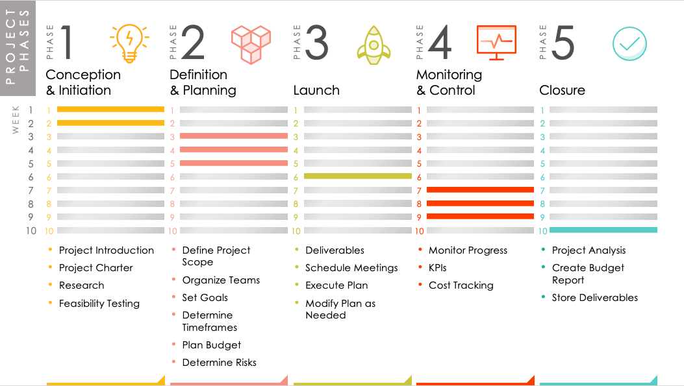
PROJECT PHASES TEMPLATE
This project phases template outlines the five phases of project management and provides specific timelines for each. It can be used for a project of any size. Add or remove weeks from the schedule and customize the deliverables to suit your project needs. Share this template with your team to show a high-level illustration of your project’s lifecycle.

Slide 2



1
2
3
4
5
PROJECT PHASES
PHASE
PHASE
PHASE
PHASE
PHASE
Conception
& Initiation
Definition
& Planning
Monitoring
& Control
Launch
Closure
1
1
1
1
1
1
WEEK
2
2
2
2
2
2
3
3
3
3
3
3
4
4
4
4
4
4
5
5
5
5
5
5
6
6
6
6
6
6
7
7
7
7
7
7
8
8
8
8
8
8
9
9
9
9
9
9
10
10
10
10
10
10
Project Introduction
Project Charter
Research
Feasibility Testing
Define Project Scope
Organize Teams
Set Goals
Determine Timeframes
Plan Budget
Determine Risks
Deliverables
Schedule Meetings
Execute Plan
Modify Plan as Needed
Monitor Progress
KPIs
Cost Tracking
Project Analysis
Create Budget Report
Store Deliverables

Slide 3
DISCLAIMER Any articles, templates, or information provided by Smartsheet on the website are for reference only. While we strive to keep the information up to date and correct, we make no representations or warranties of any kind, express or implied, about the completeness, accuracy, reliability, suitability, or availability with respect to the website or the information, articles, templates, or related graphics contained on the website. Any reliance you place on such information is therefore strictly at your own risk.

