Slide 1


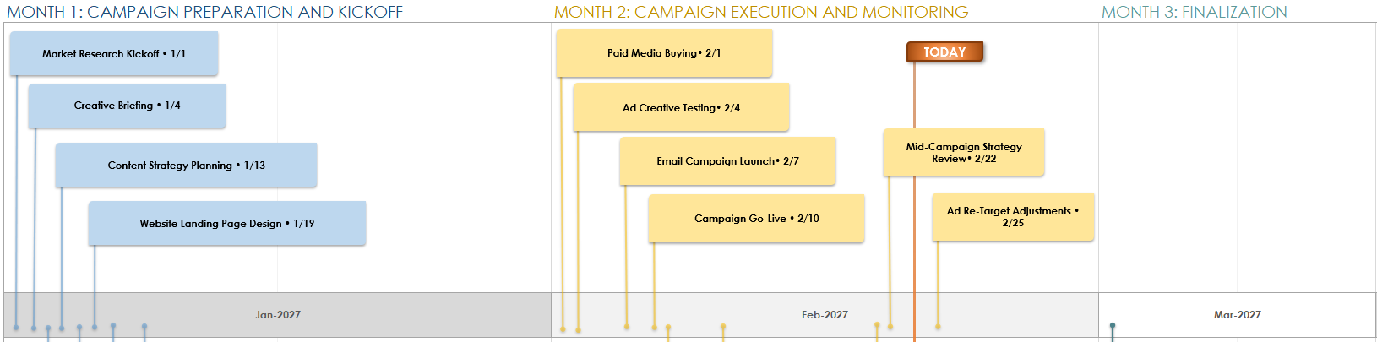
ADVERTISING AGENCY CAMPAIGN TIMELINE TEMPLATE EXAMPLE
CAMPAIGN NAME | Project Omega | START DATE | 1/1/2027
PROJECT MANAGER | Kirk Caskey

Slide 2

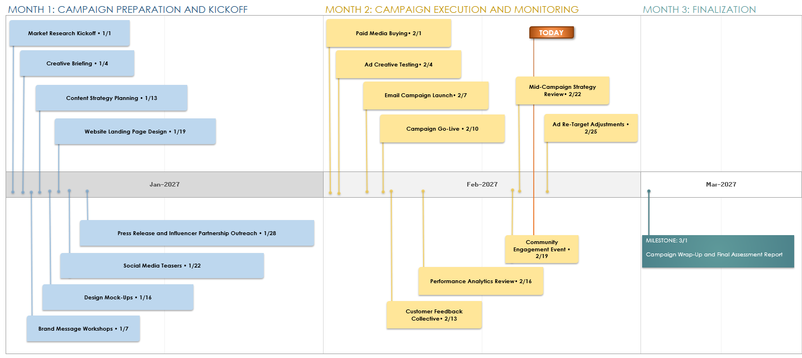
ADVERTISING AGENCY CAMPAIGN TIMELINE EXAMPLE

Slide 3
ADVERTISING AGENCY CAMPAIGN TIMELINE
MONTH 1: TITLE
MONTH 2: TITLE
Jan-2027 |  | Feb-2027

Slide 4
ADVERTISING AGENCY CAMPAIGN TIMELINE
MONTH 3: TITLE
MONTH 4: TITLE
Mar-2027 |  | Apr-2027

Slide 5
TIMELINE ASSETS
TODAY
Item • X/X
Item • X/X
MILESTONE: X/X
Content
Item • X/X
Item • X/X

Slide 6
NOTES
summary information / comments

Slide 7
DISCLAIMER Any articles, templates, or information provided by Smartsheet on the website are for reference only. While we strive to keep the information up to date and correct, we make no representations or warranties of any kind, express or implied, about the completeness, accuracy, reliability, suitability, or availability with respect to the website or the information, articles, templates, or related graphics contained on the website. Any reliance you place on such information is therefore strictly at your own risk.

