Slide 1
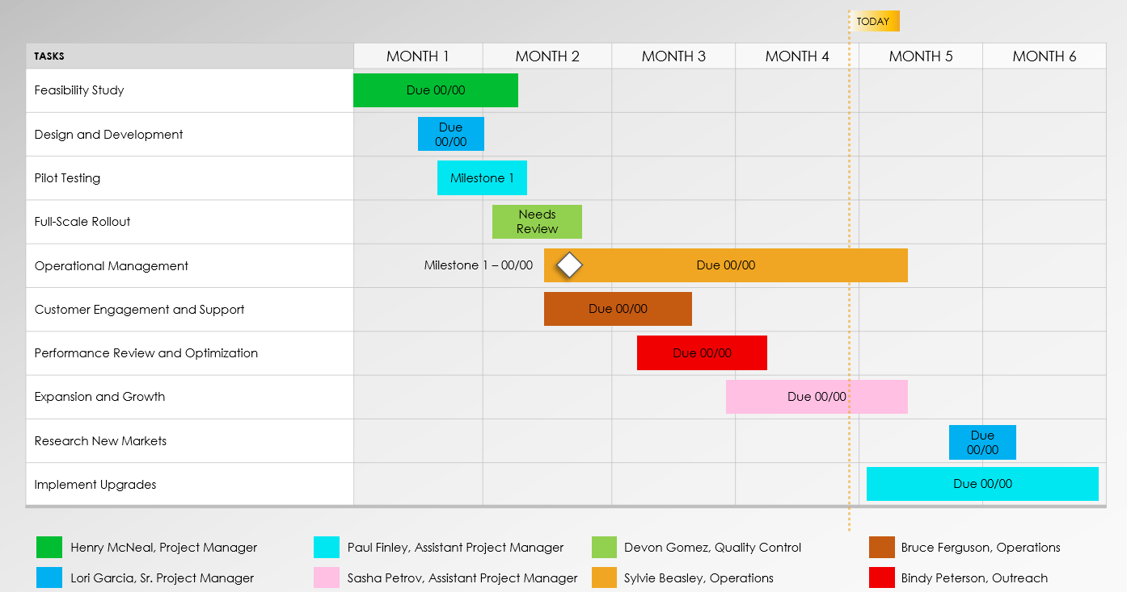
BASIC POWERPOINT IMPLEMENTATION PLAN TEMPLATE EXAMPLE
Notes for Using This Template
Enter Project Tasks in the chart area.
Enter Label Owners in the key below the chart.
Adjust bars to represent the length of time per task. Add Start and End Dates, Due Dates, Milestone Dates, or additional Task Information within each bar or in the chart area.

Slide 2
TODAY
TASKS | MONTH 1 | MONTH 2 | MONTH 3 | MONTH 4 | MONTH 5 | MONTH 6
Feasibility Study
Design and Development
Pilot Testing
Full-Scale Rollout
Operational Management
Customer Engagement and Support
Performance Review and Optimization
Expansion and Growth
Research New Markets
Implement Upgrades
Due 00/00
Due 00/00
Milestone 1
Needs Review
Milestone 1 – 00/00
Due 00/00
Due 00/00
Due 00/00
Due 00/00
Due 00/00
Due 00/00
Henry McNeal, Project Manager
Paul Finley, Assistant Project Manager
Devon Gomez, Quality Control
Bruce Ferguson, Operations
Lori Garcia, Sr. Project Manager
Sasha Petrov, Assistant Project Manager
Sylvie Beasley, Operations
Bindy Peterson, Outreach
IMPLEMENTATION PLAN EXAMPLE

Slide 3
DISCLAIMER Any articles, templates, or information provided by Smartsheet on the website are for reference only. While we strive to keep the information up to date and correct, we make no representations or warranties of any kind, express or implied, about the completeness, accuracy, reliability, suitability, or availability with respect to the website or the information, articles, templates, or related graphics contained on the website. Any reliance you place on such information is therefore strictly at your own risk.

