Slide 1

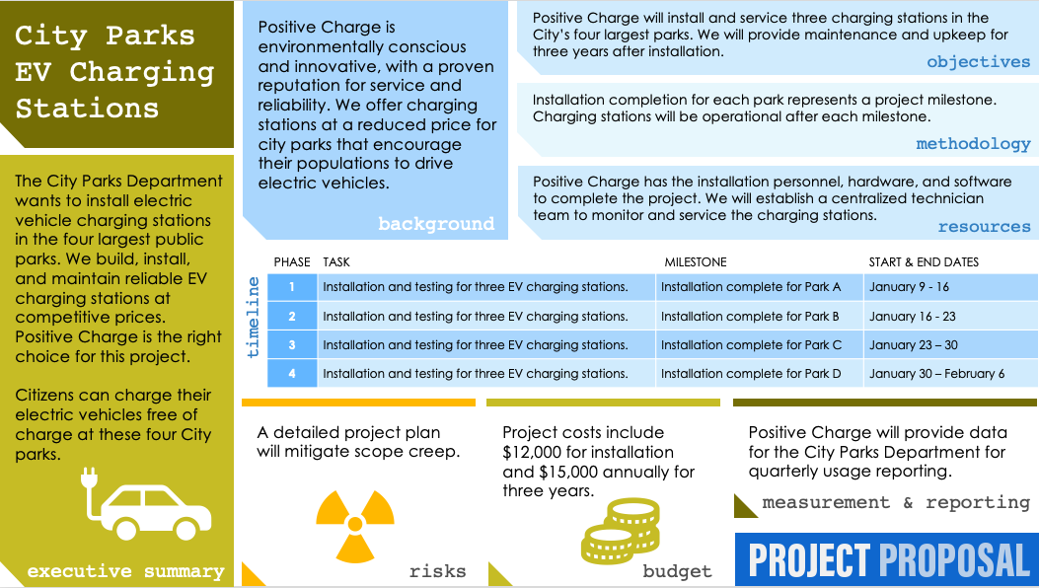
ONE-PAGE PROJECT PROPOSAL TEMPLATE EXAMPLE for PowerPoint
Use this template to clearly and succinctly present standard project proposal information, such as the executive summary, project background, and objectives, but without the hassle of arranging slides. This one-page project proposal template provides a complete picture of your proposal at a glance. Communicate your proposal's budget estimate with a simple chart, then outline your project phases with their corresponding tasks and start and end dates. Use this template to list any potential risks alongside your mitigation strategies. The sample version of this template serves as a useful guide for creating and presenting your own one-page project proposal.

Slide 2



City Parks EV Charging Stations
Positive Charge is environmentally conscious and innovative, with a proven reputation for service and reliability. We offer charging stations at a reduced price for city parks that encourage their populations to drive electric vehicles.
Positive Charge will install and service three charging stations in the City’s four largest parks. We will provide maintenance and upkeep for three years after installation.
objectives
Installation completion for each park represents a project milestone. Charging stations will be operational after each milestone.
methodology
The City Parks Department wants to install electric vehicle charging stations in the four largest public parks. We build, install, and maintain reliable EV charging stations at competitive prices. Positive Charge is the right choice for this project.
Citizens can charge their electric vehicles free of charge at these four City parks.
Positive Charge has the installation personnel, hardware, and software to complete the project. We will establish a centralized technician team to monitor and service the charging stations.
background
resources
PHASE | TASK | MILESTONE | START & END DATES
1 | Installation and testing for three EV charging stations. | Installation complete for Park A | January 9 - 16
2 | Installation and testing for three EV charging stations. | Installation complete for Park B | January 16 - 23
3 | Installation and testing for three EV charging stations. | Installation complete for Park C | January 23 – 30
4 | Installation and testing for three EV charging stations. | Installation complete for Park D | January 30 – February 6
timeline
A detailed project plan will mitigate scope creep.
Project costs include $12,000 for installation
and $15,000 annually for three years.
Positive Charge will provide data for the City Parks Department for quarterly usage reporting.
measurement & reporting
executive summary
risks
budget

Slide 3
Project Title
Enter Text
Enter Text
objectives
Enter Text
methodology
Enter Text
Enter Text
background
resources
PHASE | TASK | MILESTONE | START & END DATES
1
2
3
4
timeline
Enter Text
Enter Text
Enter Text
measurement & reporting
executive summary
risks
budget

Slide 4
DISCLAIMER Any articles, templates, or information provided by Smartsheet on the website are for reference only. While we strive to keep the information up to date and correct, we make no representations or warranties of any kind, express or implied, about the completeness, accuracy, reliability, suitability, or availability with respect to the website or the information, articles, templates, or related graphics contained on the website. Any reliance you place on such information is therefore strictly at your own risk.

