Slide 1
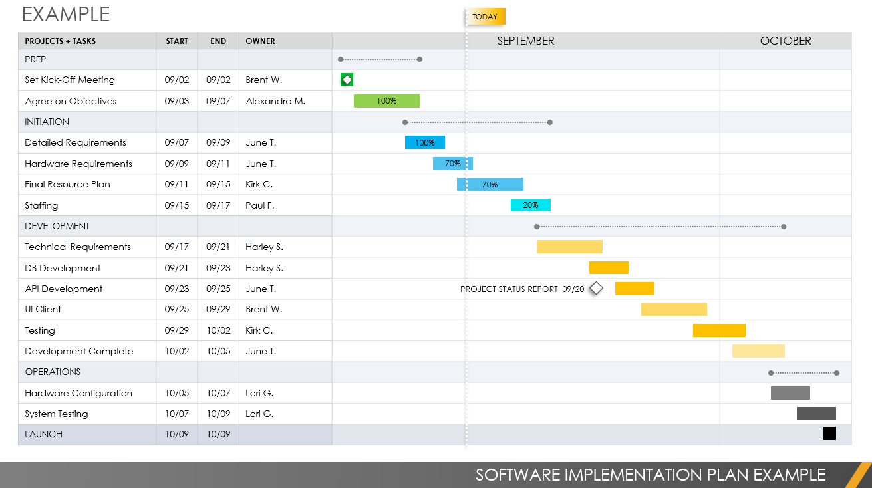
SOFTWARE IMPLEMENTATION PLAN TEMPLATE FOR POWERPOINT
Notes for Using This Template
Enter Tasks, Start and End Dates, and Task Owners in the chart area.
Adjust bars for each task to represent the length of time over the span of the project. Add Percent of Task Complete and Additional Task Information within each bar or in the graph area.

Slide 2
EXAMPLE
TODAY
PROJECTS + TASKS | START | END | OWNER | MONTH 1 | MONTH 2 | MONTH 3
TASK
Subtask
Subtask
TASK
Subtask
Subtask
Subtask
Subtask
TASK
Subtask
Subtask
Subtask
Subtask
Subtask
Subtask
TASK
Subtask
Subtask
LAUNCH
TASK NOTES / MILESTONE 00/00
TASK NOTES / MILESTONE 00/00
TASK NOTES / MILESTONE 00/00
TASK NOTES / MILESTONE 00/00
SOFTWARE IMPLEMENTATION PLAN

Slide 3
EXAMPLE
TODAY
PROJECTS + TASKS | START | END | OWNER | SEPTEMBER | OCTOBER
PREP
Set Kick-Off Meeting | 09/02 | 09/02 | Brent W.
Agree on Objectives | 09/03 | 09/07 | Alexandra M.
INITIATION
Detailed Requirements | 09/07 | 09/09 | June T.
Hardware Requirements | 09/09 | 09/11 | June T.
Final Resource Plan | 09/11 | 09/15 | Kirk C.
Staffing | 09/15 | 09/17 | Paul F.
DEVELOPMENT
Technical Requirements | 09/17 | 09/21 | Harley S.
DB Development | 09/21 | 09/23 | Harley S.
API Development | 09/23 | 09/25 | June T.
UI Client | 09/25 | 09/29 | Brent W.
Testing | 09/29 | 10/02 | Kirk C.
Development Complete | 10/02 | 10/05 | June T.
OPERATIONS
Hardware Configuration | 10/05 | 10/07 | Lori G.
System Testing | 10/07 | 10/09 | Lori G.
LAUNCH | 10/09 | 10/09
100%
100%
70%
70%
20%
PROJECT STATUS REPORT 09/20
SOFTWARE IMPLEMENTATION PLAN EXAMPLE

Slide 4
DISCLAIMER Any articles, templates, or information provided by Smartsheet on the website are for reference only. While we strive to keep the information up to date and correct, we make no representations or warranties of any kind, express or implied, about the completeness, accuracy, reliability, suitability, or availability with respect to the website or the information, articles, templates, or related graphics contained on the website. Any reliance you place on such information is therefore strictly at your own risk.

