Slide 1

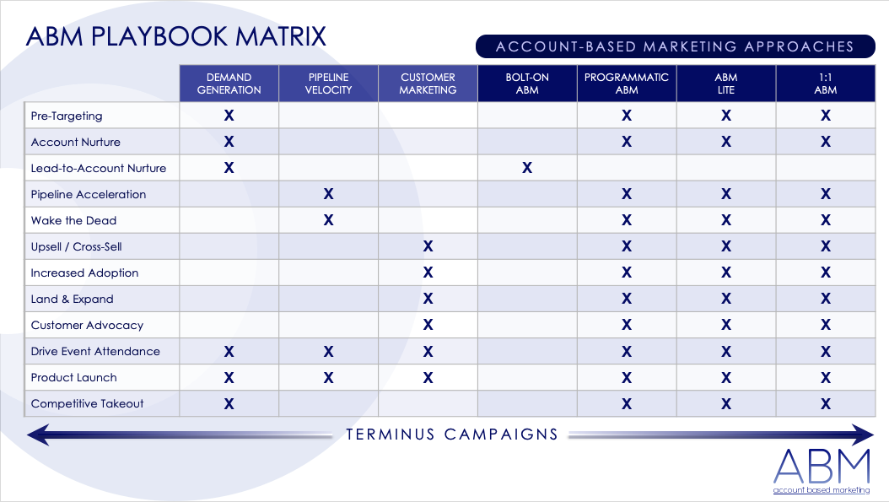
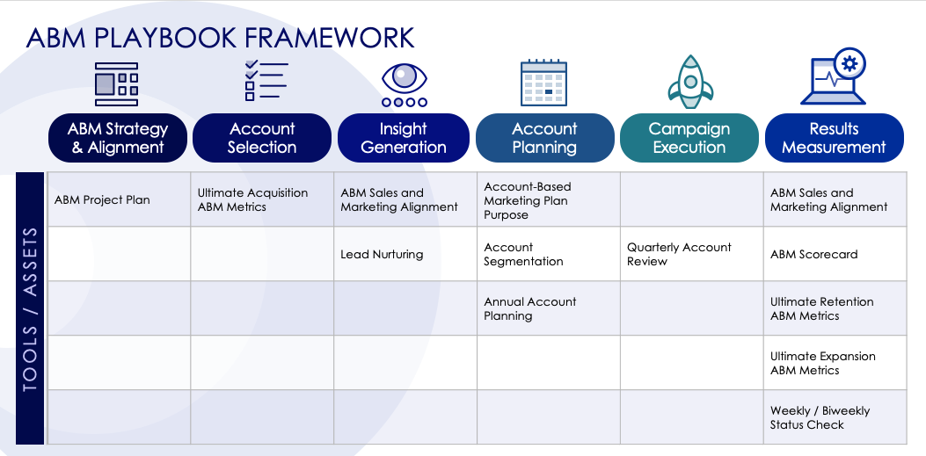
ACCOUNT-BASED MARKETING (ABM) PLAYBOOK TEMPLATE for PowerPoint
Marketing teams can use this account-based marketing (ABM) playbook template when they need a clear plan for focusing on key accounts or specific, high-value clients. This template, available in a dynamic PowerPoint format, allows teams to share and present important information to clients and key stakeholders. Use this template for team meetings, where everyone can see and discuss the plan together. The template covers everything from developing ABM strategy and selecting accounts to creating plans, so teams can make faster sales and keep customers engaged.

Slide 2
ABM PLAYBOOK MATRIX
ACCOUNT-BASED MARKETING APPROACHES
 | DEMAND GENERATION | PIPELINE VELOCITY | CUSTOMER MARKETING | BOLT-ON ABM | PROGRAMMATIC ABM | ABM LITE | 1:1 ABM
Pre-Targeting | X |  |  |  | X | X | X
Account Nurture | X |  |  |  | X | X | X
Lead-to-Account Nurture | X |  |  | X
Pipeline Acceleration |  | X |  |  | X | X | X
Wake the Dead |  | X |  |  | X | X | X
Upsell / Cross-Sell |  |  | X |  | X | X | X
Increased Adoption |  |  | X |  | X | X | X
Land & Expand |  |  | X |  | X | X | X
Customer Advocacy |  |  | X |  | X | X | X
Drive Event Attendance | X | X | X |  | X | X | X
Product Launch | X | X | X |  | X | X | X
Competitive Takeout | X |  |  |  | X | X | X
TERMINUS CAMPAIGNS

Slide 3





ABM PLAYBOOK FRAMEWORK
ABM Strategy & Alignment
Account Selection
Insight Generation
Account Planning
Campaign Execution
Results Measurement
ABM Project Plan | Ultimate Acquisition ABM Metrics | ABM Sales and Marketing Alignment | Account-Based Marketing Plan Purpose |  | ABM Sales and Marketing Alignment
 |  | Lead Nurturing | Account Segmentation | Quarterly Account Review | ABM Scorecard
 |  |  | Annual Account Planning |  | Ultimate Retention ABM Metrics
 |  |  |  |  | Ultimate Expansion ABM Metrics
 |  |  |  |  | Weekly / Biweekly Status Check
TOOLS / ASSETS

Slide 4
DISCLAIMER Any articles, templates, or information provided by Smartsheet on the website are for reference only. While we strive to keep the information up to date and correct, we make no representations or warranties of any kind, express or implied, about the completeness, accuracy, reliability, suitability, or availability with respect to the website or the information, articles, templates, or related graphics contained on the website. Any reliance you place on such information is therefore strictly at your own risk.

