Slide 1
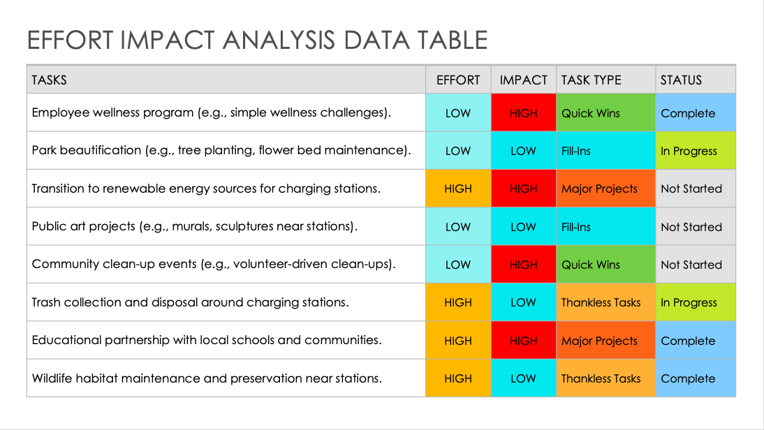
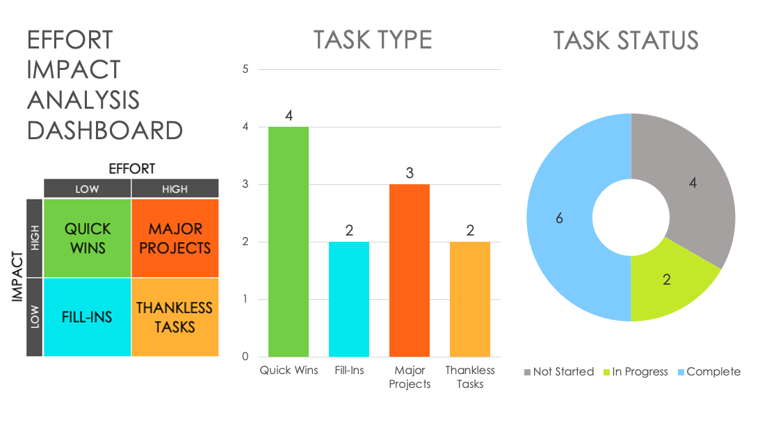
EFFORT IMPACT ANALYSIS TEMPLATE – EXAMPLE
When to Use This Template: This effort impact analysis template with or without sample data is a go-to resource for operations managers and business analysts who need comprehensive project and process evaluations. It's especially useful for examining the impact on overall operations, making it a key tool for in-depth operational analysis.
Notable Template Features: What sets this template apart is its focus on comparing the required effort and the resulting impact of various operational tasks. It breaks down complex processes into assessable components and enables users to efficiently prioritize tasks, streamline operational workflows, and enhance productivity.
Explore these free Eisenhower Matrix templates, designed to enhance your time management and prioritize tasks in alignment with your strategic goals and productivity needs.

Slide 2
EFFORT IMPACT ANALYSIS DATA TABLE – EXAMPLE
TASKS | EFFORT | IMPACT | TASK TYPE | STATUS
Employee wellness program (e.g., simple wellness challenges). | LOW | HIGH | Quick Wins | Complete
Park beautification (e.g., tree planting, flower bed maintenance). | LOW | LOW | Fill-Ins | In Progress
Transition to renewable energy sources for charging stations. | HIGH | HIGH | Major Projects | Not Started
Public art projects (e.g., murals, sculptures near stations). | LOW | LOW | Fill-Ins | Not Started
Community clean-up events (e.g., volunteer-driven clean-ups). | LOW | HIGH | Quick Wins | Not Started
Trash collection and disposal around charging stations. | HIGH | LOW | Thankless Tasks | In Progress
Educational partnership with local schools and communities. | HIGH | HIGH | Major Projects | Complete
Wildlife habitat maintenance and preservation near stations. | HIGH | LOW | Thankless Tasks | Complete

Slide 3
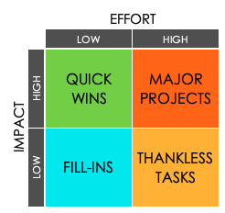
EFFORT IMPACT ANALYSIS DASHBOARD
TASK TYPE
TASK STATUS
**Right-Click charts and select “Edit Data in Excel” to input your Task Type and Status tallies.

Slide 4
DISCLAIMER Any articles, templates, or information provided by Smartsheet on the website are for reference only. While we strive to keep the information up to date and correct, we make no representations or warranties of any kind, express or implied, about the completeness, accuracy, reliability, suitability, or availability with respect to the website or the information, articles, templates, or related graphics contained on the website. Any reliance you place on such information is therefore strictly at your own risk.

