Slide 1

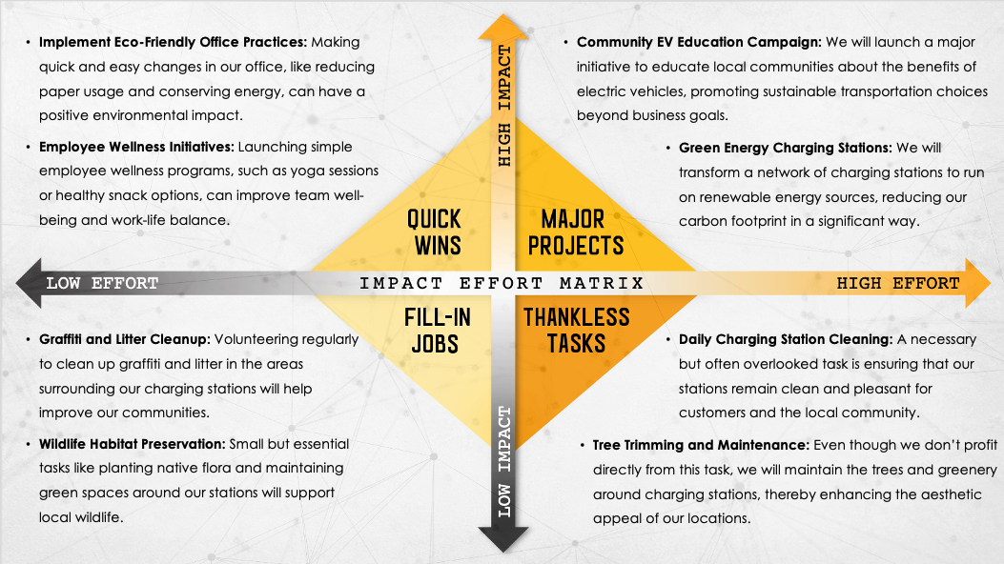
IMPACT EFFORT MATRIX PRESENTATION TEMPLATE for PowerPoint
When to Use This Template: This impact effort matrix presentation template for PowerPoint is an ideal choice for executives and team leads who need to articulate prioritization and planning strategies to stakeholders. With or without sample data, the template serves as a powerful communication tool during strategy meetings or presentations.
Notable Template Features: This template stands out with a visually engaging design that effectively conveys complex prioritization concepts. It enables presenters to clearly rank tasks and projects, facilitating comprehension and collaborative decision-making. The template’s compatibility with PowerPoint makes it easy to use in a wide range of business environments.

Slide 2
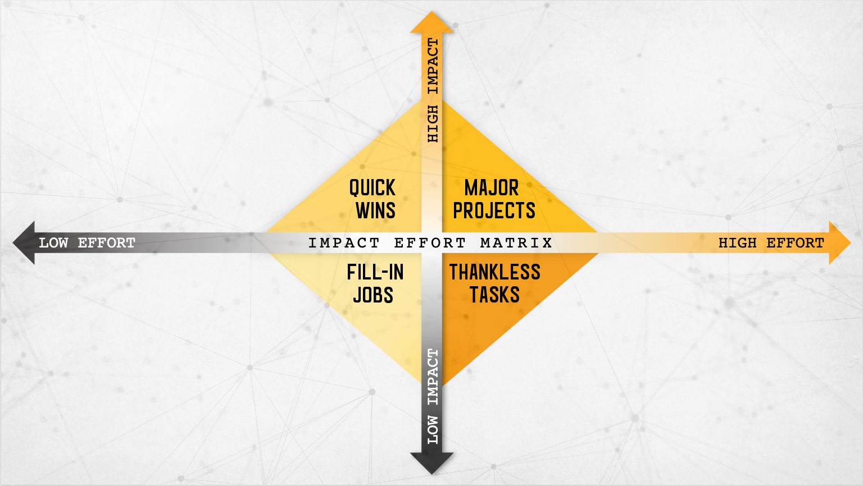
Text
Text
Text
Text
Text
Text

Slide 3
DISCLAIMER Any articles, templates, or information provided by Smartsheet on the website are for reference only. While we strive to keep the information up to date and correct, we make no representations or warranties of any kind, express or implied, about the completeness, accuracy, reliability, suitability, or availability with respect to the website or the information, articles, templates, or related graphics contained on the website. Any reliance you place on such information is therefore strictly at your own risk.

