Slide 1

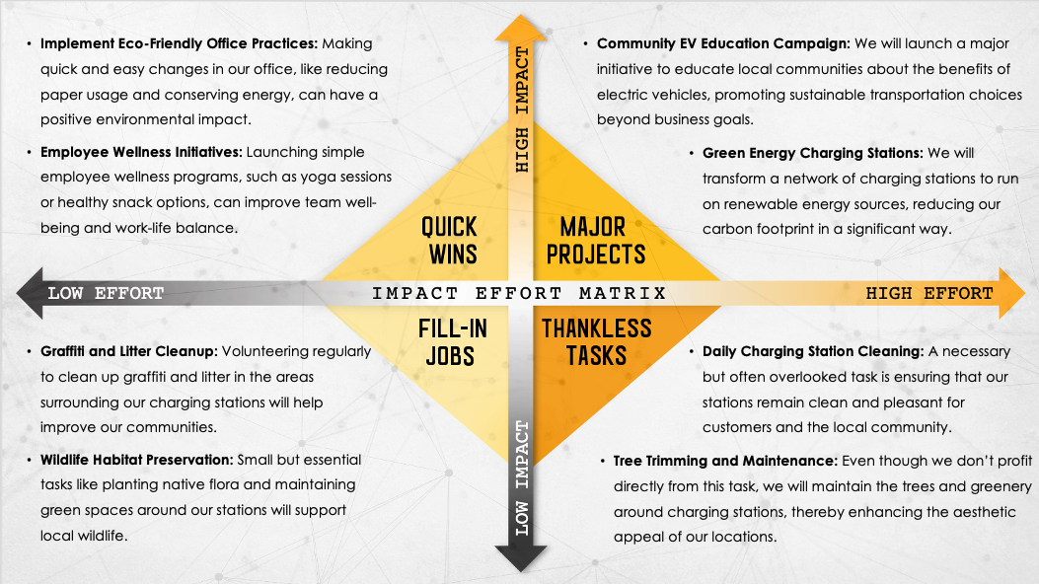
IMPACT EFFORT MATRIX PRESENTATION TEMPLATE EXAMPLE for PowerPoint
When to Use This Template: This impact effort matrix presentation template for PowerPoint is an ideal choice for executives and team leads who need to articulate prioritization and planning strategies to stakeholders. With or without sample data, the template serves as a powerful communication tool during strategy meetings or presentations.
Notable Template Features: This template stands out with a visually engaging design that effectively conveys complex prioritization concepts. It enables presenters to clearly rank tasks and projects, facilitating comprehension and collaborative decision-making. The template’s compatibility with PowerPoint makes it easy to use in a wide range of business environments.

Slide 2
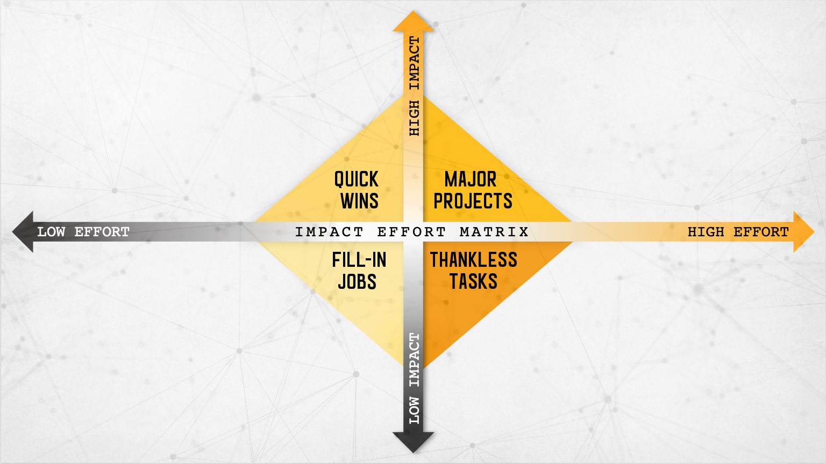
Implement Eco-Friendly Office Practices: Making quick and easy changes in our office, like reducing paper usage and conserving energy, can have a positive environmental impact.
Employee Wellness Initiatives: Launching simple employee wellness programs, such as yoga sessions or healthy snack options, can improve team well-being and work-life balance.
Community EV Education Campaign: We will launch a major initiative to educate local communities about the benefits of electric vehicles, promoting sustainable transportation choices beyond business goals.
Green Energy Charging Stations: We will transform a network of charging stations to run on renewable energy sources, reducing our carbon footprint in a significant way.
Graffiti and Litter Cleanup: Volunteering regularly to clean up graffiti and litter in the areas surrounding our charging stations will help improve our communities.
Wildlife Habitat Preservation: Small but essential tasks like planting native flora and maintaining green spaces around our stations will support local wildlife.
Daily Charging Station Cleaning: A necessary but often overlooked task is ensuring that our stations remain clean and pleasant for customers and the local community.
Tree Trimming and Maintenance: Even though we don’t profit directly from this task, we will maintain the trees and greenery around charging stations, thereby enhancing the aesthetic appeal of our locations.
EXAMPLE

Slide 3
Text
Text
Text
Text
Text
Text

Slide 4
DISCLAIMER Any articles, templates, or information provided by Smartsheet on the website are for reference only. While we strive to keep the information up to date and correct, we make no representations or warranties of any kind, express or implied, about the completeness, accuracy, reliability, suitability, or availability with respect to the website or the information, articles, templates, or related graphics contained on the website. Any reliance you place on such information is therefore strictly at your own risk.

