Slide 1


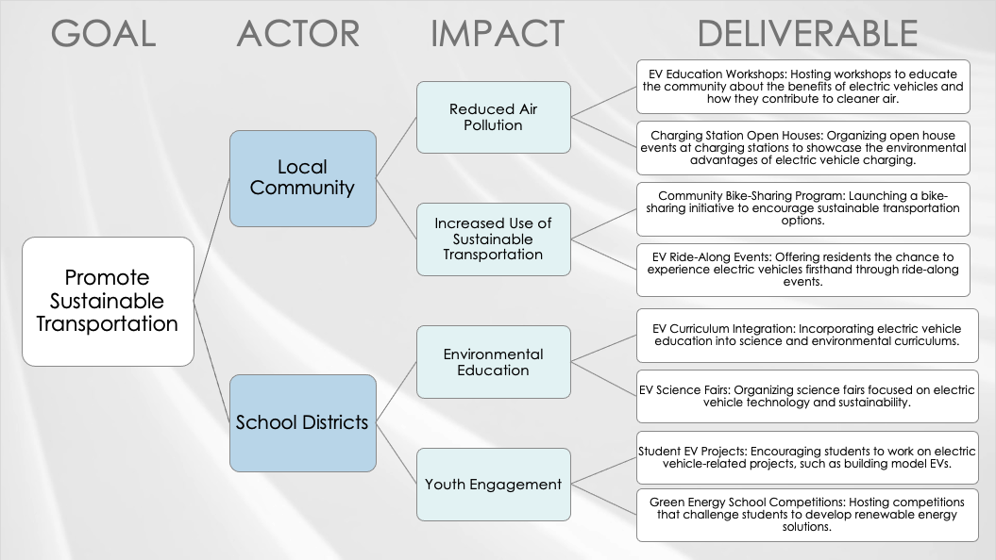
IMPACT MAPPING TEMPLATE – EXAMPLE
When to Use This Template: Ideal for strategic business developers and software development teams, the impact mapping template with or without sample data aligns strategic goals with actionable steps. It's helpful for formulating business strategies and planning software development projects, where understanding the connection between goals and required actions is crucial.
Notable Template Features: The template's strength lies in its systematic approach, which breaks down a central goal into actors, impacts, and deliverables. This clear and logical layout demonstrates the relationship between different elements of a project and ensures that each step aligns with the overarching goals, thereby streamlining strategy formulation and project execution.

Slide 2
GOAL
ACTOR
IMPACT
DELIVERABLE
Promote Sustainable Transportation
Local Community
School Districts
Environmental Education
Reduced Air Pollution
EV Education Workshops: Hosting workshops to educate the community about the benefits of electric vehicles and how they contribute to cleaner air.
Charging Station Open Houses: Organizing open house events at charging stations to showcase the environmental advantages of electric vehicle charging.
Increased Use of Sustainable Transportation
Community Bike-Sharing Program: Launching a bike-sharing initiative to encourage sustainable transportation options.
EV Ride-Along Events: Offering residents the chance to experience electric vehicles firsthand through ride-along events.
Youth Engagement
EV Curriculum Integration: Incorporating electric vehicle education into science and environmental curriculums.
Green Energy School Competitions: Hosting competitions that challenge students to develop renewable energy solutions.
Student EV Projects: Encouraging students to work on electric vehicle-related projects, such as building model EVs.
EV Science Fairs: Organizing science fairs focused on electric vehicle technology and sustainability.

Slide 3
GOAL
ACTOR
IMPACT
DELIVERABLE
Goal
Actor
Actor
Impact
Impact
Deliverable
Deliverable
Impact
Deliverable
Deliverable
Impact
Deliverable
Deliverable
Deliverable
Deliverable

Slide 4
DISCLAIMER Any articles, templates, or information provided by Smartsheet on the website are for reference only. While we strive to keep the information up to date and correct, we make no representations or warranties of any kind, express or implied, about the completeness, accuracy, reliability, suitability, or availability with respect to the website or the information, articles, templates, or related graphics contained on the website. Any reliance you place on such information is therefore strictly at your own risk.

