Slide 1
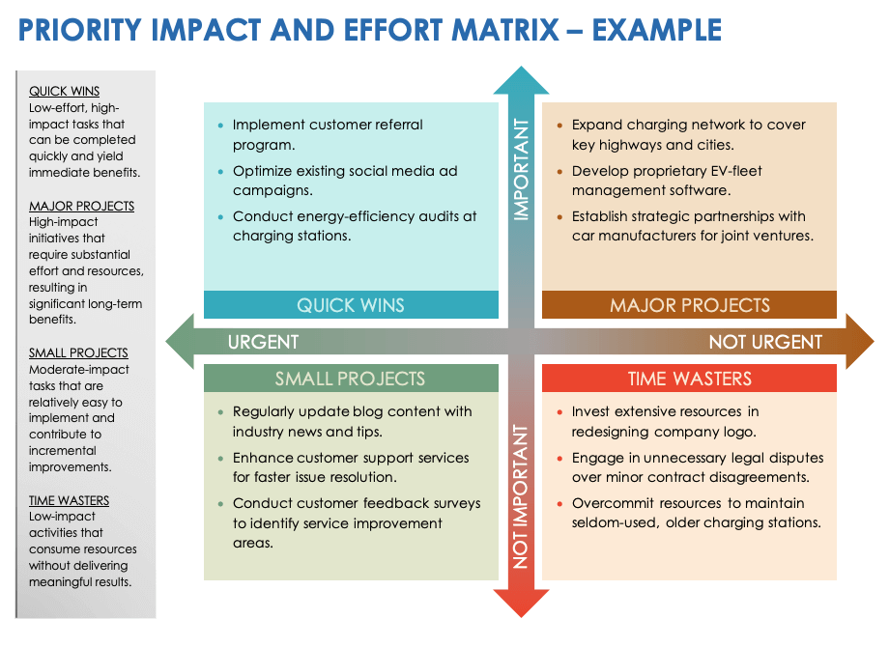
PRIORITY IMPACT AND EFFORT MATRIX
TEMPLATE
Use this template to prioritize tasks or projects based on their potential impact and required effort, enabling more efficient resource allocation and decision-making.
Example template on slide 3.

Slide 2
PRIORITY IMPACT AND EFFORT MATRIX
QUICK WINS
Low-effort, high-impact tasks that can be completed quickly and yield immediate benefits.
MAJOR PROJECTS
High-impact initiatives that require substantial effort and resources, resulting in significant long-term benefits.
SMALL PROJECTS
Moderate-impact tasks that are relatively easy to implement and contribute to incremental improvements.
TIME WASTERS
Low-impact activities that consume resources without delivering meaningful results.
Quick Win One
Major Project One
IMPORTANT
QUICK WINS
MAJOR PROJECTS
URGENT
NOT URGENT
Small Project One
Time Waster One
SMALL PROJECTS
TIME WASTERS
NOT IMPORTANT

Slide 3
PRIORITY IMPACT AND EFFORT MATRIX – EXAMPLE
QUICK WINS
Low-effort, high-impact tasks that can be completed quickly and yield immediate benefits.
MAJOR PROJECTS
High-impact initiatives that require substantial effort and resources, resulting in significant long-term benefits.
SMALL PROJECTS
Moderate-impact tasks that are relatively easy to implement and contribute to incremental improvements.
TIME WASTERS
Low-impact activities that consume resources without delivering meaningful results.
Implement customer referral program.
Optimize existing social media ad campaigns.
Conduct energy-efficiency audits at charging stations.
Expand charging network to cover key highways and cities.
Develop proprietary EV-fleet management software.
Establish strategic partnerships with car manufacturers for joint ventures.
IMPORTANT
QUICK WINS
MAJOR PROJECTS
URGENT
NOT URGENT
Regularly update blog content with industry news and tips.
Enhance customer support services for faster issue resolution.
Conduct customer feedback surveys to identify service improvement areas.
Invest extensive resources in redesigning company logo.
Engage in unnecessary legal disputes over minor contract disagreements.
Overcommit resources to maintain seldom-used, older charging stations.
SMALL PROJECTS
TIME WASTERS
NOT IMPORTANT

Slide 4
DISCLAIMER Any articles, templates, or information provided by Smartsheet on the website are for reference only. While we strive to keep the information up to date and correct, we make no representations or warranties of any kind, express or implied, about the completeness, accuracy, reliability, suitability, or availability with respect to the website or the information, articles, templates, or related graphics contained on the website. Any reliance you place on such information is therefore strictly at your own risk.

