Slide 1

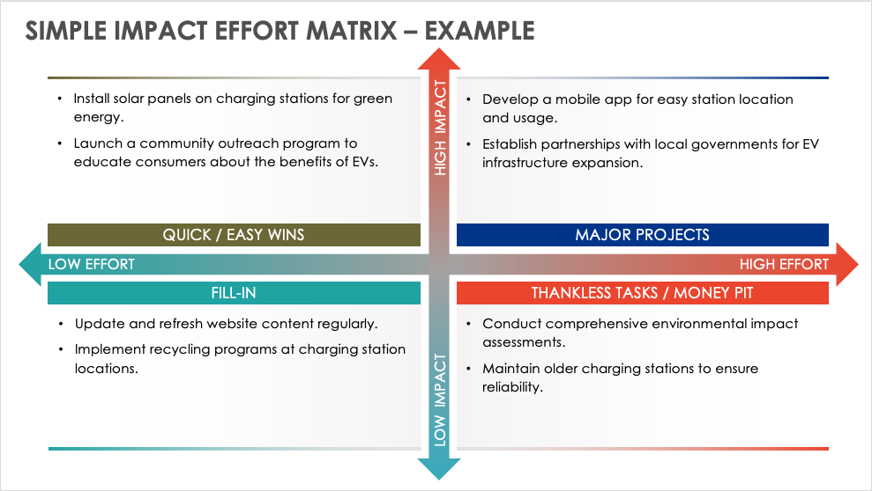
SIMPLE IMPACT EFFORT MATRIX
TEMPLATE – EXAMPLE
When to Use This Template: This straightforward template, with or without sample text, is best for small-scale projects where team leaders and project managers must assess tasks and make decisions efficiently. It focuses on comparing the impact of each task against the effort required — without getting lost in complex details.
Notable Template Features: The template stands out for its user-friendly layout that categorizes tasks into quadrants based on their impact and effort. The intuitive scoring system simplifies the evaluation process and presents a clear visualization of which tasks should be prioritized for maximum results.

Slide 2
SIMPLE IMPACT EFFORT MATRIX – EXAMPLE
Install solar panels on charging stations for green energy.
Launch a community outreach program to educate consumers about the benefits of EVs.
Develop a mobile app for easy station location and usage.
Establish partnerships with local governments for EV infrastructure expansion.
HIGH IMPACT
QUICK / EASY WINS
MAJOR PROJECTS
LOW EFFORT
HIGH EFFORT
FILL-IN
Update and refresh website content regularly.
Implement recycling programs at charging station locations.
Conduct comprehensive environmental impact assessments.
Maintain older charging stations to ensure reliability.
THANKLESS TASKS / MONEY PIT
LOW IMPACT

Slide 3
IMPACT EFFORT MATRIX
Text
Text
HIGH IMPACT
QUICK / EASY WINS
MAJOR PROJECTS
LOW EFFORT
HIGH EFFORT
FILL-IN
Text
Text
THANKLESS TASKS / MONEY PIT
LOW IMPACT

Slide 4
DISCLAIMER Any articles, templates, or information provided by Smartsheet on the website are for reference only. While we strive to keep the information up to date and correct, we make no representations or warranties of any kind, express or implied, about the completeness, accuracy, reliability, suitability, or availability with respect to the website or the information, articles, templates, or related graphics contained on the website. Any reliance you place on such information is therefore strictly at your own risk.

