Slide 1

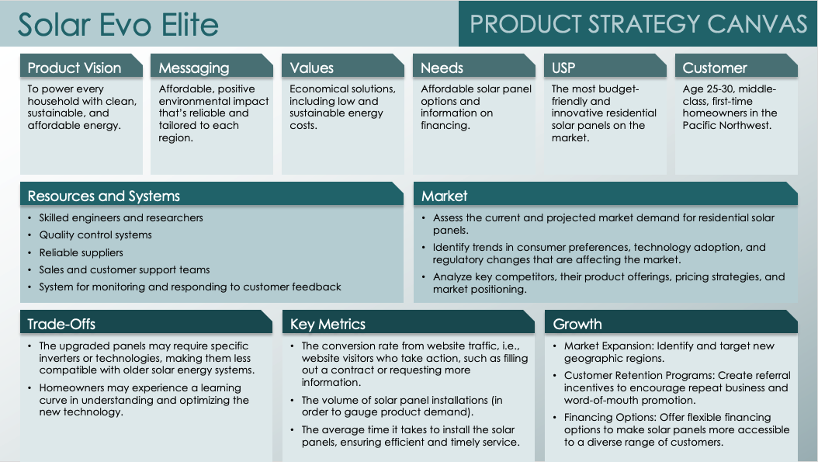
PRODUCT STRATEGY CANVAS TEMPLATE
When to Use This Template: Use this template with or without sample data when your product team needs a one-page, high-level view of a product strategy. The product strategy canvas is a great tool for visualizing the connections between various elements of product strategy.
Notable Template Features: This template allows managers to illustrate how key product strategy elements reinforce one another, enabling them to build a foundation for product development. It includes sections for describing the product vision, trade-offs, resources and systems, growth plan, and more.

Slide 2
Product Name
PRODUCT STRATEGY CANVAS
Product Vision
Messaging
Values
Needs
USP
Customer
Text
Text
Text
Text
Text
Text
Resources and Systems
Market
Text
Text
Trade-Offs
Key Metrics
Growth
Text
Text
Text

Slide 3
DISCLAIMER Any articles, templates, or information provided by Smartsheet on the website are for reference only. While we strive to keep the information up to date and correct, we make no representations or warranties of any kind, express or implied, about the completeness, accuracy, reliability, suitability, or availability with respect to the website or the information, articles, templates, or related graphics contained on the website. Any reliance you place on such information is therefore strictly at your own risk.

