Slide 1

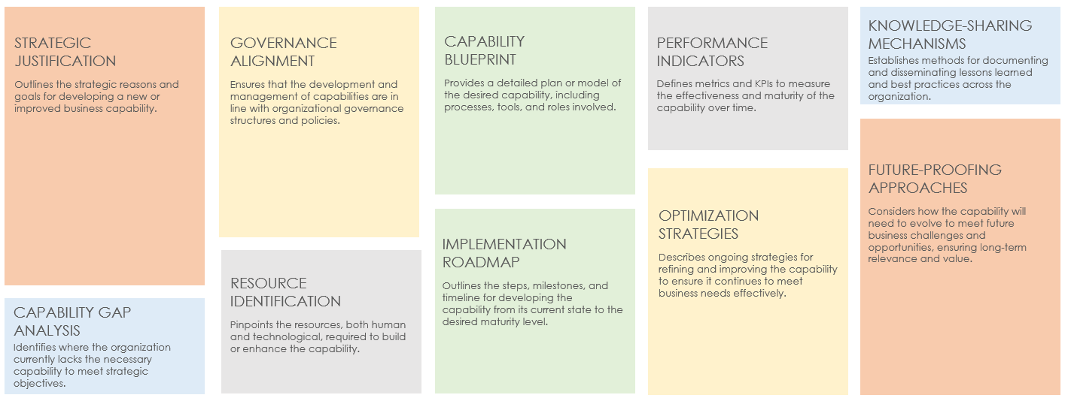
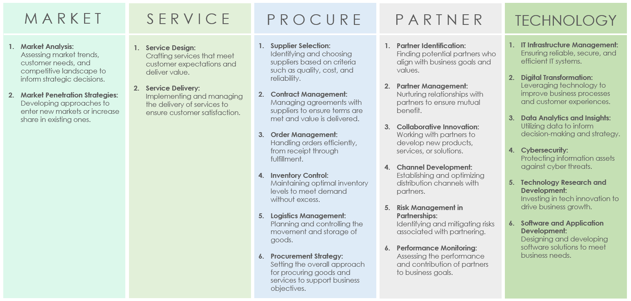
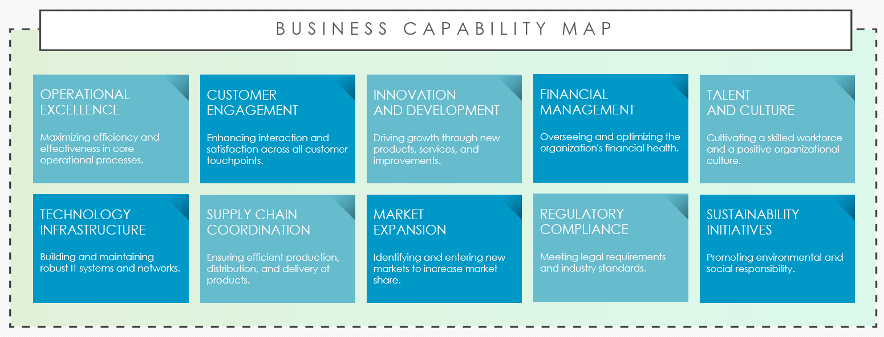
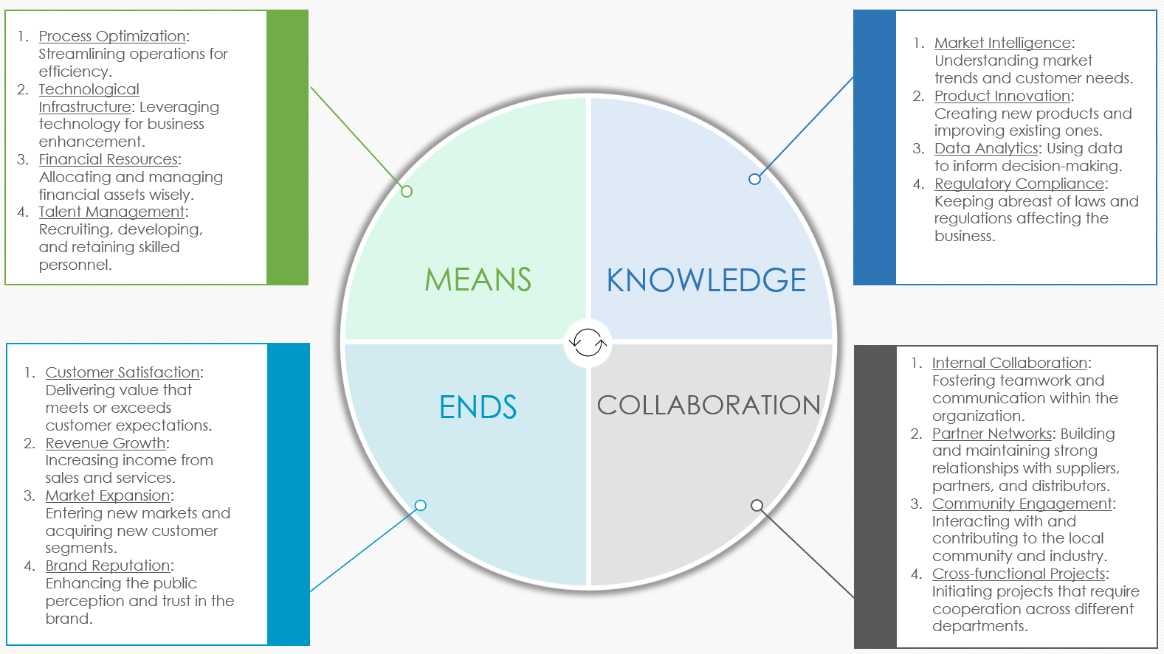
BUSINESS CAPABILITY MODEL TEMPLATE
for PowerPoint

Slide 2

CONTENTS
1
SIMPLIFIED BUSINESS CAPABILITY MATURITY FRAMEWORK
5
BUSINESS CAPABILITY MODEL
2
BUSINESS CAPABILITY MODEL / MAP
6
MEANS, KNOWLEDGE, ENDS, COLLABORATION
3
BUSINESS CAPABILITY MODEL
7-9
BUSINESS CAPABILITY MODEL
4
OVERVIEW OF AN ENTERPRISE BUSINESS CAPABILITIES FRAMEWORK
10
BASIC BUSINESS CAPABILITY MAP PATTERNS

Slide 3
SIMPLIFIED BUSINESS CAPABILITY MATURITY FRAMEWORK
Each section of this Simplified Business Capability Maturity Framework slide helps you systematically develop, manage, and enhance your business capabilities in alignment with strategic goals and changing market demands.
Identifying Gaps: Pinpoints essential elements, resources, or procedures that are currently lacking in the development of the capability.
KNOWLEDGE-SHARING MECHANISMS
STRATEGIC JUSTIFICATION
GOVERNANCE ALIGNMENT
CAPABILITY
BLUEPRINT
PERFORMANCE INDICATORS
In this section, establish methods for documenting and disseminating lessons learned and best practices across the organization.
In this section, outline the strategic reasons and goals for developing a new or improved business capability.
This section helps you ensure that the development and management of capabilities are in line with your organizational governance structures and policies.
In this section, provide a detailed plan or model of the desired capability, including the relevant processes, tools, and roles.
In this section, define metrics and KPIs to measure the effectiveness and maturity of the capability over time.
Source Exploration: Directs attention to possible locations, within or outside the organization, where you can acquire the necessary components for capability enhancement.
FUTURE-PROOFING APPROACHES
OPTIMIZATION STRATEGIES
In this section, consider how the capability will need to evolve to meet future business challenges and opportunities, ensuring long-term relevance and value.
IMPLEMENTATION ROADMAP
Capability Essence: Clarifies the core attributes and objectives of the capability.
In this section, describe ongoing strategies for refining and improving the capability to ensure that it continues to meet business needs effectively.
RESOURCE IDENTIFICATION
In this section, outline the steps, milestones, and timeline for developing the capability from its current state to the desired maturity level.
CAPABILITY GAP ANALYSIS
Strategic Approach: Details the deliberate steps and methodologies you plan to implement to build or enhance the targeted capability.
In this section, pinpoint the resources, both human and technological, required to build or enhance the capability.
In this section, identify the areas where the organization currently lacks the necessary capability to meet strategic objectives.
1
2
3
4
5
MATURITY
MATURITY LEVEL 1: Initial: The capability is in its nascent stage, with ad-hoc processes and an undefined structure.
MATURITY LEVEL 2: Managed: Processes are repeatable and there are some efforts to standardize practices related to the capability.
MATURITY LEVEL 3: Defined: The capability is well understood, documented, and standardized across the organization..
MATURITY LEVEL 4: Measured: The capability's performance is regularly measured, and data-driven improvements are made.
MATURITY LEVEL 5: Optimized: The capability is continuously refined and optimized through innovation and advanced improvements.

Slide 4
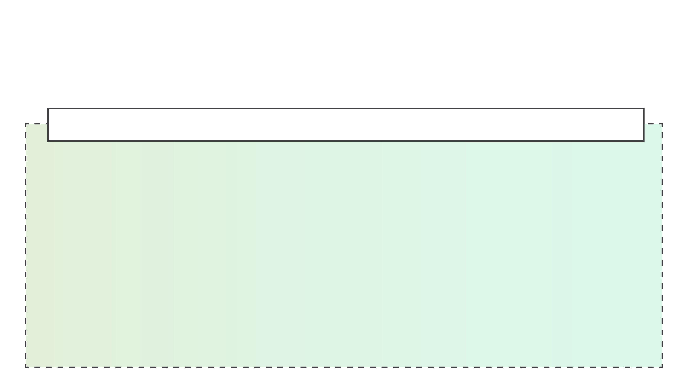
BUSINESS CAPABILITY MODEL / MAP
Each title in your Business Capability Model/Map describes the focus within essential business areas, ensuring comprehensive coverage of the functions that are critical to organizational success and sustainability.
BUSINESS CAPABILITY MAP
OPERATIONAL EXCELLENCE
CUSTOMER ENGAGEMENT
INNOVATION
AND DEVELOPMENT
FINANCIAL MANAGEMENT
TALENT
AND CULTURE
Maximizing efficiency and effectiveness in core operational processes.
Enhancing interaction and satisfaction across all customer touchpoints.
Driving growth through new products, services, and improvements.
Overseeing and optimizing the organization's financial health.
Cultivating a skilled workforce and a positive organizational culture.
TECHNOLOGY INFRASTRUCTURE
SUPPLY CHAIN
COORDINATION
MARKET
EXPANSION
REGULATORY
COMPLIANCE
SUSTAINABILITY
INITIATIVES
Building and maintaining robust IT systems and networks.
Ensuring efficient production, distribution, and delivery of products.
Identifying and entering new markets to increase market share.
Meeting legal requirements and industry standards.
Promoting environmental and social responsibility.

Slide 5
BUSINESS CAPABILITY MODEL
These tiles provide a comprehensive overview of key business capabilities, ensuring that your organization addresses the areas that are critical to sustained success and growth.
MARKET
SERVICE
PROCURE
PARTNER
TECHNOLOGY
Market Analysis:
Assessing market trends, customer needs, and the competitive landscape to inform strategic decisions.
Market Penetration Strategies:
Developing approaches to enter new markets or increase share in existing ones.
Service Design:
Crafting services that meet customer expectations and deliver value.
Service Delivery:
Implementing and managing the delivery of services to ensure customer satisfaction.
Supplier Selection:
Identifying and choosing suppliers based on criteria such as quality, cost, and reliability.
Contract Management:
Managing agreements with suppliers to ensure terms are met and value is delivered.
Order Management:
Handling orders efficiently, from receipt through fulfillment.
Inventory Control:
Maintaining optimal inventory levels to meet demand without excess.
Logistics Management: Planning and controlling the movement and storage of goods.
Procurement Strategy:
Setting the overall approach to procuring goods and services in order to support business objectives.
Partner Identification:
Finding potential partners who align with business goals and values.
Partner Management:
Nurturing relationships with partners to ensure mutual benefit.
Collaborative Innovation:
Working with partners to develop new products, services, or solutions.
Channel Development:
Establishing and optimizing distribution channels with partners.
Risk Management in Partnerships:
Identifying and mitigating risks associated with partnering.
Performance Monitoring:
Assessing the performance of partners and their contribution to business goals.
IT Infrastructure Management:
Ensuring reliable, secure, and efficient IT systems.
Digital Transformation:
Leveraging technology to improve business processes and customer experiences.
Data Analytics and Insights:
Utilizing data to inform decision-making and strategy.
Cybersecurity:
Protecting information assets against cyber threats.
Technology Research and Development:
Investing in tech innovation to drive business growth.
Software and Application Development:
Designing and developing software solutions to meet business needs.

Slide 6
OVERVIEW OF AN ENTERPRISE BUSINESS CAPABILITIES FRAMEWORK
This snippet of an Enterprise Business Capabilities Framework highlights the critical areas an organization focuses on to sustain growth, innovation, and a competitive advantage in a complex business landscape.
Trend Analysis: Evaluating market dynamics and forecasting future trends.
Customer Intelligence: Gathering and analyzing data on customer behavior and preferences.
Service Excellence: Delivering outstanding service that exceeds customer expectations.
Relationship Management: Building and maintaining strong, lasting customer relationships.
MARKET INSIGHTS
CUSTOMER ENGAGEMENT
Process Optimization: Streamlining operations for maximum efficiency and effectiveness.
Technology Integration: Seamlessly incorporating technology solutions to enhance operational capabilities.
Logistics Optimization: Ensuring efficient, reliable supply chain and logistics operations.
Supplier Collaboration: Working closely with suppliers for mutual benefit and innovation.
OPERATIONAL EFFICIENCY
SUPPLY CHAIN MASTERY
Research and Development Leadership: Leading in research and development to produce groundbreaking products.
Innovation Pipeline Management: Managing the flow of new ideas from conception to commercialization.
Alliance Building: Establishing strategic alliances to enhance business capabilities.
Ecosystem Development: Cultivating a network of partners to create added value.
PRODUCT INNOVATION
STRATEGIC PARTNERSHIPS
Asset Management: Overseeing company assets to ensure optimal financial health.
Budgetary Oversight: Monitoring and managing the organization's budget and financial planning.
Environmental Sustainability: Committing to environmentally sustainable business practices.
Social Responsibility: Engaging in practices that benefit society and the community.
SUSTAINABILITY AND RESPONSIBILITY
FINANCIAL STEWARDSHIP
Workforce Development: Investing in employee growth and skills enhancement.
Culture and Engagement: Fostering a positive work environment and high employee engagement.
TALENT EMPOWERMENT

Slide 7
BUSINESS CAPABILITY MODEL
What Business Capabilities Are
1
2
Functions or processes that create value for customers.
Strategic assets that differentiate a company in the marketplace.
Integrated activities that are supported by people, processes, and technology.
Stable over time, even as strategies and technologies change.
Focused on outcomes and the ability to execute business strategies.
STRATEGIC MANAGEMENT
CUSTOMER RELATIONSHIP MANAGEMENT
3
PRODUCT AND SERVICES DEVELOPMENT
What Business Capabilities Are Not
Individual tasks or jobs that are performed by specific departments.
Software systems or technological tools in and of themselves.
Short-term business goals or specific projects.
Static processes that never evolve or improve.
Solely focused on internal operations without considering customer value.
4
5
OPERATIONAL EXCELLENCE
FINANCIAL MANAGEMENT

Slide 8


Process Optimization: Streamlining operations for efficiency.
Technological Infrastructure: Leveraging technology for business enhancement.
Financial Resources: Allocating and managing financial assets wisely.
Talent Management: Recruiting, developing, and retaining skilled personnel.
Market Intelligence: Understanding market trends and customer needs.
Product Innovation: Creating new products and improving existing ones.
Data Analytics: Using data to inform decision-making.
Regulatory Compliance: Keeping abreast of laws and regulations affecting the business.
MEANS
KNOWLEDGE
Customer Satisfaction: Delivering value that meets or exceeds customer expectations.
Revenue Growth: Increasing income from sales and services.
Market Expansion: Entering new markets and acquiring new customer segments.
Brand Reputation: Enhancing the public perception of and trust in the brand.
Internal Collaboration: Fostering teamwork and communication within the organization.
Partner Networks: Building and maintaining strong relationships with suppliers, partners, and distributors.
Community Engagement: Interacting with and contributing to the local community and industry.
Cross-Functional Projects: Initiating projects that require cooperation across different departments.
ENDS
COLLABORATION

Slide 9
BUSINESS CAPABILITY MODEL
This Business Capability Model Map and Process Map provide a structured view of how your organization operates, highlighting the capabilities necessary to execute business strategies and the sequential stages involved in bringing new products or services to market.
Business Capability Model Map Outline
Brief Business Process Map
CORE CAPABILITIES
SUPPORT CAPABILITIES
ENABLING CAPABILITIES
PROCESS STAGE 1
IDEA GENERATION
Collect insights from market research, customer feedback, and a competitive analysis.
PROCESS STAGE 2
CONCEPT DEVELOPMENT
Define the scope, objectives, and requirements for new product/service initiatives.
1. STRATEGIC MANAGEMENT
Vision and Strategy Development
Strategic Planning and Execution
6. HUMAN RESOURCES
Talent Acquisition and Development
Employee Engagement and Performance
10. INNOVATION
& GROWTH
New Market Exploration
Strategic Partnerships and Alliances
7. INFORMATION TECHNOLOGY
IT Infrastructure and Support
Data Management and Security
11. ENABLING CAPABILITIES
Environmental Sustainability Initiatives
Community and Social Engagement
PROCESS STAGE 3
DESIGN AND DEVELOPMENT
Design the product/service, develop prototypes, and conduct testing for validation.
2. CUSTOMER RELATIONSHIP MANAGEMENT
Customer Acquisition
Customer Retention and Loyalty Programs
3. PRODUCT AND SERVICES INNOVATION
Research and Development
Product Lifecycle Management
8. SUPPLY CHAIN MANAGEMENT
Procurement and Sourcing
Logistics and Distribution
PROCESS STAGE 5
MARKET LAUNCH
Execute marketing strategies, launch to market, and monitor the sales performance.
PROCESS STAGE 4
PRODUCTION/
IMPLEMENTATION
Begin mass production of the product or roll out the implementation of the service.
4. OPERATIONAL EFFICIENCY
Process Optimization
Quality Management
9. MARKETING AND SALES
Market Research and Analysis
Sales Strategy and Execution
PROCESS STAGE 6
POST-LAUNCH REVIEW AND IMPLEMENTATION
Gather post-launch feedback, assess the performance against the objectives, and initiate improvements.
5. FINANCIAL STEWARDSHIP
Financial Planning and Analysis
Risk Management and Compliance

Slide 10
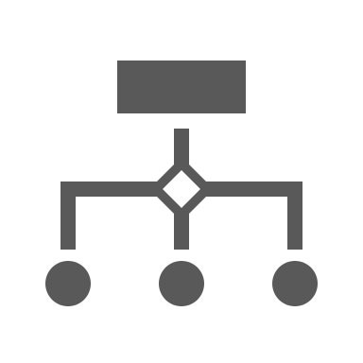


BUSINESS CAPABILITY MODEL
PROCESS
BUSINESS CAPABILITY MODEL
PEOPLE
PHYSICAL ASSETS
This visual map illustrates how the intricate dynamic among Processes, People, and Physical Assets delivers value to customers and sustains the operational foundation of the business, showcasing the essential elements that drive the company's success.

Slide 11






BUSINESS CAPABILITY MODEL
Each of the following categories and items outlines the essential components of your business, ensuring a holistic view of your organization's capacity to deliver value.
PRODUCTION Product Design and Innovation Quality Control Systems Manufacturing Efficiency Sustainability Practices Post-Production Analysis | BUSINESS SUPPORT IT Infrastructure and Services Human Resources Development Financial Planning and Analysis Legal and Compliance Oversight Facility Management | MARKETING AND SALES Brand Strategy and Development Digital Marketing Campaigns Sales Pipeline Management Market Research and Insights Customer Engagement Platforms | STRATEGIC BUSINESS MANAGEMENT Vision and Mission Articulation Competitive Strategy Formulation Risk Management Frameworks Corporate Governance Structures Strategic Partnership Alliances
 | CUSTOMER RELATIONSHIP MANAGEMENT (CRM) Customer Service Excellence Account Management Strategies Loyalty and Retention Programs Feedback and Resolution Systems Personalization and Customization |  | SUPPLY CHAIN MANAGEMENT (SCM) Procurement and Sourcing Optimization Inventory Management Techniques Logistics and Distribution Coordination Supplier Relationship Management Supply Chain Risk Mitigation

Slide 12
BASIC BUSINESS CAPABILITY MAP PATTERNS
The following structure provides a streamlined overview of your business capabilities, highlighting essential functions and areas critical to operational success and strategic growth.
CORE CAPABILITIES
CUSTOMER ENGAGEMENT
STRATEGIC MANAGEMENT
SUPPORT FUNCTIONS
SUPPLY CHAIN AND LOGISTICS
PRODUCT DEVELOPMENT
Designing and developing products to meet market needs.
SALES AND MARKETING
Promoting products and engaging with potential customers.
BUSINESS STRATEGY DEVELOPMENT
Crafting strategies for competitive advantage.
HUMAN RESOURCES
Managing recruitment, training, and employee welfare.
PROCUREMENT
Acquiring goods and services needed for operations.
PRODUCTION AND DELIVERY
Manufacturing products and delivering services efficiently.
CUSTOMER SERVICE
Providing support and managing customer interactions.
MARKET ANALYSIS
Researching market trends and opportunities.
FINANCE AND ACCOUNTING
Overseeing financial operations and planning.
INVENTORY MANAGEMENT
Controlling stock levels and storage.
QUALITY ASSURANCE
Ensuring products and services meet quality standards.
CUSTOMER FEEDBACK
Collecting and analyzing feedback for improvement.
RISK MANAGEMENT
Identifying and mitigating business risks.
IT SERVICES
Supporting business operations with technology solutions.
DISTRIBUTION NETWORKS
Managing the logistics of product distribution.

Slide 13
DISCLAIMER Any articles, templates, or information provided by Smartsheet on the website are for reference only. While we strive to keep the information up to date and correct, we make no representations or warranties of any kind, express or implied, about the completeness, accuracy, reliability, suitability, or availability with respect to the website or the information, articles, templates, or related graphics contained on the website. Any reliance you place on such information is therefore strictly at your own risk.

