Slide 1

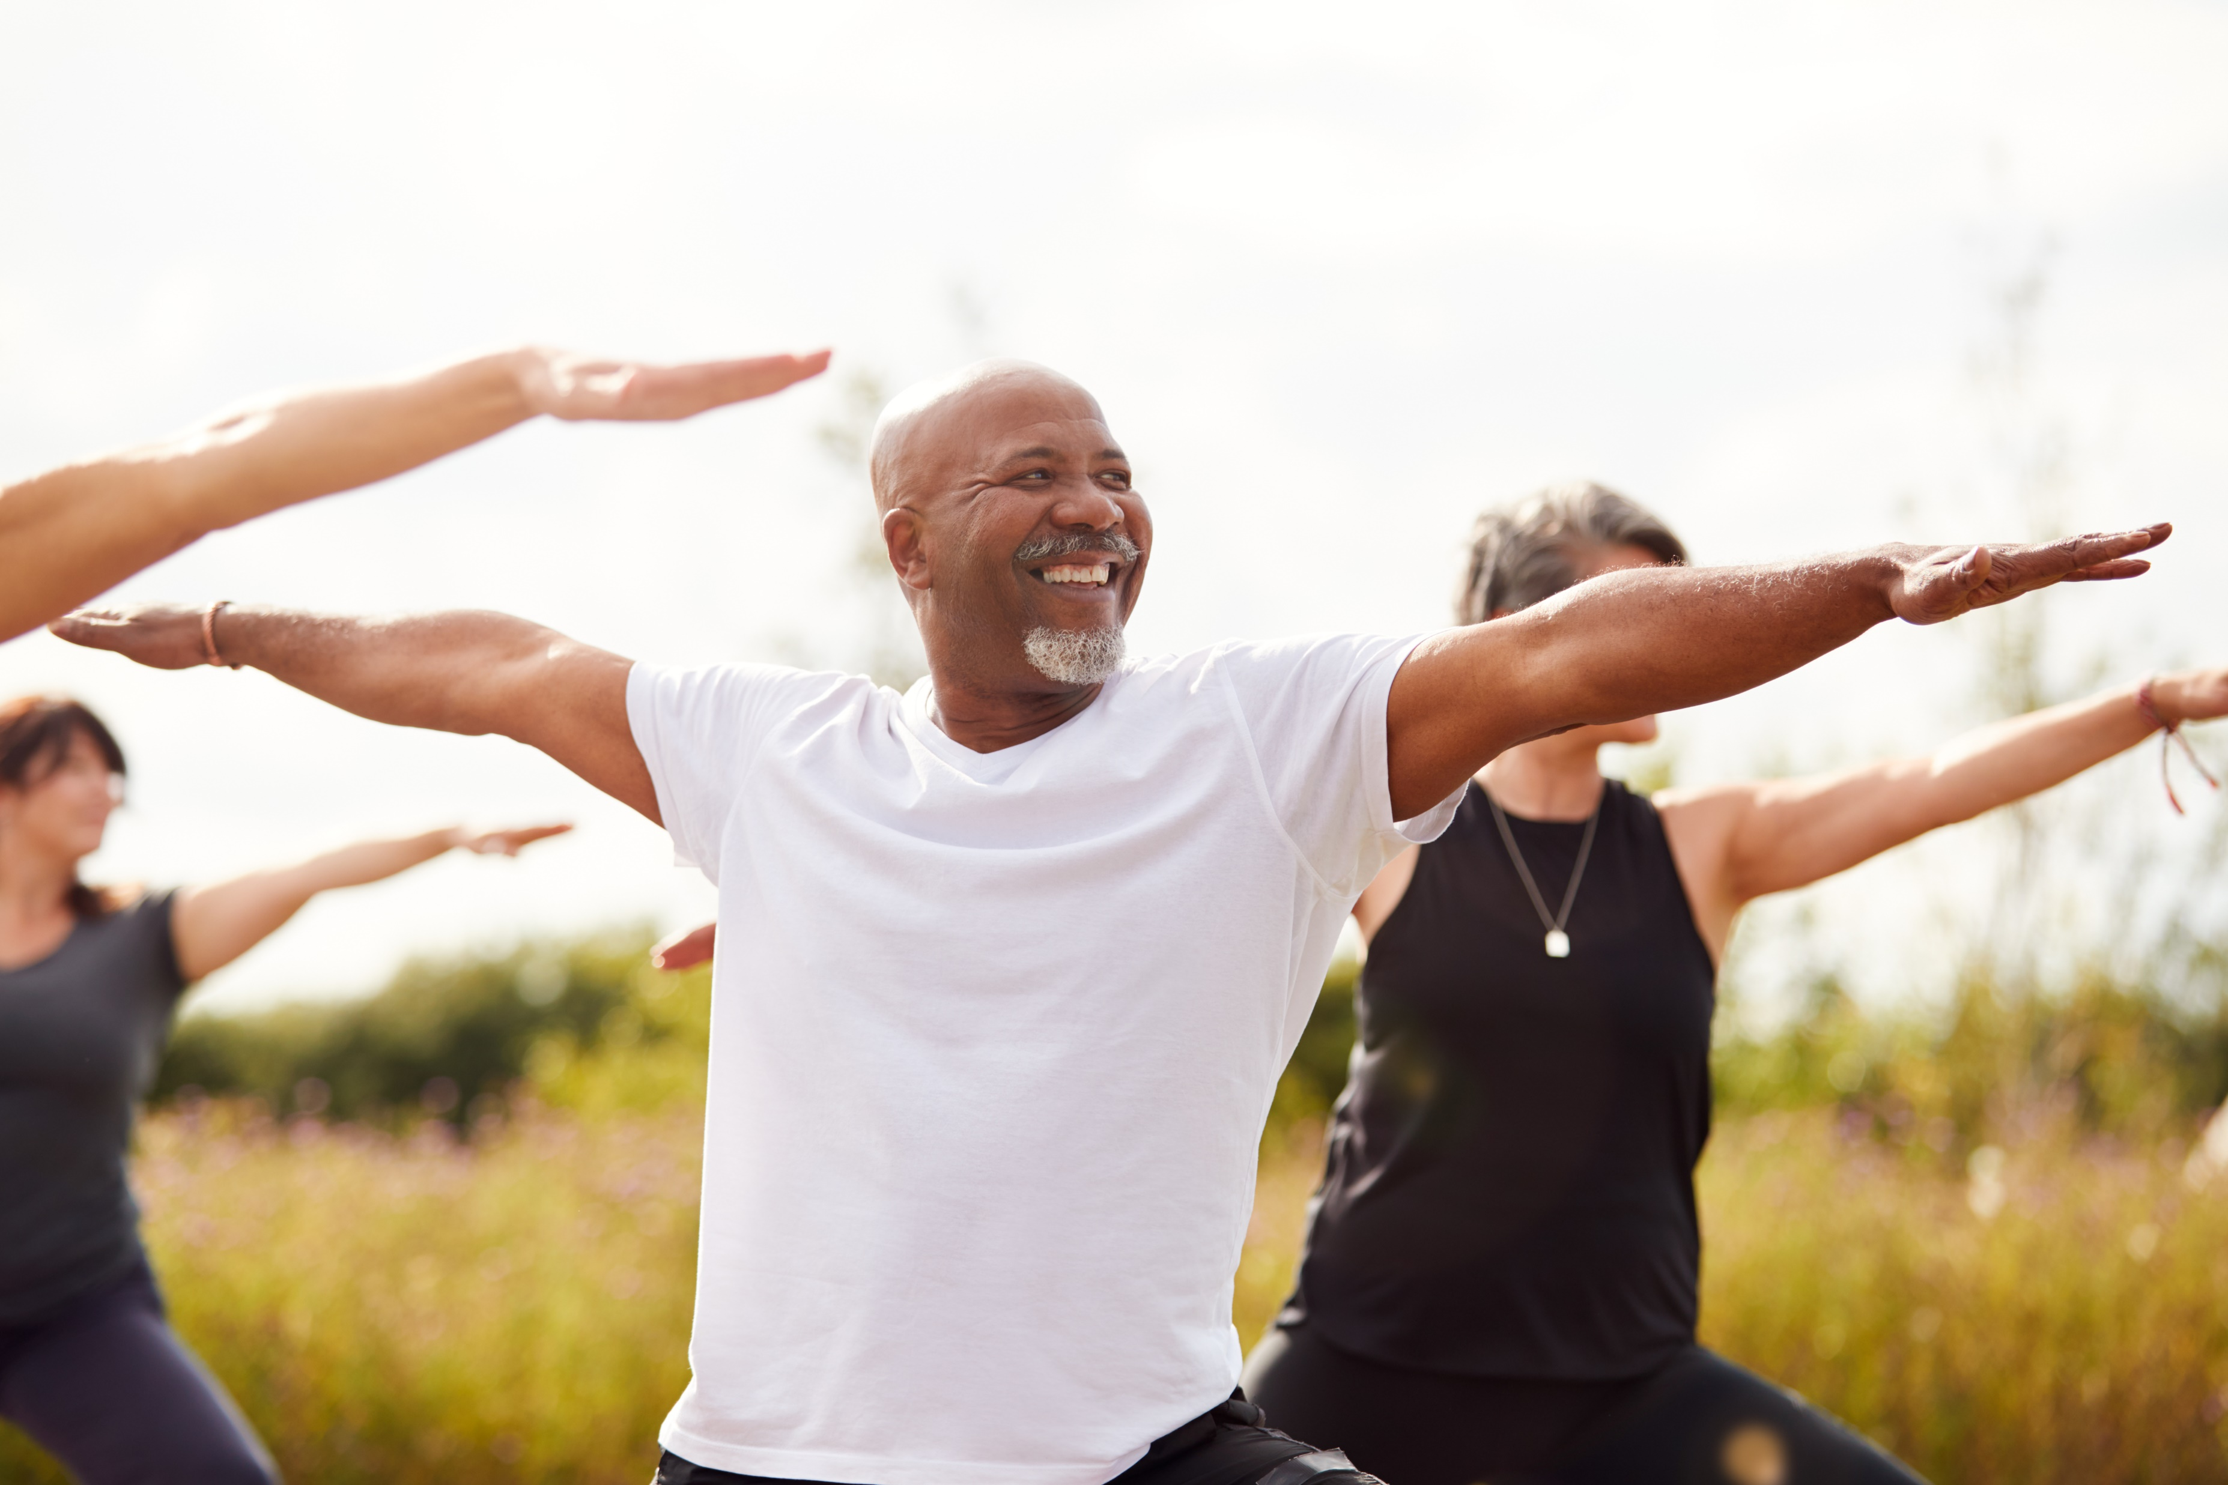
PowerPoint Event Proposal Template Example
PATH TO WELLNESS FAIR
Event Date: June 15, 20XX
Prepared by: Mariano Rivera
Prepared for: Zilker Park Outreach
PATH TO WELLNESS!

Slide 2


CONTENTS
1
EVENT OVERVIEW
6
MARKETING AND PROMOTION PLAN
2
OBJECTIVES AND GOALS
7
SPONSORSHIP OPPORTUNITIES
8
TESTIMONIALS AND PAST SUCCESS
3
AGENDA / ITINERARY
4
VENUE AND LAYOUT
9
CONTACT INFORMATION AND CALL TO ACTION
5
BUDGET OVERVIEW

Slide 3





1. EVENT OVERVIEW
This is a community-focused day of wellness.
EVENT PURPOSE
TARGET AUDIENCE
The purpose of this event is to come together as a community to engage in workshops, health screenings, and fitness demonstrations aimed at improving collective health awareness.
The target audience includes health enthusiasts, families, and local business participants.

Slide 4

2. OBJECTIVES AND GOALS
GOAL 1: Increase community health awareness.
GOAL 2: Introduce accessible wellness activities.
GOAL 3: Support local health businesses.
GOAL 4: Include an additional goal.

Slide 5
3. AGENDA / ITINERARY
TODAY
TASKS | DAY 1 | DAY 2 | DAY 3 | DAY 4 | DAY 5 | DAY 6
Morning Yoga
Health Screenings
Wellness Workshops
Health Cooking Demos
Task 5
Task 6
Task 7
Task 8
Task 9
Task 10
Daily: 10 AM-12 PM
12 PM-5 PM
Daily 10 AM–5 PM
2 PM–4 PM
Yoga Instructor
Small Businesses
Task Owner 5
Task Owner 7
Health Professional
Chef Group
Task Owner 6
Task Owner 8

Slide 6


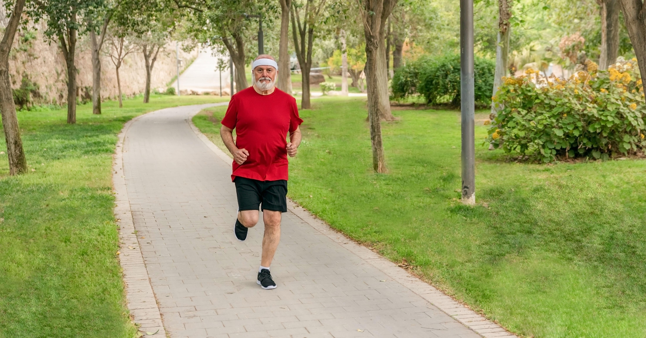
4. VENUE AND LAYOUT
Zilker Park outdoor pavilion and surrounding green spaces

Slide 7
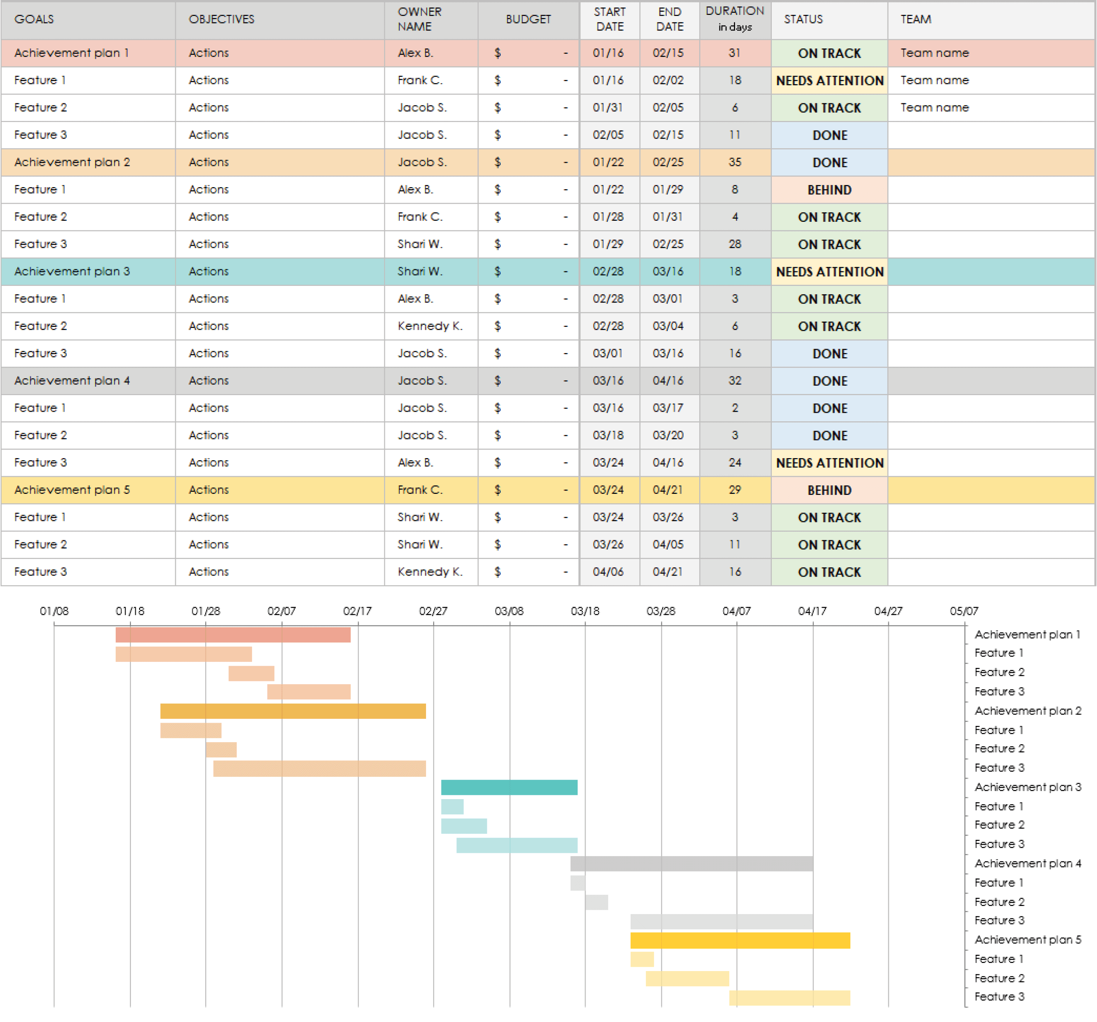
5. BUDGET OVERVIEW
Build your event budget spreadsheet in Excel, with tables, charts, etc. Then, embed the file here and/or include a static image of the Excel spreadsheet.

Slide 8

6. MARKETING AND PROMOTION PLAN
Social media campaigns, local media partnerships, community flyers.

Slide 9



7. SPONSORSHIP OPPORTUNITIES
SPONSORSHIP LEVEL A
SPONSORSHIP LEVEL B
SPONSORSHIP LEVEL C
This is the Healthy Workshop sponsorship level. Sponsorship benefits and perks include...
This is the Wellness Booth sponsorship level. Sponsorship benefits and perks include…
This is the General Event sponsorship level. Sponsorship benefits and perks include…

Slide 10
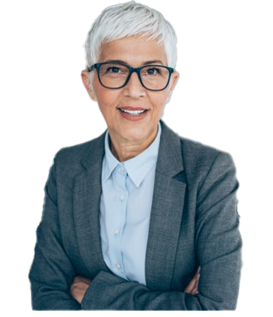

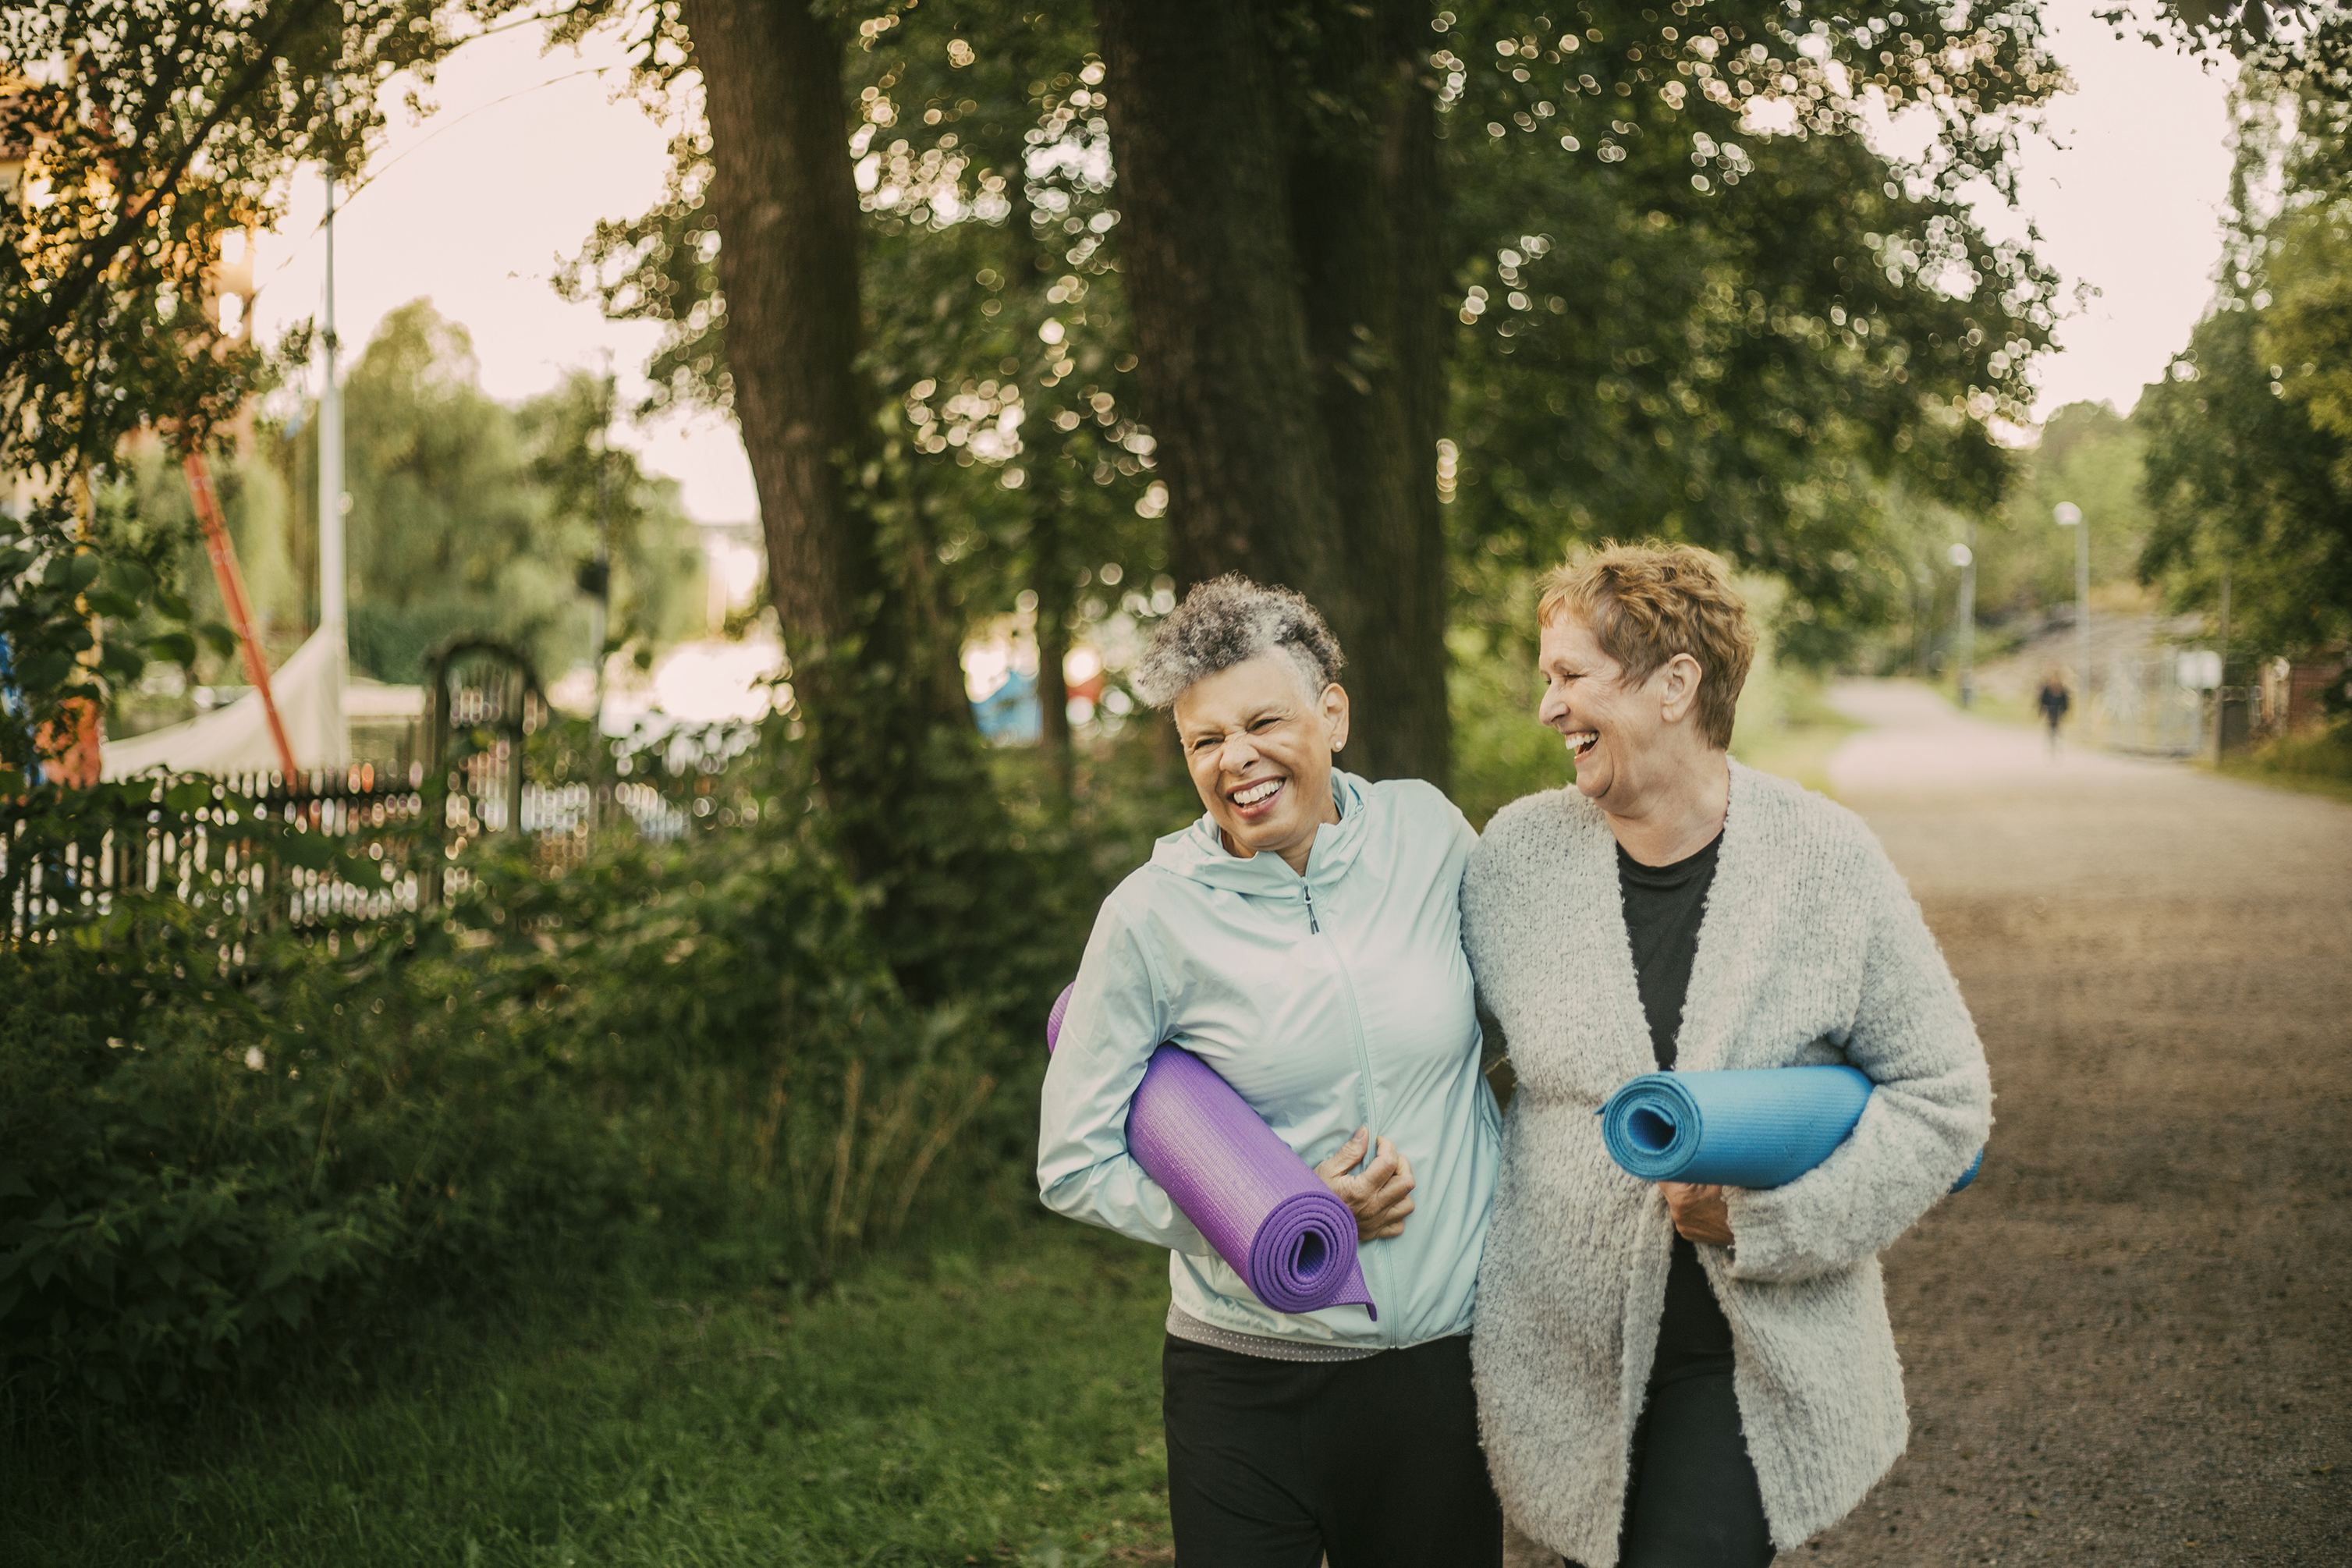
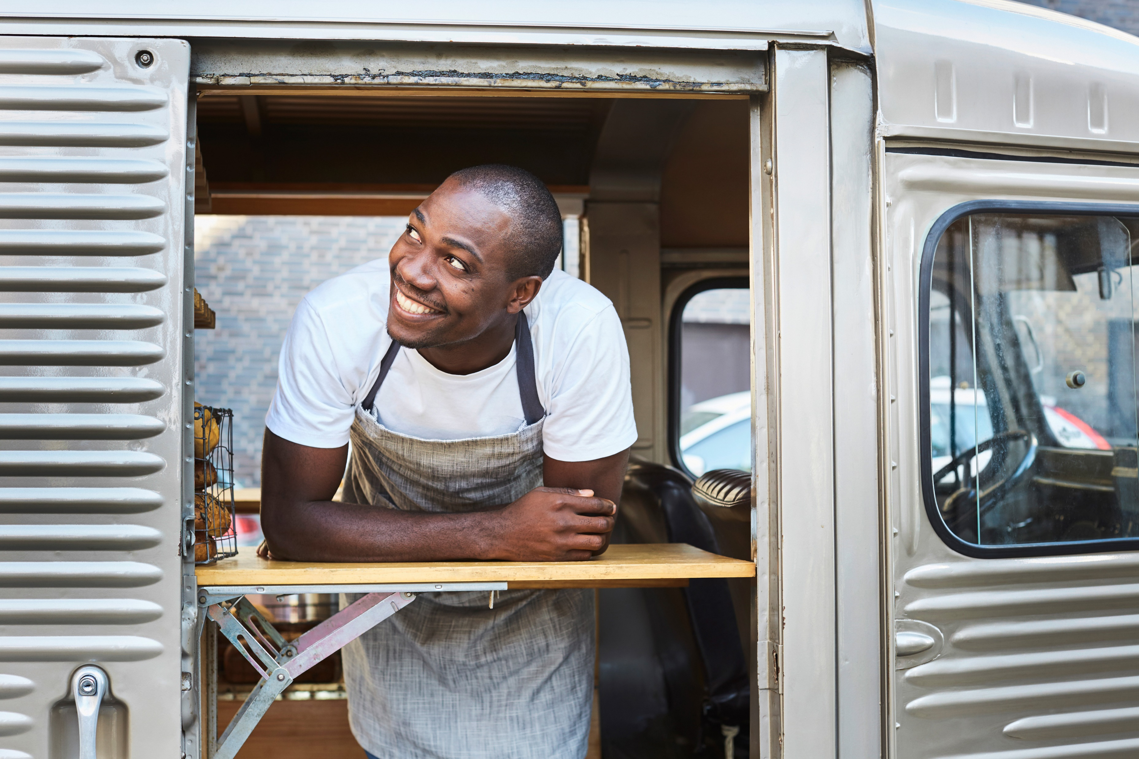
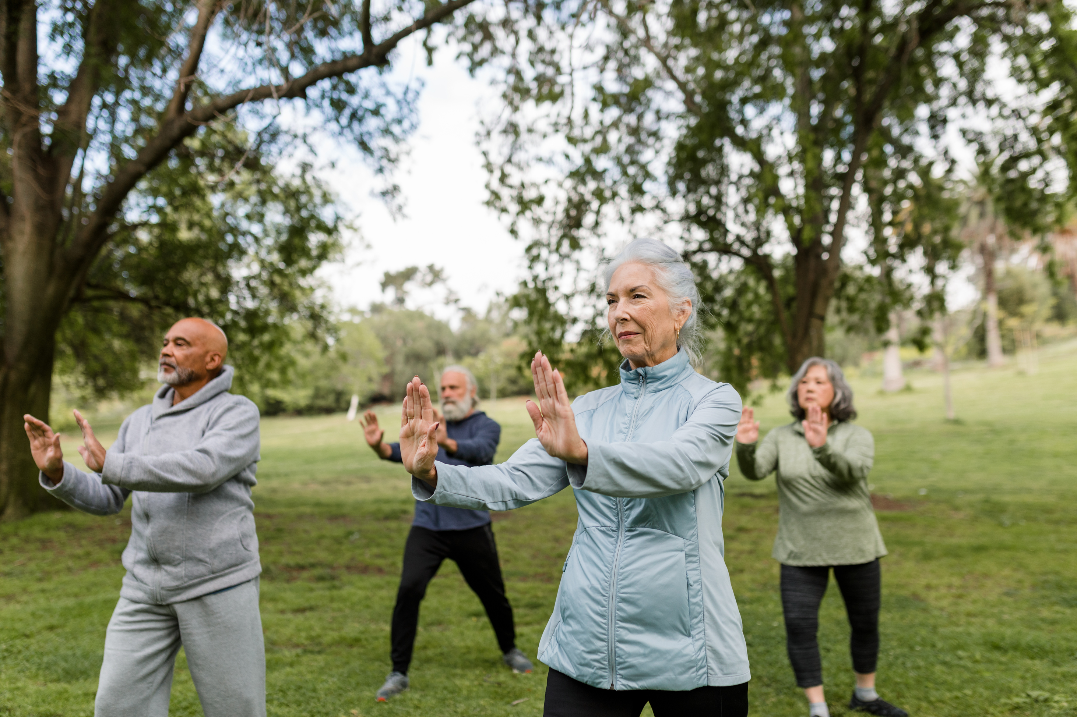
8. TESTIMONIALS AND PAST SUCCESS
Attending the Path to Wellness fair brought our community together for a week of connectivity.
- Suzyn Waldman, Attendee of Path to Wellness 20XX

Slide 11
9. CONTACT INFORMATION AND CALL TO ACTION
Join us as a participant or sponsor and be a part of fostering a healthier community!
PATH TO WELLNESS FAIR 20XX
Event Date: MM/DD/YY
Website
Path to Wellness 20XX Social Media Information
Person of Contact: Mariano Rivera, Event Mgr.
Phone
Email
Address
Insert QR code

Slide 12
DISCLAIMER Any articles, templates, or information provided by Smartsheet on the website are for reference only. While we strive to keep the information up to date and correct, we make no representations or warranties of any kind, express or implied, about the completeness, accuracy, reliability, suitability, or availability with respect to the website or the information, articles, templates, or related graphics contained on the website. Any reliance you place on such information is therefore strictly at your own risk.

