Slide 1


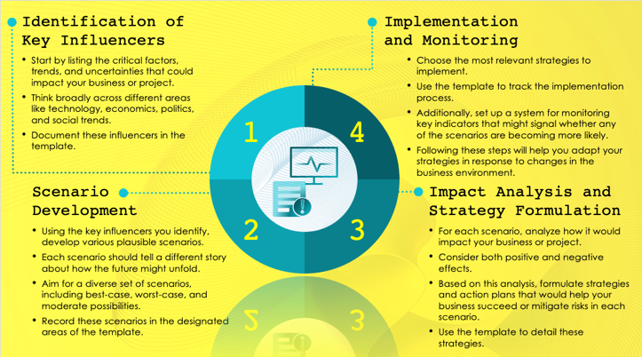
Analysis Scenario Planning Template
When to Use This Template: This analysis scenario planning template is ideal for senior executives and strategic planners when crafting long-term strategies. It is particularly valuable in strategy sessions focused on mapping out the future direction of the business, taking into account diverse potential scenarios that could unfold.
Notable Template Features: This template is tailored to facilitating the exploration of scenarios that have the potential to affect the business's long-term trajectory. It helps senior decision-makers visualize various scenarios and their impacts in order to understand the full range of possible outcomes. The layout is structured to encourage comprehensive and forward-thinking strategy development, making it a key asset for high-level strategic planning.

Slide 2

Identification of Key Influencers
Implementation and Monitoring
Start by listing the critical factors, trends, and uncertainties that could impact your business or project.
Think broadly across different areas like technology, economics, politics, and social trends.
Document these influencers in the template.
Choose the most relevant strategies to implement.
Use the template to track the implementation process.
Additionally, set up a system for monitoring key indicators that might signal whether any of the scenarios are becoming more likely.
Following these steps will help you adapt your strategies in response to changes in the business environment.
1
4
Scenario Development
Impact Analysis and Strategy Formulation
2
3
Using the key influencers you identify, develop various plausible scenarios.
Each scenario should tell a different story about how the future might unfold.
Aim for a diverse set of scenarios, including best-case, worst-case, and moderate possibilities.
Record these scenarios in the designated areas of the template.
For each scenario, analyze how it would impact your business or project.
Consider both positive and negative effects.
Based on this analysis, formulate strategies and action plans that would help your business succeed or mitigate risks in each scenario.
Use the template to detail these strategies.

Slide 3
DISCLAIMER Any articles, templates, or information provided by Smartsheet on the website are for reference only. While we strive to keep the information up to date and correct, we make no representations or warranties of any kind, express or implied, about the completeness, accuracy, reliability, suitability, or availability with respect to the website or the information, articles, templates, or related graphics contained on the website. Any reliance you place on such information is therefore strictly at your own risk.

