Slide 1

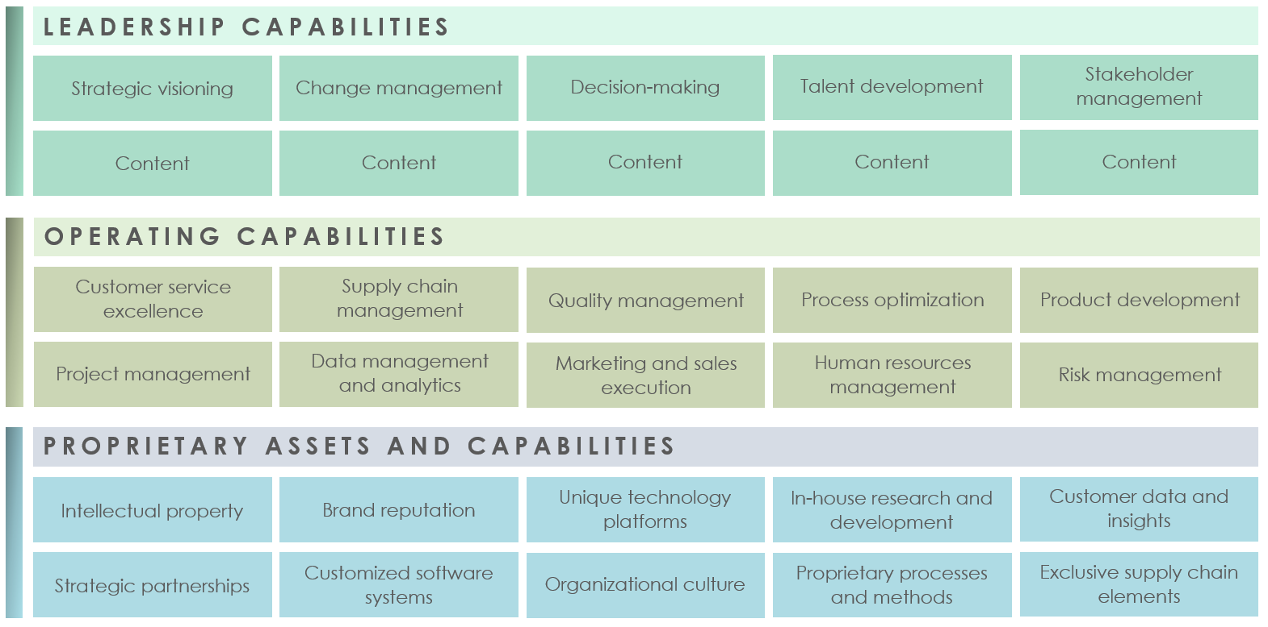
BUSINESS CAPABILITY MODEL TEMPLATE EXAMPLE

Slide 2
BUSINESS CAPABILITY MODEL TEMPLATE EXAMPLE
LEADERSHIP CAPABILITIES
Strategic visioning
Change management
Decision-making
Talent development
Stakeholder management
Content
Content
Content
Content
Content
OPERATING CAPABILITIES
Customer service excellence
Supply chain management
Quality management
Process optimization
Product development
Project management
Data management and analytics
Marketing and sales execution
Human resources management
Risk management
PROPRIETARY ASSETS AND CAPABILITIES
Intellectual property
Brand reputation
Unique technology platforms
In-house research and development
Customer data and insights
Strategic partnerships
Customized software systems
Organizational culture
Proprietary processes and methods
Exclusive supply chain elements

Slide 3
DISCLAIMER Any articles, templates, or information provided by Smartsheet on the website are for reference only. While we strive to keep the information up to date and correct, we make no representations or warranties of any kind, express or implied, about the completeness, accuracy, reliability, suitability, or availability with respect to the website or the information, articles, templates, or related graphics contained on the website. Any reliance you place on such information is therefore strictly at your own risk.

