Slide 1


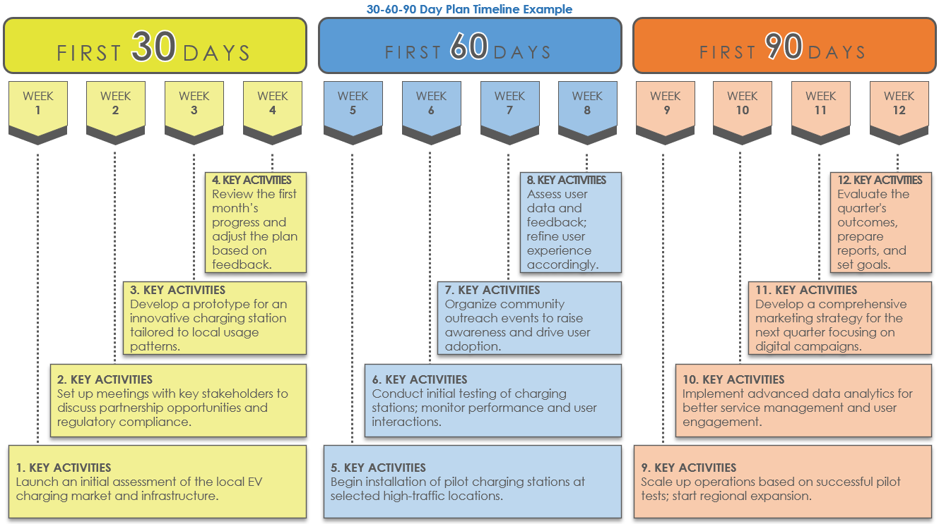
PowerPoint 30-60-90 Day Plan
Timeline Template
When to Use This Template: Use this template to create a detailed plan for key activities during the critical first 30, 60, and 90 days of your project.
Notable Template Features: This template simplifies the process of setting and tracking key project activities and goals for 30, 60, and 90 days in a single slide. It allows the user to make precise adjustments to task durations and create a clear visualization of milestones. The template also includes sample text for each stage for additional guidance.

Slide 2
FIRST 30 DAYS
FIRST 60 DAYS
FIRST 90 DAYS
WEEK
1
WEEK
2
WEEK
3
WEEK
4
WEEK
5
WEEK
6
WEEK
7
WEEK
8
WEEK
9
WEEK 10
WEEK 11
WEEK 12
4. KEY ACTIVITIES
Compile a monthly review of goals met and outline adjustments needed.
8. KEY ACTIVITIES
Evaluate progress against project benchmarks.
12. KEY ACTIVITIES
Prepare a detailed report on outcomes and future proposals.
3. KEY ACTIVITIES
Focus on refining strategies based on initial feedback.
7. KEY ACTIVITIES
Address challenges and engage more deeply with key stakeholders.
11. KEY ACTIVITIES
Finalize all project components and gather feedback.
2. KEY ACTIVITIES
Document key interactions and early achievements.
6. KEY ACTIVITIES
Strengthen collaborations and check progress against targets.
10. KEY ACTIVITIES
Start wrapping up the main project deliverables and begin final assessments.
1. KEY ACTIVITIES
Enter the initial setup tasks to establish the groundwork for the project.
5. KEY ACTIVITIES
Begin implementing more complex project elements.
9. KEY ACTIVITIES
Initiate the final phase implementations and critical evaluations.

Slide 3
DISCLAIMER Any articles, templates, or information provided by Smartsheet on the website are for reference only. While we strive to keep the information up to date and correct, we make no representations or warranties of any kind, express or implied, about the completeness, accuracy, reliability, suitability, or availability with respect to the website or the information, articles, templates, or related graphics contained on the website. Any reliance you place on such information is therefore strictly at your own risk.

