Slide 1

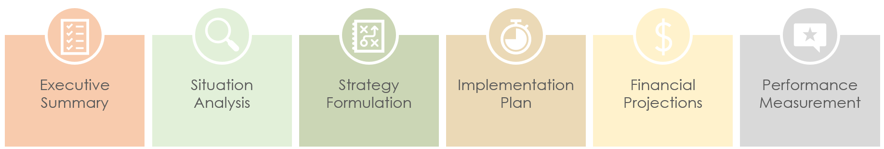
PowerPoint Basic Strategic Plan Template
This template offers a comprehensive overview, allowing viewers to grasp your business’s strategic plan's core elements quickly.

Slide 2











STRATEGIC PLAN
Executive Summary
Situation
Analysis
Strategy Formulation
Implementation Plan
Financial Projections
Performance Measurement
Business mission and views
Objectives overview
Market analysis
SWOT analysis (strengths, weaknesses, opportunities, threats)
Strategic priorities
Target market segmentation
Value proposition
Key initiatives and actions
Timeline and milestones
Resource allocation
Revenue forecasts
Budget and investment needs
Key performance indicators (KPIs)
Evaluation and review process

Slide 3
DISCLAIMER Any articles, templates, or information provided by Smartsheet on the website are for reference only. While we strive to keep the information up to date and correct, we make no representations or warranties of any kind, express or implied, about the completeness, accuracy, reliability, suitability, or availability with respect to the website or the information, articles, templates, or related graphics contained on the website. Any reliance you place on such information is therefore strictly at your own risk.

