Slide 1

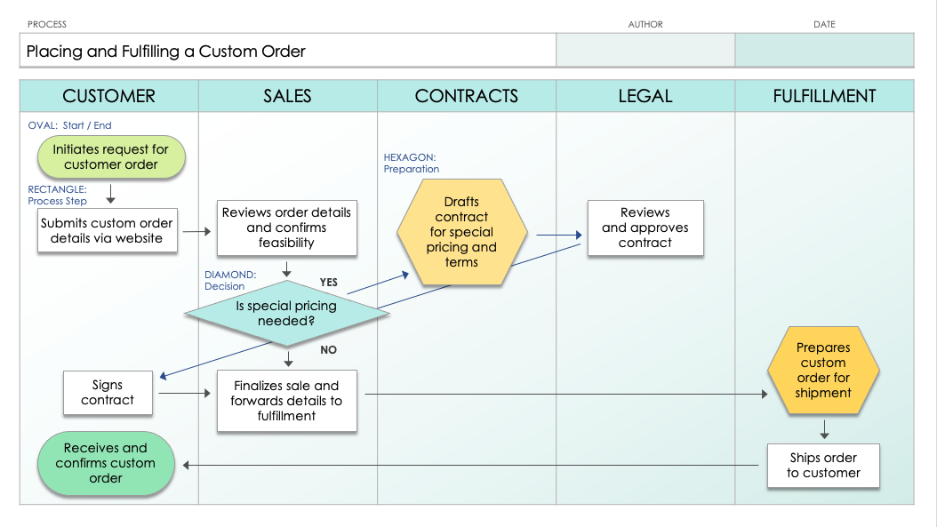
PowerPoint Cross-Functional Flowchart Template
When to Use This Template: Pull out this cross-functional flowchart template when your project involves multiple departments or teams, showing the interconnected roles and processes. It's particularly useful for projects that require a clear understanding of how different parts of the organization contribute to the workflow.
Notable Template Features: With its distinct color-coding and streamlined design, this template makes it easy to visualize the flow of tasks across various functions, helping to identify both collaboration points and bottlenecks. It also includes customizable features to tailor the diagram to your specific project needs, ensuring effective cross-departmental communication.

Slide 2
PROCESS | AUTHOR | DATE
Placing and Fulfilling a Custom Order
CUSTOMER | SALES | CONTRACTS | LEGAL | FULFILLMENT
OVAL: Start / End
Initiates request for customer order
HEXAGON:
Preparation
RECTANGLE:
Process Step
Drafts contract
for special pricing and terms
Submits custom order details via website
Reviews order details and confirms feasibility
Reviews
and approves contract
DIAMOND:
Decision
YES
Is special pricing needed?
Prepares custom order for shipment
NO
Signs contract
Finalizes sale and forwards details to fulfillment
Receives and confirms custom order
Ships order
to customer

Slide 3
PROCESS | AUTHOR | DATE
CUSTOMER | SALES | CONTRACTS | LEGAL | FULFILLMENT
YES
NO

Slide 4
PROCESS | AUTHOR | DATE
CUSTOMER | SALES | CONTRACTS | LEGAL | FULFILLMENT
START
YES or NO
question
Input / Output
STEP 1
Input / Output
STEP 2
NO
YES
YES or NO
question
Document /
Data Input
Input / Output
STEP 3
Document /
Data Input
YES
STEP 4
NO
End Step
NO
Input / Output
YES or NO
question
STEP 5
YES
YES or NO
question
STEP 5.1
END
NO
YES

Slide 5
PROCESS | AUTHOR | DATE
CUSTOMER | SALES | CONTRACTS | LEGAL | FULFILLMENT

Slide 6
DISCLAIMER Any articles, templates, or information provided by Smartsheet on the website are for reference only. While we strive to keep the information up to date and correct, we make no representations or warranties of any kind, express or implied, about the completeness, accuracy, reliability, suitability, or availability with respect to the website or the information, articles, templates, or related graphics contained on the website. Any reliance you place on such information is therefore strictly at your own risk.

