Slide 1

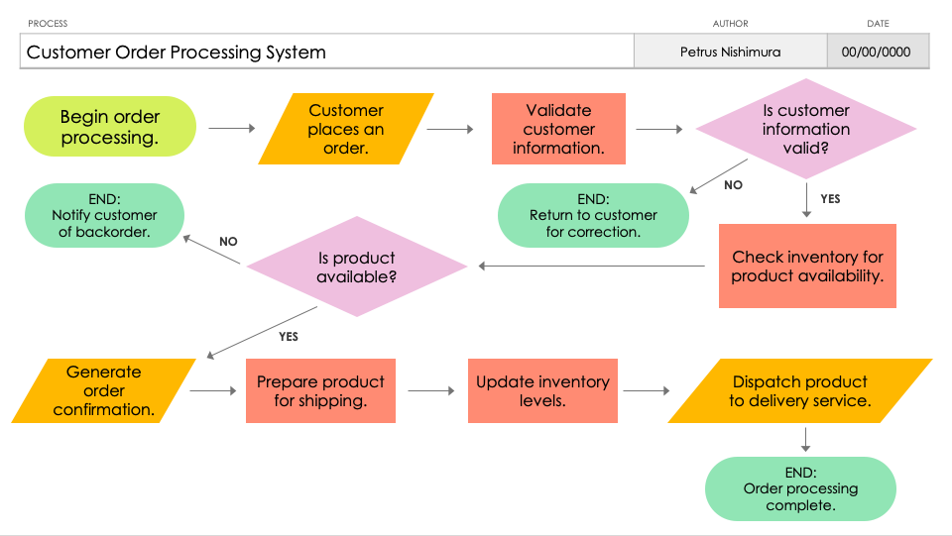
PowerPoint Data Flowchart Template
When to Use This Template: Use the data flowchart template when you need to visualize how data moves through your systems, making it easier to identify and understand each step from input to output. It's perfect for projects aimed at improving or securing data processes.
Notable Template Features: This template is designed to clearly show data pathways, storage points, and how data is processed within any system. It offers customizable elements to accurately represent different data flows, aiding in the detection of potential bottlenecks or vulnerabilities in data handling.

Slide 2
PROCESS | AUTHOR | DATE
Customer Order Processing System | Petrus Nishimura | 00/00/0000
Is customer information valid?
Begin order processing.
Customer places an order.
Validate customer information.
NO
END:
Notify customer
of backorder.
END:
Return to customer
for correction.
YES
NO
Is product available?
Check inventory for product availability.
YES
Generate order confirmation.
Prepare product for shipping.
Update inventory
levels.
Dispatch product
to delivery service.
END:
Order processing complete.

Slide 3
PROCESS | AUTHOR | DATE
RECTANGLE:
Process Step
DIAMOND:
Decision Point
NO
OVAL:
Start / End
of the Process
PARALLELOGRAM:
Input / Output
YES
– KEY –

Slide 4
DISCLAIMER Any articles, templates, or information provided by Smartsheet on the website are for reference only. While we strive to keep the information up to date and correct, we make no representations or warranties of any kind, express or implied, about the completeness, accuracy, reliability, suitability, or availability with respect to the website or the information, articles, templates, or related graphics contained on the website. Any reliance you place on such information is therefore strictly at your own risk.

