Slide 1

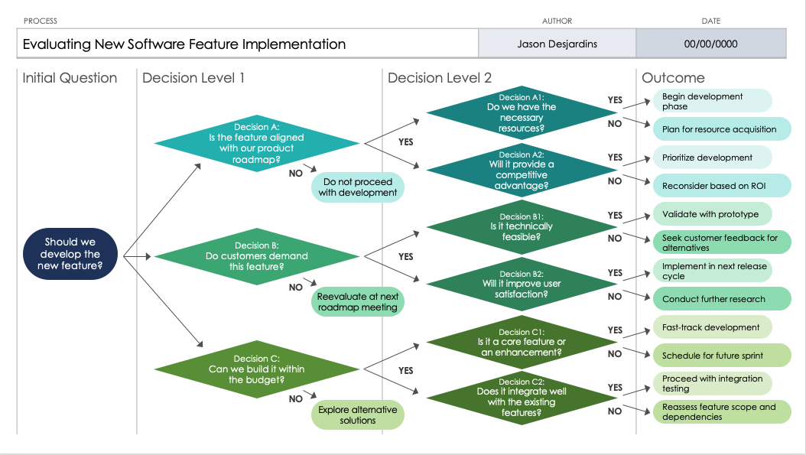
PowerPoint Decision Flowchart Template
When to Use This Template: This decision flowchart template should be used when you're faced with making complex decisions and need to visualize the outcomes of various options. It's perfect for strategic planning sessions or when trying to resolve dilemmas that involve multiple choices.
Notable Template Features: This template stands out by offering a structured way to break down decisions and their possible results, making it easier to understand the impact of each choice. It comes equipped with customizable paths and outcomes, allowing teams to thoroughly explore and present decision-making scenarios.

Slide 2
PROCESS | AUTHOR | DATE
Evaluating New Software Feature Implementation | Jason Desjardins | 00/00/0000
Initial Question | Decision Level 1 | Decision Level 2 | Outcome
Decision A1: Do we have the necessary
resources?
Begin development phase
YES
Decision A: Is the feature aligned with our product roadmap?
NO
Plan for resource acquisition
YES
Decision A2: Will it provide a competitive advantage?
Prioritize development
YES
NO
Do not proceed with development
NO
Reconsider based on ROI
Decision B1: Is it technically feasible?
Validate with prototype
YES
Should we develop the new feature?
Decision B: Do customers demand this feature?
NO
Seek customer feedback for alternatives
YES
Decision B2: Will it improve user satisfaction?
Implement in next release cycle
YES
NO
Reevaluate at next roadmap meeting
NO
Conduct further research
Decision C1: Is it a core feature or an enhancement?
Fast-track development
YES
Decision C: Can we build it within the budget?
NO
Schedule for future sprint
YES
Decision C2: Does it integrate well with the existing features?
YES
Proceed with integration testing
NO
Explore alternative solutions
NO
Reassess feature scope and dependencies

Slide 3
PROCESS | AUTHOR | DATE
Initial Question | Decision Level 1 | Decision Level 2 | Outcome
YES
NO
YES
YES
NO
NO
YES
NO
YES
YES
NO
NO
YES
NO
YES
YES
NO
NO

Slide 4
DISCLAIMER Any articles, templates, or information provided by Smartsheet on the website are for reference only. While we strive to keep the information up to date and correct, we make no representations or warranties of any kind, express or implied, about the completeness, accuracy, reliability, suitability, or availability with respect to the website or the information, articles, templates, or related graphics contained on the website. Any reliance you place on such information is therefore strictly at your own risk.

