Slide 1

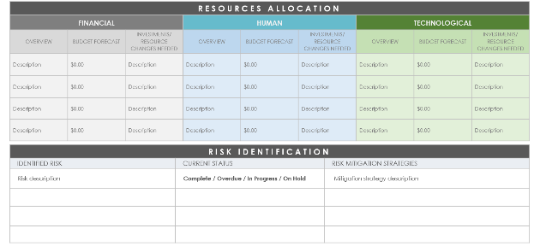
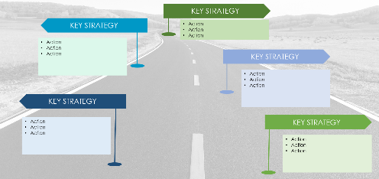
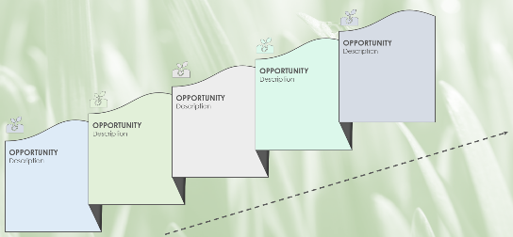
PowerPoint Growth Strategic Plan Template
This template is designed to effectively convey your growth strategy, making it accessible and motivating for your team and stakeholders, and driving alignment towards your growth objectives.

Slide 2



INTRODUCTION AND MARKET ANALYSIS
Start with an engaging overview of your growth strategy and vision. Next, conduct a succinct market analysis, highlighting trends, target segments, and key competitors. Use visuals like charts or infographics to make an impact.
OVERVIEW
Describe your growth strategy and vision.
MARKET
ANALYSIS
TRENDS
TARGET SEGMENTS
KEY COMPETITORS
Description
Description
Description

Slide 3





GROWTH AND OPPORTUNITY
Identify growth opportunities and set strategic SMART goals. Display these opportunities and goals visually using icons or concise descriptions to enhance clarity and engagement.
OPPORTUNITY
Description
OPPORTUNITY
Description
OPPORTUNITY
Description
OPPORTUNITY
Description
OPPORTUNITY
Description

Slide 4

STRATEGIES FOR GROWTH
Outline key strategies and actions to achieve your goals. Use diagrams or flowcharts to depict the steps and processes involved, making it easy to understand and follow.
KEY STRATEGY
KEY STRATEGY
Action
Action
Action
Action
Action
Action
KEY STRATEGY
Action
Action
Action
KEY STRATEGY
Action
Action
Action
KEY STRATEGY
Action
Action
Action

Slide 5
RESOURCE ALLOCATION AND RISK MANAGEMENT
Discuss the allocation of resources — financial, human, and technological. Incorporate risk management by presenting a prioritized list of potential challenges and mitigation strategies, using visual tools such as pie charts or risk matrices.
RESOURCES ALLOCATION
FINANCIAL |  |  | HUMAN |  |  | TECHNOLOGICAL
OVERVIEW | BUDGET FORECAST | INVESTMENTS/ RESOURCE CHANGES NEEDED | OVERVIEW | BUDGET FORECAST | INVESTMENTS/ RESOURCE CHANGES NEEDED | OVERVIEW | BUDGET FORECAST | INVESTMENTS/ RESOURCE CHANGES NEEDED
Description | $0.00 | Description | Description | $0.00 | Description | Description | $0.00 | Description
Description | $0.00 | Description | Description | $0.00 | Description | Description | $0.00 | Description
Description | $0.00 | Description | Description | $0.00 | Description | Description | $0.00 | Description
Description | $0.00 | Description | Description | $0.00 | Description | Description | $0.00 | Description
RISK IDENTIFICATION
IDENTIFIED RISK | CURRENT STATUS | RISK MITIGATION STRATEGIES
Risk description | Complete / Overdue / In Progress / On Hold | Mitigation strategy description

Slide 6



PERFORMANCE MONITORING
Define the key performance indicators (KPIs) for measuring success and illustrate how progress will be monitored using dashboards or scorecards. Ensure the presentation is visual and straightforward.
FOCUS AREA A
Objective | 00
Measure | 00
Target | 00
Invites | 00
Other | 00
FOCUS AREA B
Objective | 00
Measure | 00
Target | 00
Invites | 00
Other | 00
FOCUS AREA C
Objective | 00
Measure | 00
Target | 00
Invites | 00
Other | 00
FOCUS AREA A
FOCUS AREA B
FOCUS AREA C
50%
20%
95%

Slide 7
IMPLEMENTATION TIMELINE
Present a clear timeline with major milestones and deadlines. A Gantt chart or timeline graphic works well here to outline phases and key actions over time.
JAN | FEB | MAR | APR | MAY | JUN | JUL | AUG | SEP | OCT | NOV | DEC
STATUS
TARGET
PHASES
Description of the current state …
PHASE 1: Title
PHASE 2: Title
PHASE 3: Title
Description of final target …
Initiative 1:
Name
Project
Project
Initiative 2:
Name
Project
Project
Milestone MM/DD
TIMELINE
Initiative 3:
Name
Project
Initiative 4:
Name
TASK OWNER
TASK OWNER
TASK OWNER
TASK OWNER
TASK OWNER
Milestone MM/DD

Slide 8

CONCLUSION AND CALL TO ACTION
Wrap up with a summary of the growth strategy and a compelling call to action. Encourage commitment with a strong visual cue or graphic to leave a lasting impression.
CALL
TO
ACTION
Compelling call to action…

Slide 9
DISCLAIMER Any articles, templates, or information provided by Smartsheet on the website are for reference only. While we strive to keep the information up to date and correct, we make no representations or warranties of any kind, express or implied, about the completeness, accuracy, reliability, suitability, or availability with respect to the website or the information, articles, templates, or related graphics contained on the website. Any reliance you place on such information is therefore strictly at your own risk.

