Slide 1

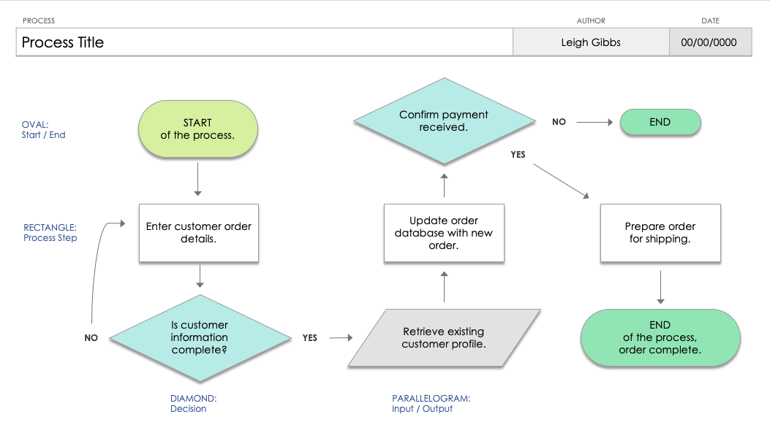
PowerPoint Simple Flowchart Template
When to Use This Template: Turn to this simple flowchart template for PowerPoint for simplifying complex ideas during presentations or when outlining straightforward tasks and decisions. It's perfect for visualizing basic steps and outcomes in a process, making it easier for your audience to follow along.
Notable Template Features: This simple flowchart template for PowerPoint stands out with its clear, easy-to-follow layout and customizable design, allowing you to effortlessly tailor it to your specific needs. Its user-friendly interface ensures that even those with no prior experience can create effective flowcharts.

Slide 2
PROCESS | AUTHOR | DATE
Process Title | Leigh Gibbs | 00/00/0000
Confirm payment received.
START
of the process.
NO
OVAL:
Start / End
END
YES
Enter customer order details.
Update order database with new order.
Prepare order
for shipping.
RECTANGLE:
Process Step
Is customer information complete?
Retrieve existing customer profile.
END
of the process, order complete.
NO
YES
DIAMOND:
Decision
PARALLELOGRAM:
Input / Output

Slide 3
PROCESS | AUTHOR | DATE
NO
END
YES
END
NO
YES

Slide 4
DISCLAIMER Any articles, templates, or information provided by Smartsheet on the website are for reference only. While we strive to keep the information up to date and correct, we make no representations or warranties of any kind, express or implied, about the completeness, accuracy, reliability, suitability, or availability with respect to the website or the information, articles, templates, or related graphics contained on the website. Any reliance you place on such information is therefore strictly at your own risk.

