Slide 1

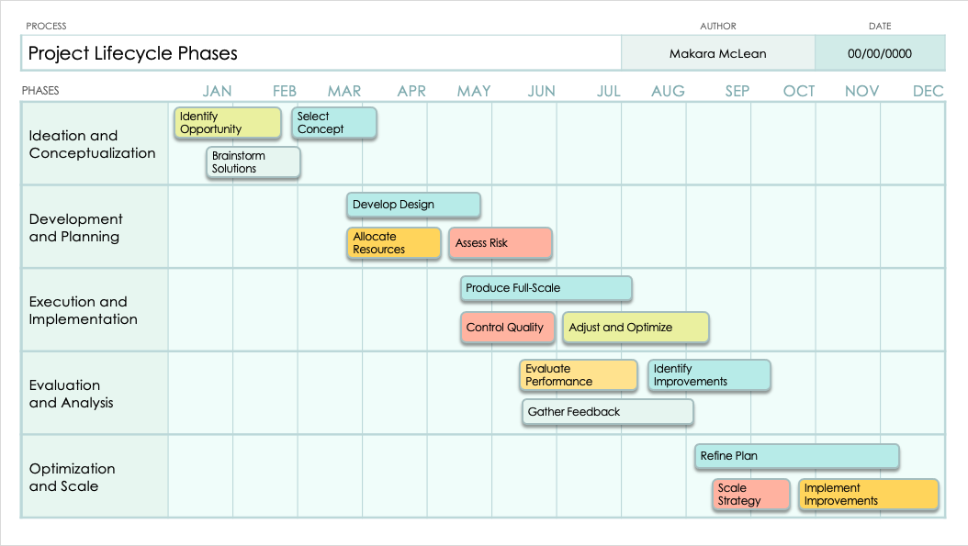
PowerPoint Swimlane Flowchart Template
When to Use This Template: Utilize this swimlane flowchart template to make clear who does what in a process. It’s especially helpful for projects requiring coordination across different departments or groups, making sure everyone knows their specific roles.
Notable Template Features: This template shines by visually dividing tasks and responsibilities into distinct lanes, each assigned to a particular team or individual. With its easy-to-understand layout, it streamlines communication and improves project management by highlighting the flow of tasks across different parts of the organization.

Slide 2
PROCESS | AUTHOR | DATE
Project Lifecycle Phases | Makara McLean | 00/00/0000
PHASES | JAN | FEB | MAR | APR | MAY | JUN | JUL | AUG | SEP | OCT | NOV | DEC
Ideation and Conceptualization
Development and Planning
Execution and Implementation
Evaluation and Analysis
Optimization and Scale
Identify Opportunity
Select Concept
Brainstorm Solutions
Develop Design
Allocate Resources
Assess Risk
Produce Full-Scale
Control Quality
Adjust and Optimize
Evaluate Performance
Identify Improvements
Gather Feedback
Refine Plan
Scale Strategy
Implement
Improvements

Slide 3
PROCESS | AUTHOR | DATE
PHASES | JAN | FEB | MAR | APR | MAY | JUN | JUL | AUG | SEP | OCT | NOV | DEC

Slide 4
PROCESS | AUTHOR | DATE
PHASES | JAN | FEB | MAR | APR | MAY | JUN | JUL | AUG | SEP | OCT | NOV | DEC

Slide 5
DISCLAIMER Any articles, templates, or information provided by Smartsheet on the website are for reference only. While we strive to keep the information up to date and correct, we make no representations or warranties of any kind, express or implied, about the completeness, accuracy, reliability, suitability, or availability with respect to the website or the information, articles, templates, or related graphics contained on the website. Any reliance you place on such information is therefore strictly at your own risk.

