Slide 1

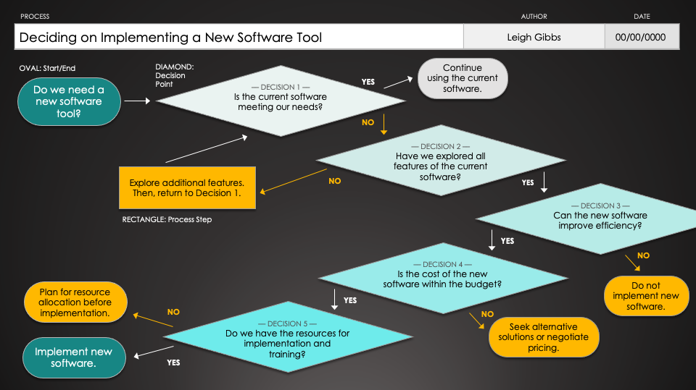
PowerPoint Yes/No Flowchart Template
When to Use This Template: The yes/no flowchart template is perfect for simplifying complex decision-making into manageable, binary choices. It's a go-to tool for training sessions or meetings where clear, straightforward decision paths need to be explored.
Notable Template Features: This template features a clear, step-by-step layout that branches out based on yes or no responses, making it easier to follow through a series of decisions. Its design helps in visualizing the consequences of choices, aiding in quicker, more informed decision-making processes.

Slide 2
PROCESS | AUTHOR | DATE
Deciding on Implementing a New Software Tool | Leigh Gibbs | 00/00/0000
OVAL: Start/End
DIAMOND:
Decision
Point
Continue
using the current software.
–– DECISION 1 ––
Is the current software meeting our needs?
Do we need a new software tool?
YES
NO
–– DECISION 2 ––
Have we explored all features of the current software?
Explore additional features. Then, return to Decision 1.
NO
YES
–– DECISION 3 ––
Can the new software improve efficiency?
RECTANGLE: Process Step
YES
–– DECISION 4 ––
Is the cost of the new software within the budget?
NO
Plan for resource allocation before implementation.
Do not implement new software.
NO
YES
–– DECISION 5 ––
Do we have the resources for implementation and training?
NO
Seek alternative solutions or negotiate pricing.
Implement new software.
YES

Slide 3
PROCESS | AUTHOR | DATE
YES
NO
NO
YES
YES
NO
NO
YES
NO
YES

Slide 4
DISCLAIMER Any articles, templates, or information provided by Smartsheet on the website are for reference only. While we strive to keep the information up to date and correct, we make no representations or warranties of any kind, express or implied, about the completeness, accuracy, reliability, suitability, or availability with respect to the website or the information, articles, templates, or related graphics contained on the website. Any reliance you place on such information is therefore strictly at your own risk.

