Slide 1

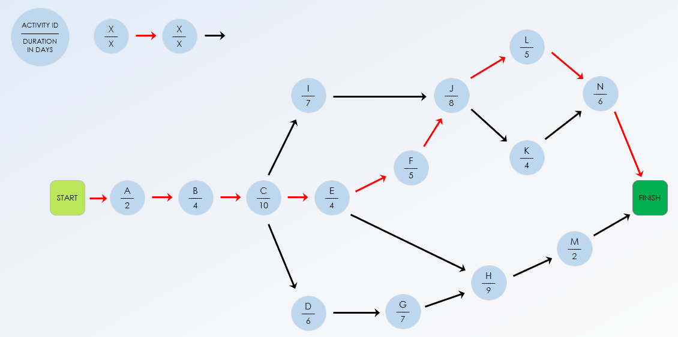
Critical Path Chart Template Example

Slide 2
Establishing a Nationwide Cybersecurity Awareness Program
ID | PREDECESSOR ACTIVITIES enter separately in columns |  |  |  |  |  | DURATION in days | ACTIVITY DESCRIPTION
A | - | - | - | - | - | - | 10 | Project Initiation
B | A |  |  |  |  |  | 15 | Stakeholder Analysis
C | B |  |  |  |  |  | 10 | Program Goals Definition
D | C |  |  |  |  |  | 20 | Budget Approval
E | C |  |  |  |  |  | 30 | Curriculum Development
F | E |  |  |  |  |  | 20 | Pilot Program Design
G | D |  |  |  |  |  | 25 | Hiring of Trainers and Staff
H | D |  |  |  |  |  | 40 | IT Infrastructure Setup
I | E |  |  |  |  |  | 45 | Development of Online Resources
J | C |  |  |  |  |  | 25 | Marketing and Public Relations Plan
K | F | G | H | I |  |  | 15 | Pilot Program Launch
L | K |  |  |  |  |  | 20 | Pilot Program Review and Feedback Analysis
M | L |  |  |  |  |  | 30 | Full Program Rollout Planning
N | M |  |  |  |  |  | 50 | Implementation of Full Program
EXAMPLE

Slide 3
ACTIVITY ID
–––––––––––
DURATION IN DAYS
X
–––––––
X
X
–––––––
X
J
–––––––
25
I
–––––––
45
START
A
–––––––
10
B
–––––––
15
C
–––––––
10
E
–––––––
30
F
–––––––
20
K
–––––––
15
L
–––––––
20
M
–––––––
30
N
–––––––
6
FINISH
H
–––––––
40
D
–––––––
20
G
–––––––
25
CRITICAL PATH EXAMPLE
Use red arrows to illustrate the critical path.

Slide 4
DISCLAIMER Any articles, templates, or information provided by Smartsheet on the website are for reference only. While we strive to keep the information up to date and correct, we make no representations or warranties of any kind, express or implied, about the completeness, accuracy, reliability, suitability, or availability with respect to the website or the information, articles, templates, or related graphics contained on the website. Any reliance you place on such information is therefore strictly at your own risk.

