Slide 1


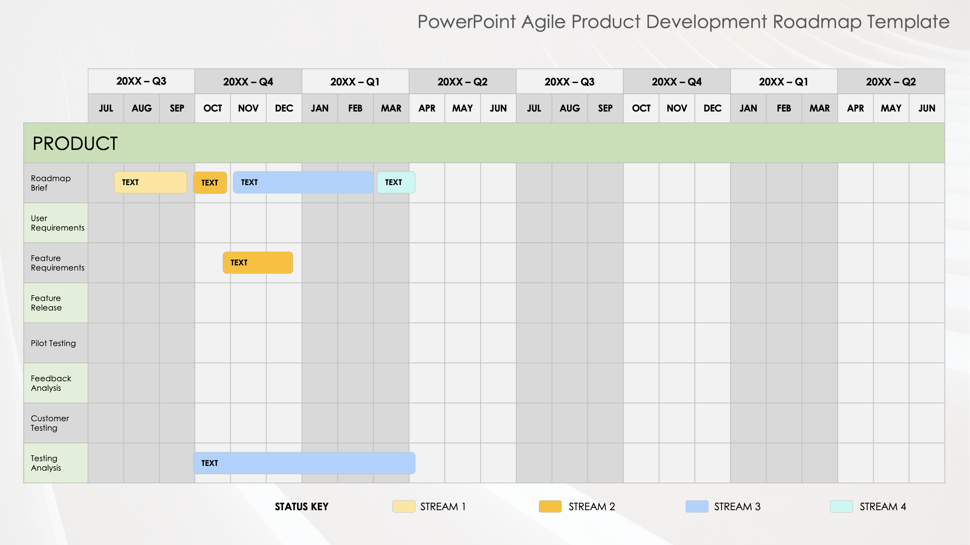
PowerPoint Agile Product Development Roadmap Template
When to Use This Template: Use this template to manage and present complex product development projects using Agile methodologies. Product managers, Scrum Masters, and development teams can use this template to keep track of multiple project streams and phases at once, or in sprint planning sessions and Agile retrospectives, to ensure clear communication and alignment across all aspects of the project.
Notable Template Features: The template includes slides for product, development, user experience, and quality assurance. Together, they provide a comprehensive view of the entire product development process. Each slide offers a detailed timeline for every quarter, which allows you to precisely track key activities such as roadmap briefs, user requirements, and feature releases. The color-coded status key and work streams help you visualize progress and dependencies so it’s easy to identify bottlenecks and adjust plans accordingly. You can also customize the template by updating the task descriptions and timelines.

Slide 2
PowerPoint Agile Product Development Roadmap Template
 | 20XX – Q3 |  |  | 20XX – Q4 |  |  | 20XX – Q1 |  |  | 20XX – Q2 |  |  | 20XX – Q3 |  |  | 20XX – Q4 |  |  | 20XX – Q1 |  |  | 20XX – Q2
 | JUL | AUG | SEP | OCT | NOV | DEC | JAN | FEB | MAR | APR | MAY | JUN | JUL | AUG | SEP | OCT | NOV | DEC | JAN | FEB | MAR | APR | MAY | JUN
PRODUCT
Roadmap Brief
User Requirements
Feature Requirements
Feature Release
Pilot Testing
Feedback Analysis
Customer Testing
Testing Analysis
TEXT
TEXT
TEXT
TEXT
TEXT
TEXT
STATUS KEY STREAM 1 STREAM 2 STREAM 3 STREAM 4

Slide 3
PowerPoint Agile Product Development Roadmap Template
 | 20XX – Q3 |  |  | 20XX – Q4 |  |  | 20XX – Q1 |  |  | 20XX – Q2 |  |  | 20XX – Q3 |  |  | 20XX – Q4 |  |  | 20XX – Q1 |  |  | 20XX – Q2
 | JUL | AUG | SEP | OCT | NOV | DEC | JAN | FEB | MAR | APR | MAY | JUN | JUL | AUG | SEP | OCT | NOV | DEC | JAN | FEB | MAR | APR | MAY | JUN
DEVELOPMENT
Prototype
Deployment
Beta Testing
Tech Analysis
Story Review
Demo
Integrated Prototype
TEXT
TEXT
TEXT
TEXT
STATUS KEY STREAM 1 STREAM 2 STREAM 3 STREAM 4

Slide 4
PowerPoint Agile Product Development Roadmap Template
 | 20XX – Q3 |  |  | 20XX – Q4 |  |  | 20XX – Q1 |  |  | 20XX – Q2 |  |  | 20XX – Q3 |  |  | 20XX – Q4 |  |  | 20XX – Q1 |  |  | 20XX – Q2
 | JUL | AUG | SEP | OCT | NOV | DEC | JAN | FEB | MAR | APR | MAY | JUN | JUL | AUG | SEP | OCT | NOV | DEC | JAN | FEB | MAR | APR | MAY | JUN
USER EXPERIENCE
Wireframe
Style Guide
Surface Design
UX Templates
Feature Design
UX Audit
Site Test
TEXT
TEXT
TEXT
TEXT
STATUS KEY STREAM 1 STREAM 2 STREAM 3 STREAM 4

Slide 5
PowerPoint Agile Product Development Roadmap Template
 | 20XX – Q3 |  |  | 20XX – Q4 |  |  | 20XX – Q1 |  |  | 20XX – Q2 |  |  | 20XX – Q3 |  |  | 20XX – Q4 |  |  | 20XX – Q1 |  |  | 20XX – Q2
 | JUL | AUG | SEP | OCT | NOV | DEC | JAN | FEB | MAR | APR | MAY | JUN | JUL | AUG | SEP | OCT | NOV | DEC | JAN | FEB | MAR | APR | MAY | JUN
QUALITY ASSURANCE
Preview Testing
Quality Assurance
Metrics Analysis
Variance Testing
User Acceptance
TEXT
TEXT
TEXT
STATUS KEY STREAM 1 STREAM 2 STREAM 3 STREAM 4

Slide 6
DISCLAIMER Any articles, templates, or information provided by Smartsheet on the website are for reference only. While we strive to keep the information up to date and correct, we make no representations or warranties of any kind, express or implied, about the completeness, accuracy, reliability, suitability, or availability with respect to the website or the information, articles, templates, or related graphics contained on the website. Any reliance you place on such information is therefore strictly at your own risk.

