Slide 1


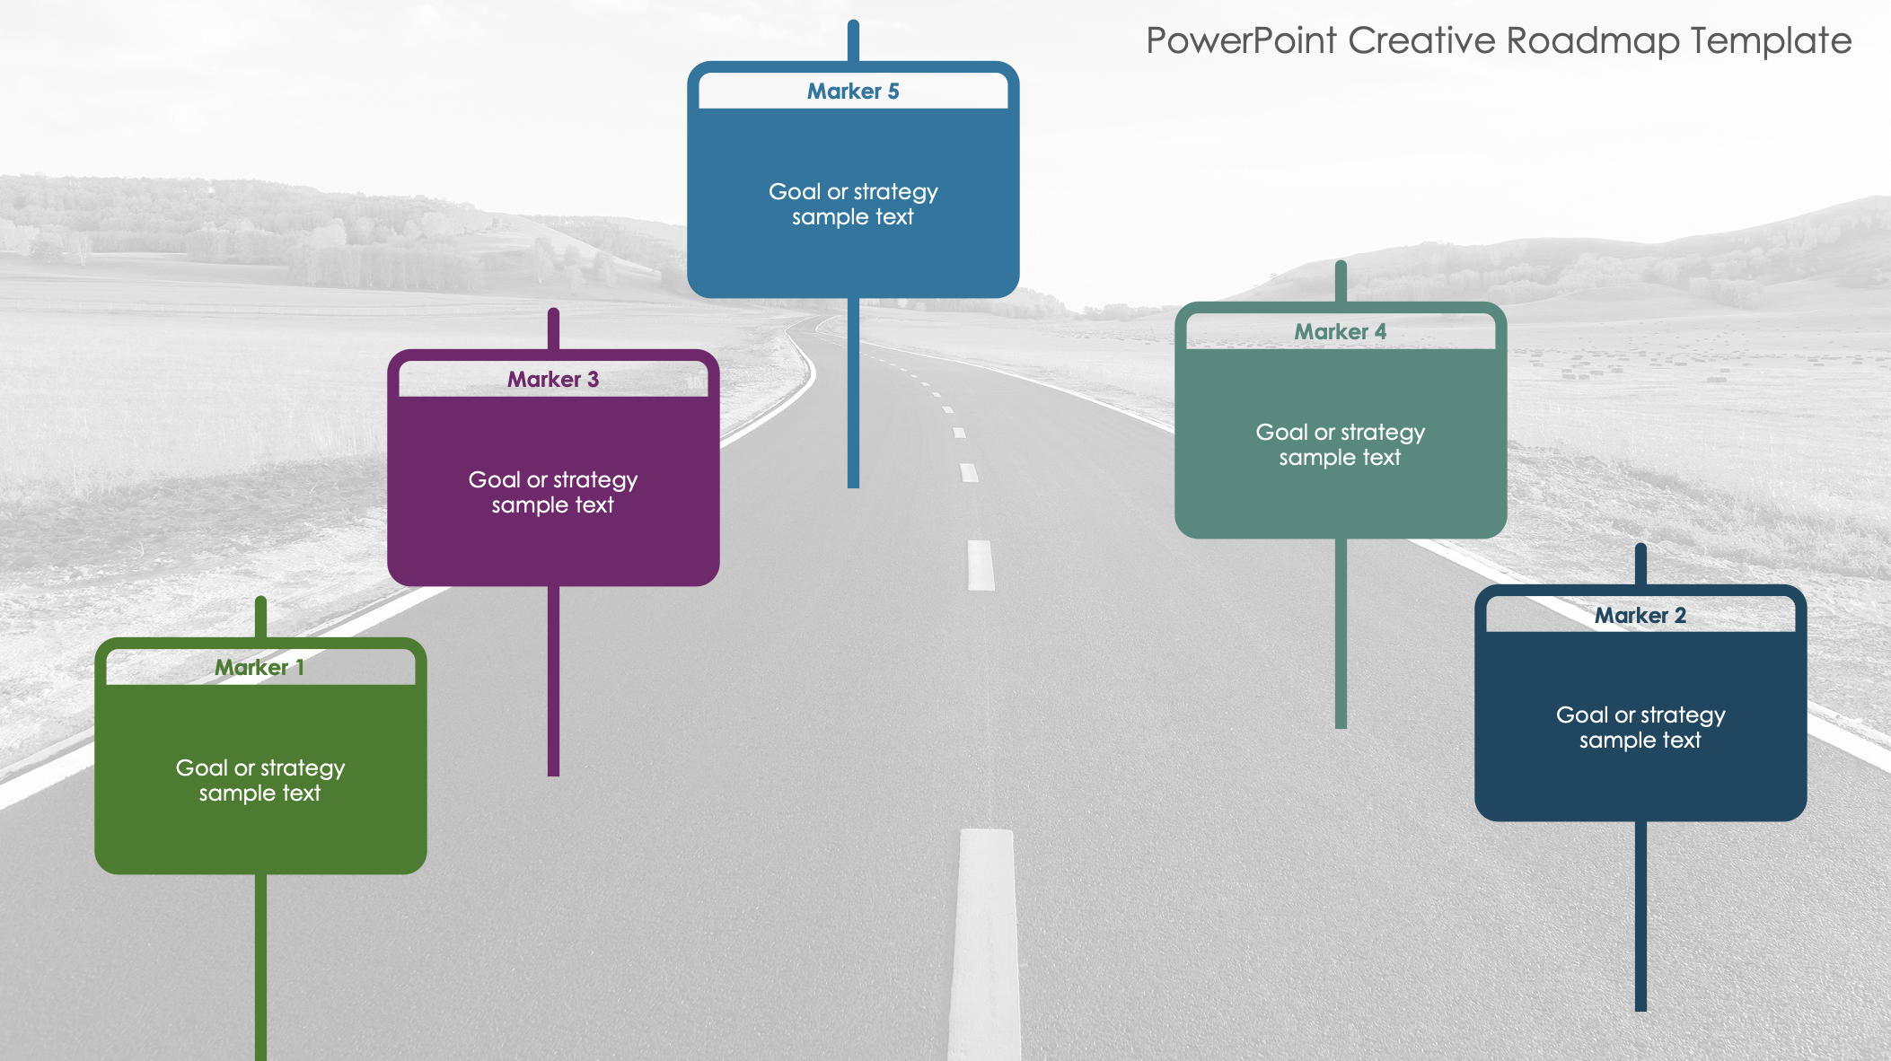
PowerPoint Creative Roadmap Template
When to Use This Template: This creative product roadmap template is perfect for illustrating the progression of product development in a visually engaging manner. Use this template in strategy meetings, client presentations, and team briefings to capture viewers' attention while conveying key details.
Notable Template Features: This template features a winding road design that adds a dynamic and visually appealing element to your roadmap presentation. Each milestone is marked along the road to emphasize the strategic path of a project. Edit the text boxes next to each marker to highlight product stages, specific activities, deliverables, or other information.

Slide 2





PowerPoint Creative Roadmap Template
Marker 5
Goal or strategy sample text
Marker 4
Marker 3
Goal or strategy sample text
Goal or strategy sample text
Marker 2
Marker 1
Goal or strategy sample text
Goal or strategy sample text

Slide 3
DISCLAIMER Any articles, templates, or information provided by Smartsheet on the website are for reference only. While we strive to keep the information up to date and correct, we make no representations or warranties of any kind, express or implied, about the completeness, accuracy, reliability, suitability, or availability with respect to the website or the information, articles, templates, or related graphics contained on the website. Any reliance you place on such information is therefore strictly at your own risk.

