Slide 1


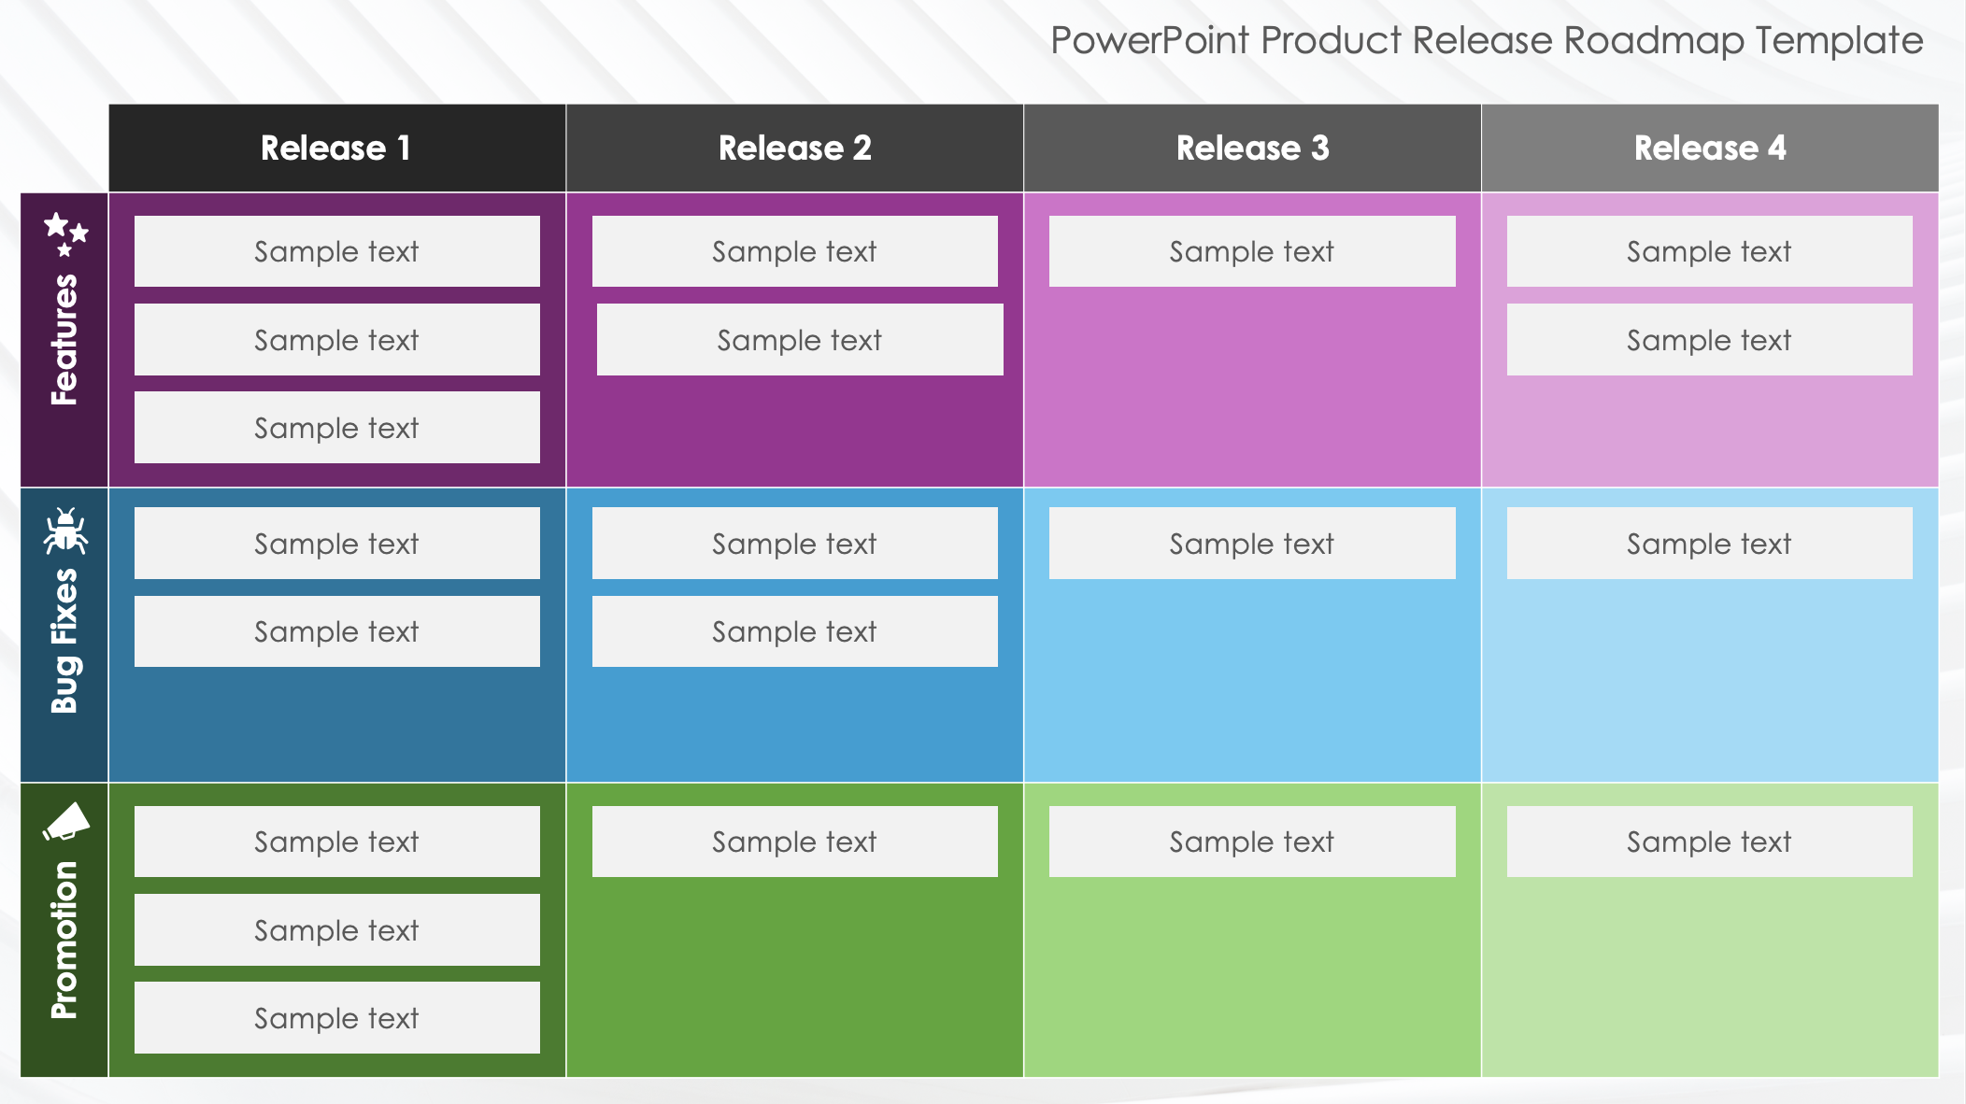
PowerPoint Product Release Roadmap Template
When to Use This Template: This PowerPoint product release roadmap template is ideal for planning and communicating the details of upcoming product releases. It is perfect for product managers, development teams, and marketing professionals who need to coordinate and track the progress of new features, bug fixes, and marketing activities. Use this template in release planning meetings, sprint reviews, and presentations to provide a clear and structured overview of your product release schedule.
Notable Template Features: The template features a grid layout with columns for each release and rows categorizing new features, fixes, and marketing activities. Each cell is customizable, allowing teams to specify the details of what's included in each release. Color-coded sections help differentiate between types of tasks, making it easy to visualize the scope and timeline of each release. The inclusion of icons for new features, fixes, and marketing adds a visual element that enhances understanding and engagement. This template is designed to facilitate agile release planning by providing a comprehensive and adaptable framework for managing multiple aspects of product development and launch.

Slide 2



PowerPoint Product Release Roadmap Template
 | Release 1 | Release 2 | Release 3 | Release 4
Features
Bug Fixes
Promotion
Sample text
Sample text
Sample text
Sample text
Sample text
Sample text
Sample text
Sample text
Sample text
Sample text
Sample text
Sample text
Sample text
Sample text
Sample text
Sample text
Sample text
Sample text
Sample text
Sample text

Slide 3
DISCLAIMER Any articles, templates, or information provided by Smartsheet on the website are for reference only. While we strive to keep the information up to date and correct, we make no representations or warranties of any kind, express or implied, about the completeness, accuracy, reliability, suitability, or availability with respect to the website or the information, articles, templates, or related graphics contained on the website. Any reliance you place on such information is therefore strictly at your own risk.

