Slide 1

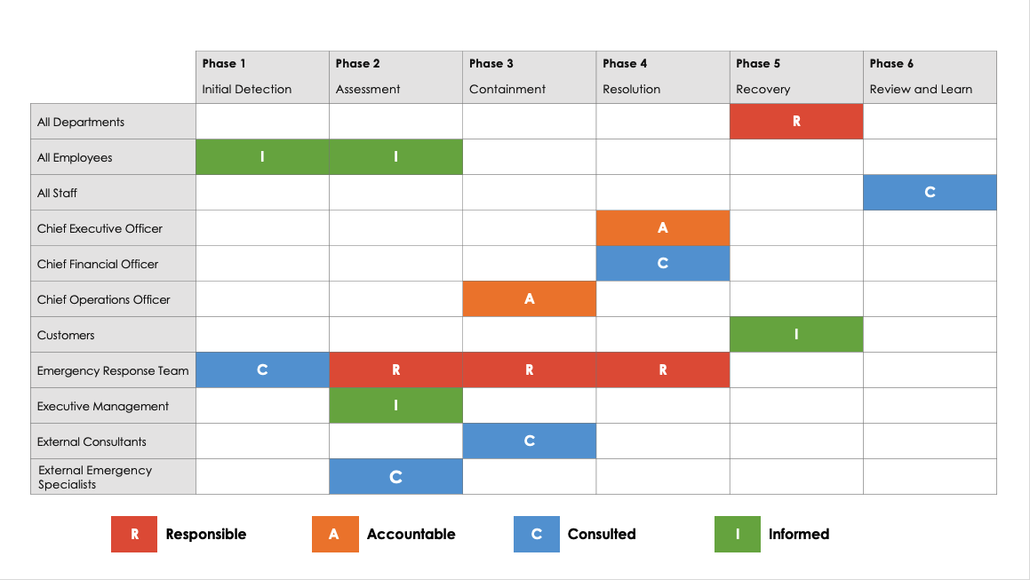
Emergency Response Escalation Matrix Template
When To Use This Template: Use this template to manage and escalate emergency responses efficiently, ensuring that each phase of the emergency is handled by the appropriate roles and individuals according to a clear, structured plan.
Notable Templates Features: This template features a responsible, accountable, consulted, and informed (RACI) matrix format with escalation phases listed in the left-hand column and responsible roles/individuals as column headers. This matrix provides a detailed and organized approach to assigning responsibilities and ensuring accountability during emergency situations.

Slide 2
Emergency Response Escalation Matrix Template
Escalation Phases | Lists each phase of the emergency response.
R - Responsible | Person(s) who will perform the task
A - Accountable | The individual who is ultimately accountable and has yes/no authority and veto power
C - Consulted | Those whose opinions are sought; typically subject matter experts
I - Informed | Those who are kept up-to-date on progress; typically those affected by the outcome of the tasks

Slide 3
Emergency Response Escalation Matrix
 | Phase 1 | Phase 2 | Phase 3 | Phase 4 | Phase 5 | Phase 6
 | Initial Detection | Assessment | Containment | Resolution | Recovery | Review and Learn
All Departments |  |  |  |  | R
All Employees | I | I
All Staff |  |  |  |  |  | C
Chief Executive Officer |  |  |  | A
Chief Financial Officer |  |  |  | C
Chief Operations Officer |  |  | A
Customers |  |  |  |  | I
Emergency Response Team | C | R | R | R
Executive Management |  | I
External Consultants |  |  | C
External Emergency Specialists |  | C
R | Responsible | A | Accountable | C | Consulted | I | Informed

Slide 4
Emergency Response Escalation Matrix
 | Phase 1 | Phase 2 | Phase 3 | Phase 4 | Phase 5 | Phase 6
 | Initial Detection | Assessment | Containment | Resolution | Recovery | Review and Learn
Financial Advisor |  |  |  |  | C
Human Resources |  |  |  |  | C
Industry Peers |  |  |  |  |  | I
Legal Advisor | C |  | C
Local Emergency Services | I
Local Government Authorities |  |  | I
On-site Security Team | R
Public Relations |  |  | I
Quality Assurance Manager |  |  |  |  |  | A
Recovery Manager |  |  |  |  | A
Regulatory Bodies |  |  |  | I
R | Responsible | A | Accountable | C | Consulted | I | Informed

Slide 5
Emergency Response Escalation Matrix
 | Phase 1 | Phase 2 | Phase 3 | Phase 4 | Phase 5 | Phase 6
 | Initial Detection | Assessment | Containment | Resolution | Recovery | Review and Learn
Review Committee |  |  |  |  |  | R
Risk Management |  |  |  | C
Safety Officer |  | A | R
Security Manager | A | C
Shareholders |  |  |  | I
Suppliers |  |  |  |  | I
Technical Teams |  |  |  | R
R | Responsible | A | Accountable | C | Consulted | I | Informed

Slide 6
DISCLAIMER Any articles, templates, or information provided by Smartsheet on the website are for reference only. While we strive to keep the information up to date and correct, we make no representations or warranties of any kind, express or implied, about the completeness, accuracy, reliability, suitability, or availability with respect to the website or the information, articles, templates, or related graphics contained on the website. Any reliance you place on such information is therefore strictly at your own risk.

