Slide 1

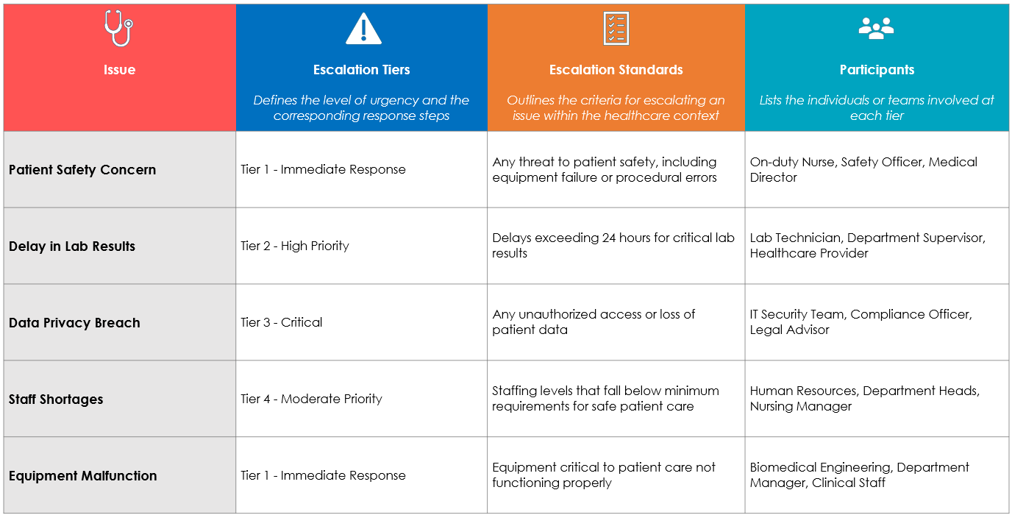
Healthcare Escalation Matrix Template
When To Use This Template:
Use this template to manage and escalate healthcare issues efficiently, ensuring that patient care concerns are addressed promptly by the appropriate personnel according to established standards.
Notable Templates Features:
This template includes columns for Escalation Tiers, Escalation Standards, and Participants (e.g., healthcare-related individuals and their roles/titles), providing a clear framework for defining the levels of escalation, the standards to follow, and the roles involved in each tier.

Slide 2




Healthcare Escalation Matrix
Issue | Escalation Tiers | Escalation Standards | Participants
 | Defines the level of urgency and the corresponding response steps | Outlines the criteria for escalating an issue within the healthcare context | Lists the individuals or teams involved at each tier
Patient Safety Concern | Tier 1 - Immediate Response | Any threat to patient safety, including equipment failure or procedural errors | On-duty Nurse, Safety Officer, Medical Director
Delay in Lab Results | Tier 2 - High Priority | Delays exceeding 24 hours for critical lab results | Lab Technician, Department Supervisor, Healthcare Provider
Data Privacy Breach | Tier 3 - Critical | Any unauthorized access or loss of patient data | IT Security Team, Compliance Officer, Legal Advisor
Staff Shortages | Tier 4 - Moderate Priority | Staffing levels that fall below minimum requirements for safe patient care | Human Resources, Department Heads, Nursing Manager
Equipment Malfunction | Tier 1 - Immediate Response | Equipment critical to patient care not functioning properly | Biomedical Engineering, Department Manager, Clinical Staff

Slide 3
DISCLAIMER Any articles, templates, or information provided by Smartsheet on the website are for reference only. While we strive to keep the information up to date and correct, we make no representations or warranties of any kind, express or implied, about the completeness, accuracy, reliability, suitability, or availability with respect to the website or the information, articles, templates, or related graphics contained on the website. Any reliance you place on such information is therefore strictly at your own risk.

