Slide 1

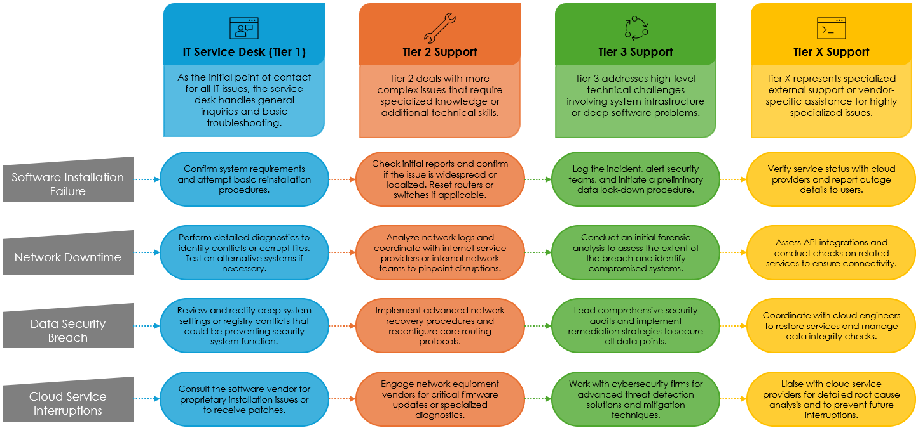
IT Service Desk / ITIL Escalation Matrix Template Example
When To Use This Template:
Use this template to manage and escalate Information Technology (IT) service desk incidents effectively, ensuring that issues are resolved at the appropriate tier level according to ITIL best practices.
Notable Templates Features:
This template includes detailed tiers for IT Service Desk (Tier 1), Tier 2, and Tier 3 support, along with a customizable escalation workflow diagram to adapt the process to your IT organization's specific needs.

Slide 2


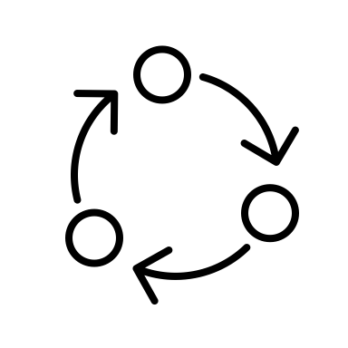

IT Service Desk / ITIL Escalation Matrix
IT Service Desk (Tier 1)
Tier 2 Support
Tier 3 Support
Tier X Support
As the initial point of contact for all IT issues, the service desk handles general inquiries and basic troubleshooting.
Tier 2 deals with more complex issues that require specialized knowledge or additional technical skills.
Tier 3 addresses high-level technical challenges involving system infrastructure or deep software problems.
Tier X represents specialized external support or vendor-specific assistance for highly specialized issues.
Software Installation Failure
Confirm system requirements and attempt basic reinstallation procedures.
Check initial reports and confirm if the issue is widespread or localized. Reset routers or switches if applicable.
Log the incident, alert security teams, and initiate a preliminary data lock-down procedure.
Verify service status with cloud providers and report outage details to users.
Network Downtime
Perform detailed diagnostics to identify conflicts or corrupt files. Test on alternative systems if necessary.
Analyze network logs and coordinate with internet service providers or internal network teams to pinpoint disruptions.
Conduct an initial forensic analysis to assess the extent of the breach and identify compromised systems.
Assess API integrations and conduct checks on related services to ensure connectivity.
Data Security Breach
Review and rectify deep system settings or registry conflicts that could be preventing security system function.
Implement advanced network recovery procedures and reconfigure core routing protocols.
Lead comprehensive security audits and implement remediation strategies to secure all data points.
Coordinate with cloud engineers to restore services and manage data integrity checks.
Cloud Service Interruptions
Consult the software vendor for proprietary installation issues or to receive patches.
Engage network equipment vendors for critical firmware updates or specialized diagnostics.
Work with cybersecurity firms for advanced threat detection solutions and mitigation techniques.
Liaise with cloud service providers for detailed root cause analysis and to prevent future interruptions.

Slide 3
DISCLAIMER Any articles, templates, or information provided by Smartsheet on the website are for reference only. While we strive to keep the information up to date and correct, we make no representations or warranties of any kind, express or implied, about the completeness, accuracy, reliability, suitability, or availability with respect to the website or the information, articles, templates, or related graphics contained on the website. Any reliance you place on such information is therefore strictly at your own risk.

