Slide 1


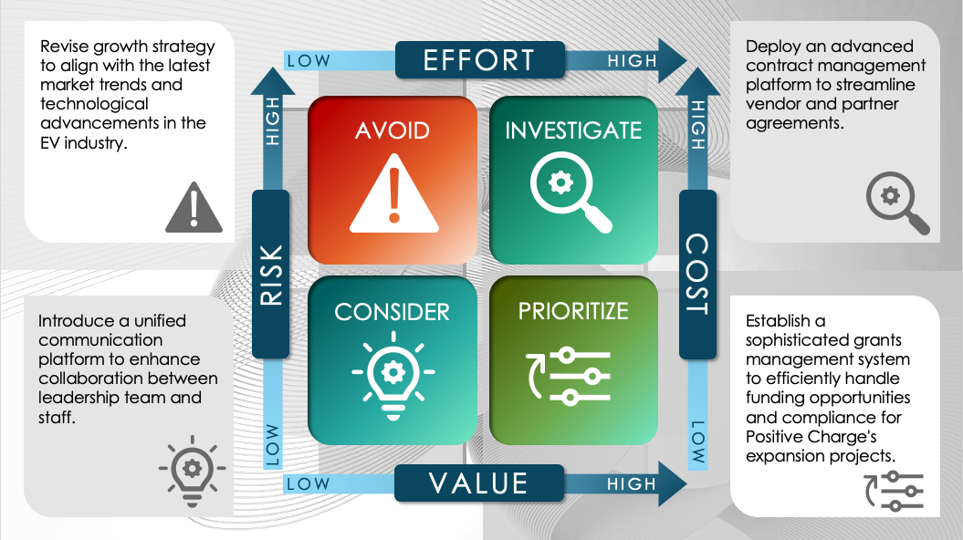
PowerPoint Project Prioritization Matrix Template
When to Use This Template: Use this template to rank and prioritize projects based on their importance and impact to ensure that your team or organization allocates resources to the most critical initiatives.
Notable Template Attributes: This PowerPoint template allows you to customize the criteria you use to score each project, as well as the scoring sections and priority rankings. This template provides a systematic approach to project evaluation and decision-making.

Slide 2





Revise growth strategy to align with the latest market trends and technological advancements in the EV industry.
Deploy an advanced contract management platform to streamline vendor and partner agreements.
LOW
EFFORT
HIGH
AVOID
INVESTIGATE
HIGH
HIGH
RISK
COST
CONSIDER
PRIORITIZE
Introduce a unified communication platform to enhance collaboration between leadership team and staff.
Establish a sophisticated grants management system to efficiently handle funding opportunities and compliance for Positive Charge's expansion projects.
LOW
LOW
LOW
VALUE
HIGH

Slide 3
Text
Text
LOW
EFFORT
HIGH
AVOID
INVESTIGATE
HIGH
HIGH
RISK
COST
CONSIDER
PRIORITIZE
Text
Text
LOW
LOW
LOW
VALUE
HIGH

Slide 4
DISCLAIMER Any articles, templates, or information provided by Smartsheet on the website are for reference only. While we strive to keep the information up to date and correct, we make no representations or warranties of any kind, express or implied, about the completeness, accuracy, reliability, suitability, or availability with respect to the website or the information, articles, templates, or related graphics contained on the website. Any reliance you place on such information is therefore strictly at your own risk.

