Slide 1


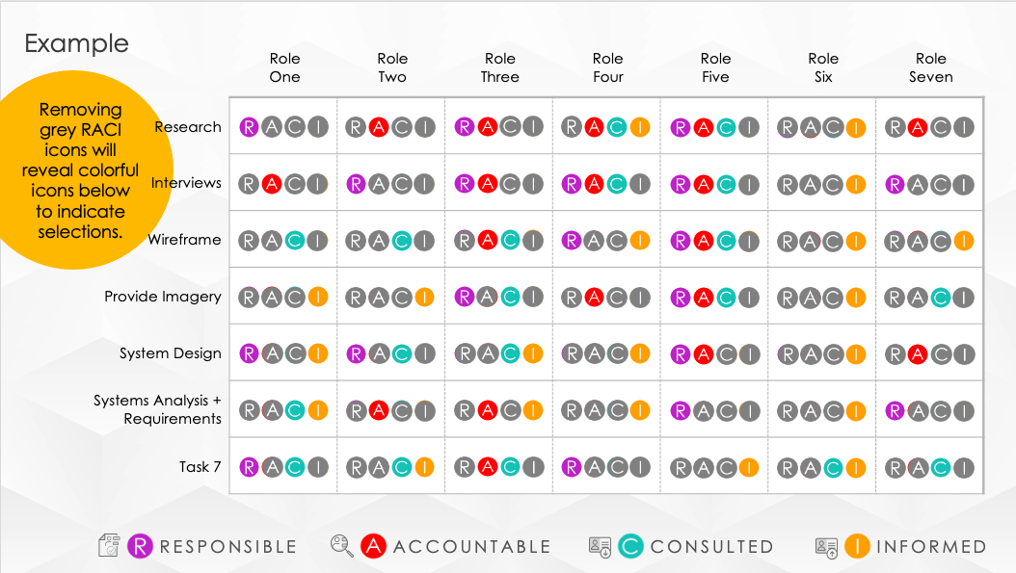




PowerPoint RACI Matrix Template
When to Use This Template: Use this template to define and clarify roles and responsibilities in a project to ensure that each task is assigned to the appropriate team members.
Notable Template Features: This template lists each task alongside the responsible, accountable, consulted, and informed (RACI) parties. This layout facilitates clear communication and accountability within the team, and it helps ensure that everyone is on the same page regarding their role.

Slide 2




RESPONSIBLE
RACI
MATRIX
ACCOUNTABLE
CONSULTED
INFORMED
00/00/0000

Slide 3




PROJECT OVERVIEW
RESPONSIBLE
PROJECT
Mission to Complete the Thing We Need to Do
ACCOUNTABLE
PROJECT MANAGER
Nelle Porter
CONSULTED
BUDGET
$82,500
DUE DATE
INFORMED
Tuesday, 00/00/0000
RESPONSIBLE
ACCOUNTABLE
CONSULTED
INFORMED

Slide 4




Example
 | Role One | Role Two | Role Three | Role Four | Role Five | Role Six | Role Seven
Research
Interviews
Wireframe
Provide Imagery
System Design
Systems Analysis + Requirements
Task 7
Removing grey RACI icons will reveal colorful icons below to indicate selections.
RESPONSIBLE
ACCOUNTABLE
CONSULTED
INFORMED

Slide 5
Removing grey RACI icons will reveal colorful icons below to indicate selections.
 | Role One | Role Two | Role Three | Role Four | Role Five | Role Six | Role Seven
Research
Interviews
Wireframe
Provide Imagery
System Design
Systems Analysis + Requirements
Task 7
RESPONSIBLE
ACCOUNTABLE
CONSULTED
INFORMED

Slide 6
ROLES & RESPONSIBILITIES
summary information / comments

Slide 7
DISCLAIMER Any articles, templates, or information provided by Smartsheet on the website are for reference only. While we strive to keep the information up to date and correct, we make no representations or warranties of any kind, express or implied, about the completeness, accuracy, reliability, suitability, or availability with respect to the website or the information, articles, templates, or related graphics contained on the website. Any reliance you place on such information is therefore strictly at your own risk.

