Slide 1

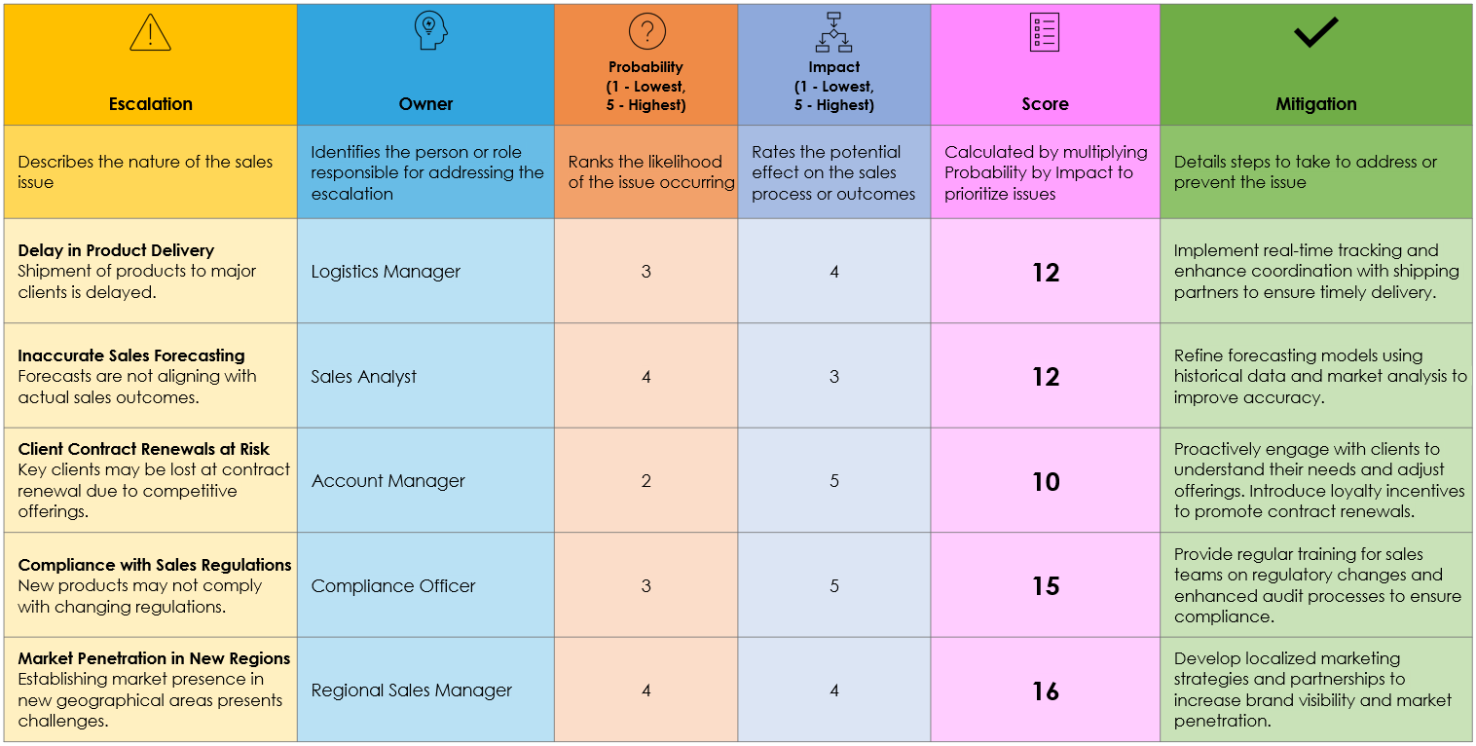
Sales Escalation Matrix Template
When To Use This Template:
Use this template to systematically manage and escalate sales-related issues, ensuring that potential problems are addressed by the appropriate owner to minimize negative impacts on sales performance.
Notable Templates Features:
This template includes columns for Escalation, Owner, Probability (1 lowest, 5 highest), Sales Impact, Score, and Mitigation, providing a structured approach to assess the likelihood and impact of issues and implement effective mitigation strategies.

Slide 2






Sales Escalation Matrix
Escalation | Owner | Probability (1 - Lowest, 5 - Highest) | Impact (1 - Lowest, 5 - Highest) | Score | Mitigation
Describes the nature of the sales issue | Identifies the person or role responsible for addressing the escalation | Ranks the likelihood of the issue occurring | Rates the potential effect on the sales process or outcomes | Calculated by multiplying Probability by Impact to prioritize issues | Details steps to take to address or prevent the issue
Delay in Product Delivery Shipment of products to major clients is delayed. | Logistics Manager | 3 | 4 | 12 | Implement real-time tracking and enhance coordination with shipping partners to ensure timely delivery.
Inaccurate Sales Forecasting Forecasts are not aligning with actual sales outcomes. | Sales Analyst | 4 | 3 | 12 | Refine forecasting models using historical data and market analysis to improve accuracy.
Client Contract Renewals at Risk Key clients may be lost at contract renewal due to competitive offerings. | Account Manager | 2 | 5 | 10 | Proactively engage with clients to understand their needs and adjust offerings. Introduce loyalty incentives to promote contract renewals.
Compliance with Sales Regulations New products may not comply with changing regulations. | Compliance Officer | 3 | 5 | 15 | Provide regular training for sales teams on regulatory changes and enhanced audit processes to ensure compliance.
Market Penetration in New Regions Establishing market presence in new geographical areas presents challenges. | Regional Sales Manager | 4 | 4 | 16 | Develop localized marketing strategies and partnerships to increase brand visibility and market penetration.

Slide 3
DISCLAIMER Any articles, templates, or information provided by Smartsheet on the website are for reference only. While we strive to keep the information up to date and correct, we make no representations or warranties of any kind, express or implied, about the completeness, accuracy, reliability, suitability, or availability with respect to the website or the information, articles, templates, or related graphics contained on the website. Any reliance you place on such information is therefore strictly at your own risk.

