Slide 1

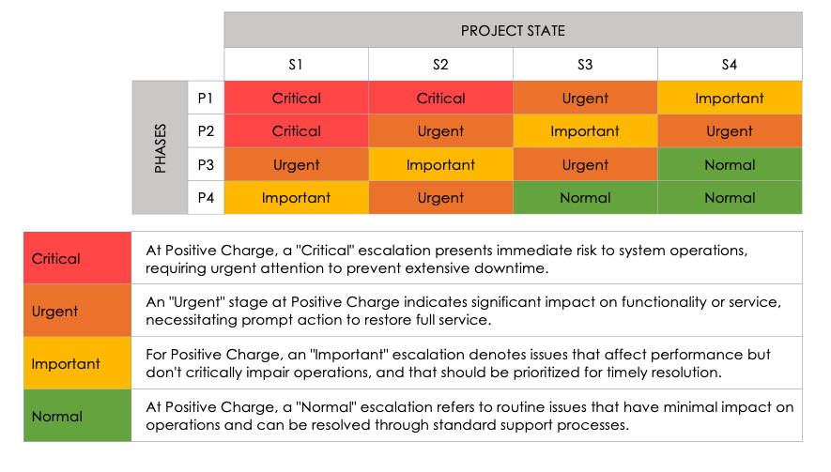
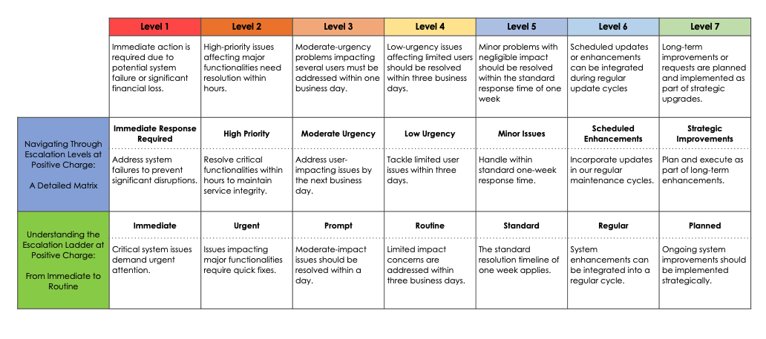
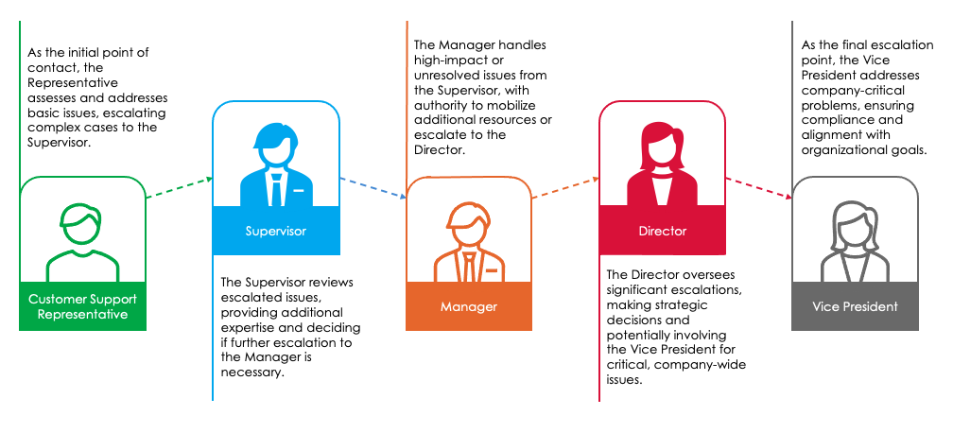
Simple Escalation Matrix Template Example
When To Use This Template: Use this template for straightforward, small-scale projects when you need to document a clear escalation path that is easy to follow.
Notable Templates Features: This template includes space for you to document the severity level of each project or individual issue (e.g., Critical, Urgent, Important, or Normal). You can also use this template to document the phase and specific escalation workflow.

Slide 2
Simple Escalation Matrix Example
You can edit this text, customize it with your escalation process details, and change the font or style.
 |  | PROJECT STATE
 |  | S1 | S2 | S3 | S4
PHASES | P1 | Critical | Critical | Urgent | Important
 | P2 | Critical | Urgent | Important | Urgent
 | P3 | Urgent | Important | Urgent | Normal
 | P4 | Important | Urgent | Normal | Normal
Critical | At Positive Charge, a "Critical" escalation presents immediate risk to system operations, requiring urgent attention to prevent extensive downtime.
Urgent | An "Urgent" stage at Positive Charge indicates significant impact on functionality or service, necessitating prompt action to restore full service.
Important | For Positive Charge, an "Important" escalation denotes issues that affect performance but don't critically impair operations, and that should be prioritized for timely resolution.
Normal | At Positive Charge, a "Normal" escalation refers to routine issues that have minimal impact on operations and can be resolved through standard support processes.

Slide 3
Simple Escalation Matrix Example
You can edit this text, customize it with your escalation process details, and change the font or style.
 | Level 1 | Level 2 | Level 3 | Level 4 | Level 5 | Level 6 | Level 7
 | Immediate action is required due to potential system failure or significant financial loss. | High-priority issues affecting major functionalities need resolution within hours. | Moderate-urgency problems impacting several users must be addressed within one business day. | Low-urgency issues affecting limited users should be resolved within three business days. | Minor problems with negligible impact should be resolved within the standard response time of one week | Scheduled updates or enhancements can be integrated during regular update cycles | Long-term improvements or requests are planned and implemented as part of strategic upgrades.
Navigating Through Escalation Levels at Positive Charge: A Detailed Matrix | Immediate Response Required | High Priority | Moderate Urgency | Low Urgency | Minor Issues | Scheduled Enhancements | Strategic Improvements
 | Address system failures to prevent significant disruptions. | Resolve critical functionalities within hours to maintain service integrity. | Address user-impacting issues by the next business day. | Tackle limited user issues within three days. | Handle within standard one-week response time. | Incorporate updates in our regular maintenance cycles. | Plan and execute as part of long-term enhancements.
Understanding the Escalation Ladder at Positive Charge: From Immediate to Routine | Immediate | Urgent | Prompt | Routine | Standard | Regular | Planned
 | Critical system issues demand urgent attention. | Issues impacting major functionalities require quick fixes. | Moderate-impact issues should be resolved within a day. | Limited impact concerns are addressed within three business days. | The standard resolution timeline of one week applies. | System enhancements can be integrated into a regular cycle. | Ongoing system improvements should be implemented strategically.

Slide 4





Simple Escalation Matrix Example
You can edit this text, customize it with your escalation process details, and change the font or style.
As the initial point of contact, the Representative assesses and addresses basic issues, escalating complex cases to the Supervisor.
The Manager handles high-impact or unresolved issues from the Supervisor, with authority to mobilize additional resources or escalate to the Director.
As the final escalation point, the Vice President addresses company-critical problems, ensuring compliance and alignment with organizational goals.
Supervisor
Director
The Supervisor reviews escalated issues, providing additional expertise and deciding if further escalation to the Manager is necessary.
The Director oversees significant escalations, making strategic decisions and potentially involving the Vice President for critical, company-wide issues.
Customer Support Representative
Manager
Vice President

Slide 5
DISCLAIMER Any articles, templates, or information provided by Smartsheet on the website are for reference only. While we strive to keep the information up to date and correct, we make no representations or warranties of any kind, express or implied, about the completeness, accuracy, reliability, suitability, or availability with respect to the website or the information, articles, templates, or related graphics contained on the website. Any reliance you place on such information is therefore strictly at your own risk.

