Slide 1


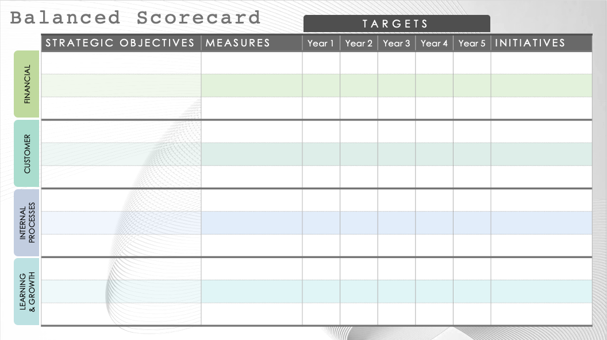
Basic Balanced Scorecard Template
When To Use This Template: Strategic planners can use this balanced scorecard template to align company activities with the broader vision and strategic goals. This template is especially useful for organizations that need a structured approach to manage and measure performance across key business areas, from financial to learning and growth. For example, a startup looking to monitor growth metrics or a manufacturing company wanting to enhance operational efficiency could use this framework to set clear targets and initiatives.
Notable Template Features: This template lists strategic objectives and measures along with a five-year projection for targets and corresponding initiatives for long-term planning. The template shows how targets progress over time, such as annual sales growth or new customer acquisition, enabling companies to adjust their strategies as needed. The straightforward design integrates financial and customer metrics with internal and innovation objectives, making it comprehensive and easy to interpret.

Slide 2

Balanced Scorecard
TARGETS
STRATEGIC OBJECTIVES | MEASURES | Year 1 | Year 2 | Year 3 | Year 4 | Year 5 | INITIATIVES
FINANCIAL
CUSTOMER
INTERNAL PROCESSES
LEARNING
& GROWTH

Slide 3
DISCLAIMER Any articles, templates, or information provided by Smartsheet on the website are for reference only. While we strive to keep the information up to date and correct, we make no representations or warranties of any kind, express or implied, about the completeness, accuracy, reliability, suitability, or availability with respect to the website or the information, articles, templates, or related graphics contained on the website. Any reliance you place on such information is therefore strictly at your own risk.

