Slide 1


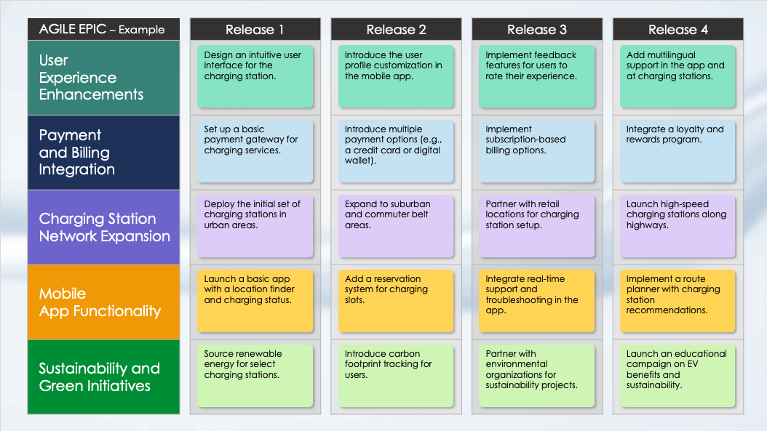
Agile Epic Roadmap Slide Template
When to Use This Template: Use this Agile epic roadmap slide template to present the planning and tracking of your Agile epics across multiple releases to team members and stakeholders. The template is particularly useful for conveying project timelines and progress in a clear, visual format.
Notable Template Features: Available with or without sample text, this template includes release-by-release columns that help you organize and track epics. This format enables you to present projects clearly and to ensure that you’ve aligned all stakeholders concerning progress and upcoming milestones.

Slide 2
AGILE EPIC |  | Release 1 |  | Release 2 |  | Release 3 |  | Release 4
Epic 1
Epic 2
Epic 3
Epic 4
Epic 5
Release Task
Release Task
Release Task
Release Task
Release Task
Release Task
Release Task
Release Task
Release Task
Release Task
Release Task
Release Task
Release Task
Release Task
Release Task
Release Task
Release Task
Release Task
Release Task
Release Task

Slide 3
AGILE EPIC |  | Release 1 |  | Release 2 |  | Release 3 |  | Release 4
Epic 1
Epic 2
Epic 3
Epic 4
Epic 5
Release Task
Release Task
Release Task
Release Task
Release Task
Release Task
Release Task
Release Task
Release Task
Release Task
Release Task
Release Task
Release Task
Release Task
Release Task
Release Task
Release Task
Release Task
Release Task
Release Task

Slide 4
AGILE EPIC | Release 1 | Release 2 | Release 3 | Release 4 | Release 5 | Release 6
Epic 1
Epic 2
Epic 3
Epic 4
Epic 5
Release Task
Release Task
Release Task
Release Task
Release Task
Release Task
Release Task
Release Task
Release Task
Release Task
Release Task
Release Task
Release Task
Release Task
Release Task
Release Task
Release Task
Release Task
Release Task
Release Task
Release Task
Release Task
Release Task
Release Task
Release Task
Release Task
Release Task
Release Task
Release Task
Release Task

Slide 5
AGILE EPIC | Release 1 | Release 2 | Release 3 | Release 4 | Release 5 | Release 6
Epic 1
Epic 2
Epic 3
Epic 4
Epic 5
Epic 6
Release Task
Release Task
Release Task
Release Task
Release Task
Release Task
Release Task
Release Task
Release Task
Release Task
Release Task
Release Task
Release Task
Release Task
Release Task
Release Task
Release Task
Release Task
Release Task
Release Task
Release Task
Release Task
Release Task
Release Task
Release Task
Release Task
Release Task
Release Task
Release Task
Release Task
Release Task
Release Task
Release Task
Release Task
Release Task
Release Task

Slide 6
DISCLAIMER Any articles, templates, or information provided by Smartsheet on the website are for reference only. While we strive to keep the information up to date and correct, we make no representations or warranties of any kind, express or implied, about the completeness, accuracy, reliability, suitability, or availability with respect to the website or the information, articles, templates, or related graphics contained on the website. Any reliance you place on such information is therefore strictly at your own risk.

