Slide 1

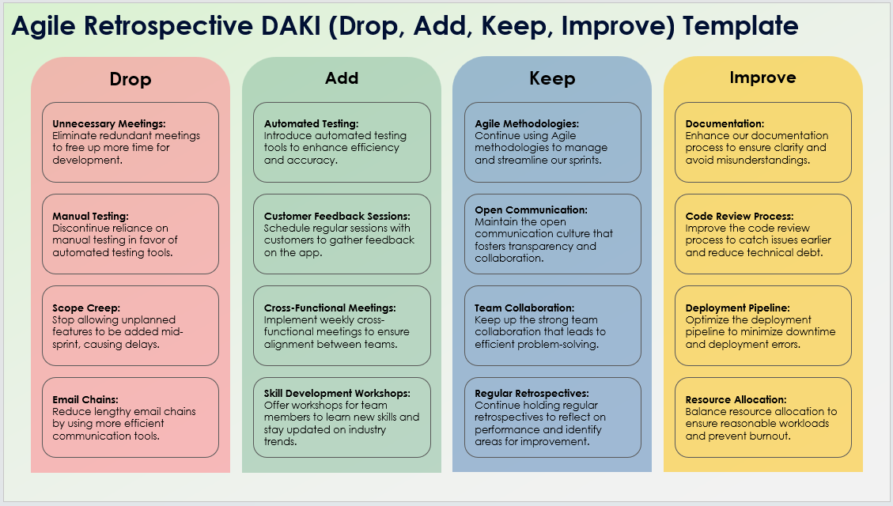
Agile Retrospective DAKI (Drop, Add, Keep, Improve)
Template Example
When To Use This Template: Use this Agile retrospective DAKI template in sprint retrospectives to decide what practices or processes to drop, add, keep, and improve. It's effective for refining team workflows and enhancing performance.
Notable Templates Features: The template includes sections to record what to drop, add, keep, and improve, facilitating structured discussions on eliminating ineffective practices, introducing new methods, maintaining successful processes, and enhancing areas needing improvement.

Slide 2
Agile Retrospective DAKI (Drop, Add, Keep, Improve) Template Example
Drop
Add
Keep
Improve
Unnecessary Meetings:
Eliminate redundant meetings to free up more time for development.
Automated Testing:
Introduce automated testing tools to enhance efficiency and accuracy.
Agile Methodologies:
Continue using Agile methodologies to manage and streamline our sprints.
Documentation:
Enhance our documentation process to ensure clarity and avoid misunderstandings.
Manual Testing:
Discontinue reliance on manual testing in favor of automated testing tools.
Customer Feedback Sessions:
Schedule regular sessions with customers to gather feedback on the app.
Open Communication:
Maintain the open communication culture that fosters transparency and collaboration.
Code Review Process:
Improve the code review process to catch issues earlier and reduce technical debt.
Scope Creep:
Stop allowing unplanned features to be added mid-sprint, causing delays.
Cross-Functional Meetings:
Implement weekly cross-functional meetings to ensure alignment between teams.
Team Collaboration:
Keep up the strong team collaboration that leads to efficient problem-solving.
Deployment Pipeline:
Optimize the deployment pipeline to minimize downtime and deployment errors.
Email Chains:
Reduce lengthy email chains by using more efficient communication tools.
Skill Development Workshops:
Offer workshops for team members to learn new skills and stay updated on industry trends.
Regular Retrospectives:
Continue holding regular retrospectives to reflect on performance and identify areas for improvement.
Resource Allocation:
Balance resource allocation to ensure reasonable workloads and prevent burnout.

Slide 3
DISCLAIMER Any articles, templates, or information provided by Smartsheet on the website are for reference only. While we strive to keep the information up to date and correct, we make no representations or warranties of any kind, express or implied, about the completeness, accuracy, reliability, suitability, or availability with respect to the website or the information, articles, templates, or related graphics contained on the website. Any reliance you place on such information is therefore strictly at your own risk.

