Slide 1

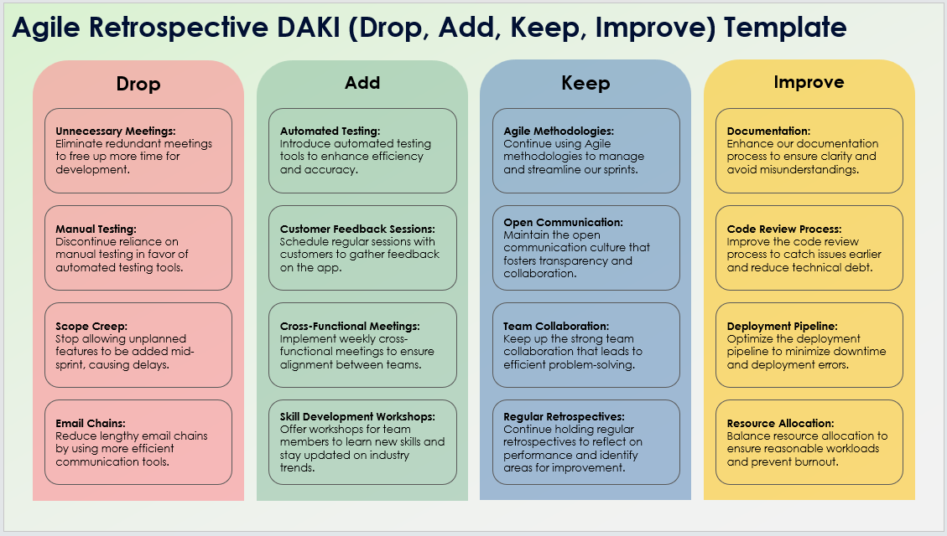
Agile Retrospective DAKI (Drop, Add, Keep, Improve) Template
When To Use This Template: Use this Agile retrospective DAKI template in sprint retrospectives to decide what practices or processes to drop, add, keep, and improve. It's effective for refining team workflows and enhancing performance.
Notable Templates Features: The template includes sections to record what to drop, add, keep, and improve, facilitating structured discussions on eliminating ineffective practices, introducing new methods, maintaining successful processes, and enhancing areas needing improvement.

Slide 2
Agile Retrospective DAKI (Drop, Add, Keep, Improve) Template
Drop
Add
Keep
Improve
Drop 1
Add 1
Keep 1
Improve 1
Drop 2
Add 2
Keep 2
Improve 2
Drop 3
Add 3
Keep 3
Improve 3
Drop 4
Add 4
Keep 4
Improve 4

Slide 3
DISCLAIMER Any articles, templates, or information provided by Smartsheet on the website are for reference only. While we strive to keep the information up to date and correct, we make no representations or warranties of any kind, express or implied, about the completeness, accuracy, reliability, suitability, or availability with respect to the website or the information, articles, templates, or related graphics contained on the website. Any reliance you place on such information is therefore strictly at your own risk.

