Slide 1

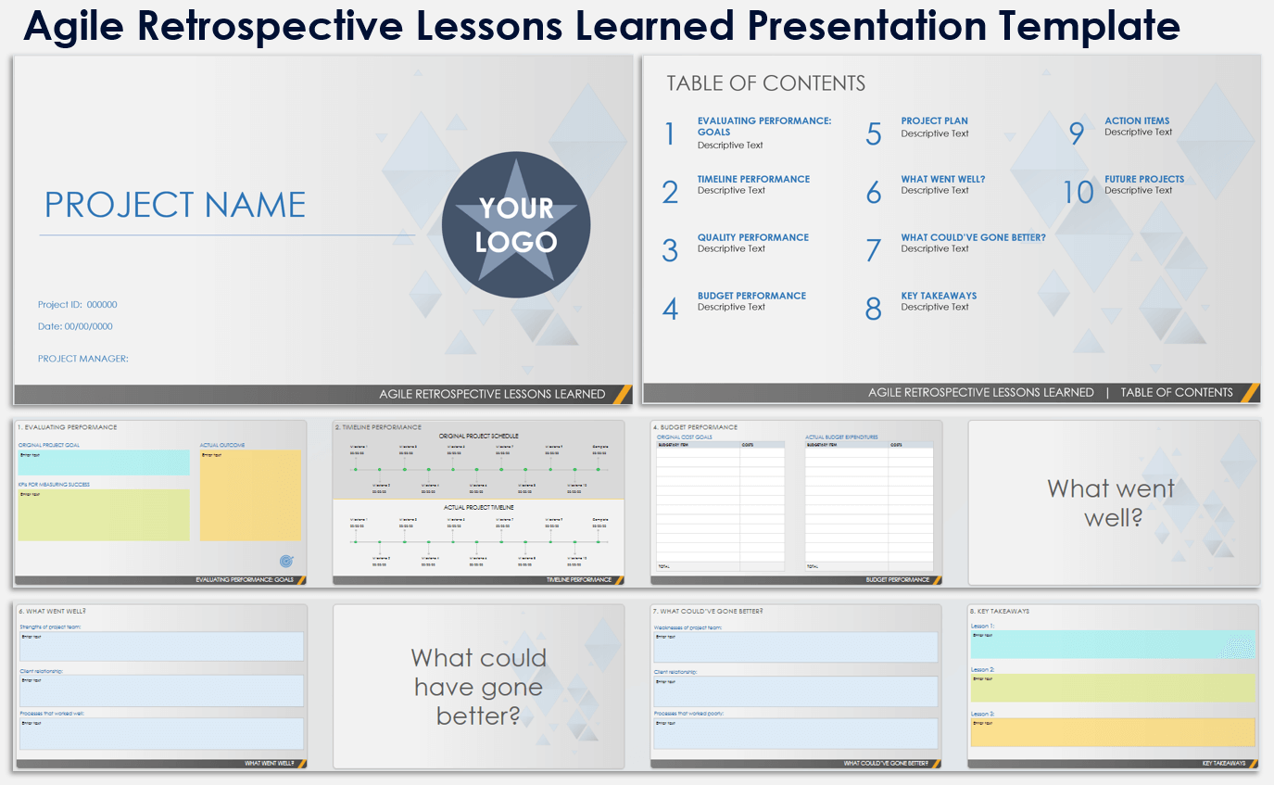
Agile Retrospective Lessons Learned Presentation Template
When to Use This Template:
Use this Agile retrospective lessons learned template to present a comprehensive review of project performances, focusing on goals, timeline, quality, budget, and key takeaways. It's ideal for post-project evaluations to identify successes and areas for improvement.
Notable Templates Features:
The template features slides for evaluating performance, the project plan, what went well, what could’ve gone better, key takeaways, action items, and future projects. This template provides a structured format for thorough project analysis and strategic planning.

Slide 2

Agile Retrospective Lessons Learned Presentation Template
PROJECT NAME
YOUR
LOGO
Project ID: 000000
Date: 00/00/0000
PROJECT MANAGER:
AGILE RETROSPECTIVE LESSONS LEARNED

Slide 3
TABLE OF CONTENTS
1 | EVALUATING PERFORMANCE: GOALS Descriptive Text | 5 | PROJECT PLAN Descriptive Text | 9 | ACTION ITEMS Descriptive Text
2 | TIMELINE PERFORMANCE Descriptive Text | 6 | WHAT WENT WELL? Descriptive Text | 10 | FUTURE PROJECTS Descriptive Text
3 | QUALITY PERFORMANCE Descriptive Text | 7 | WHAT COULD’VE GONE BETTER? Descriptive Text
4 | BUDGET PERFORMANCE Descriptive Text | 8 | KEY TAKEAWAYS Descriptive Text
AGILE RETROSPECTIVE LESSONS LEARNED | TABLE OF CONTENTS

Slide 4

1. EVALUATING PERFORMANCE
ORIGINAL PROJECT GOAL
ACTUAL OUTCOME
Enter text
Enter text
KPIs FOR MEASURING SUCCESS
Enter text
EVALUATING PERFORMANCE: GOALS

Slide 5
2. TIMELINE PERFORMANCE
ORIGINAL PROJECT SCHEDULE
Milestone 1
00/00/00
Milestone 3
00/00/00
Milestone 5
00/00/00
Milestone 7
00/00/00
Milestone 9
00/00/00
Complete
00/00/00
Milestone 2
00/00/00
Milestone 4
00/00/00
Milestone 6
00/00/00
Milestone 8
00/00/00
Milestone 10
00/00/00
ACTUAL PROJECT TIMELINE
Milestone 1
00/00/00
Milestone 3
00/00/00
Milestone 5
00/00/00
Milestone 7
00/00/00
Milestone 9
00/00/00
Complete
00/00/00
Milestone 2
00/00/00
Milestone 4
00/00/00
Milestone 6
00/00/00
Milestone 8
00/00/00
Milestone 10
00/00/00
TIMELINE PERFORMANCE

Slide 6
3. QUALITY PERFORMANCE
INITIAL GOAL FOR QUALITY STANDARDS
ACTUAL OUTCOME
Enter text
Enter text
KPIs FOR MEASURING SUCCESS
Enter text
QUALITY PERFORMANCE

Slide 7
4. BUDGET PERFORMANCE
ORIGINAL COST GOALS
ACTUAL BUDGET EXPENDITURES
BUDGETARY ITEM | COSTS
TOTAL
BUDGETARY ITEM | COSTS
TOTAL
BUDGET PERFORMANCE

Slide 8
5. PROJECT PLAN
Was the plan clearly defined and communicated?
Enter text
Was it the right plan for this project?
Enter text
What could have been improved?
Enter text
PROJECT PLAN

Slide 9
What went
well?

Slide 10
6. WHAT WENT WELL?
Strengths of the project team:
Enter text
Client relationship:
Enter text
Processes that worked well:
Enter text
WHAT WENT WELL?
WHAT WENT WELL?

Slide 11
What could have gone better?

Slide 12
7. WHAT COULD’VE GONE BETTER?
Weaknesses of the project team:
Enter text
Client relationship:
Enter text
Processes that worked poorly:
Enter text
WHAT COULD’VE GONE BETTER?

Slide 13
8. KEY TAKEAWAYS
Lesson 1:
Enter text
Lesson 2:
Enter text
Lesson 3:
Enter text
KEY TAKEAWAYS

Slide 14
9. ACTION ITEMS – STEPS WE CAN TAKE NOW
Action 1:
Enter text
Action 2:
Enter text
Action 3:
Enter text
ACTION ITEMS

Slide 15
10. FUTURE PROJECTS
RECOMMENDATIONS FOR FUTURE PROJECTS
DATE | IDEA | COMMENTS
FUTURE PROJECTS
FUTURE PROJECTS

Slide 16
DISCLAIMER Any articles, templates, or information provided by Smartsheet on the website are for reference only. While we strive to keep the information up to date and correct, we make no representations or warranties of any kind, express or implied, about the completeness, accuracy, reliability, suitability, or availability with respect to the website or the information, articles, templates, or related graphics contained on the website. Any reliance you place on such information is therefore strictly at your own risk.

