Slide 1

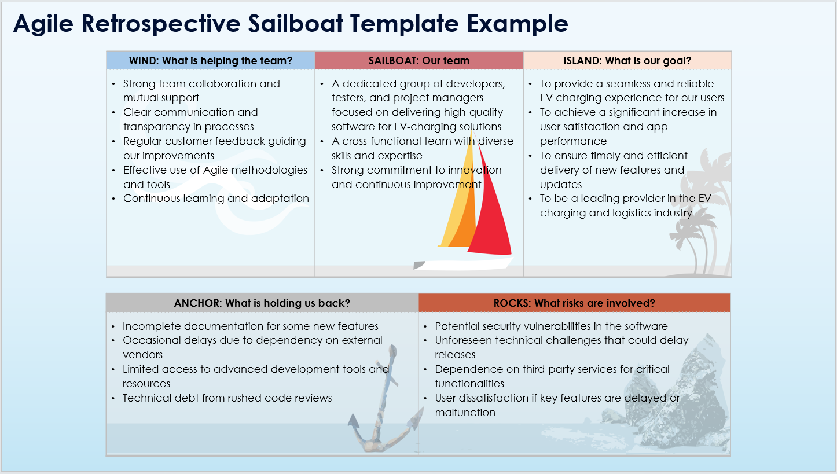
Agile Retrospective Sailboat Template Example
When To Use This Template:
Use this Agile retrospective sailboat template during sprint retrospectives to assess what is helping the team (Wind), the team's status (Sailboat), the team's goals (Island), obstacles (Anchor), and potential risks (Rocks). It's perfect for visualizing team dynamics and understanding both positive and negative influences.
Notable Templates Features:
Features five interactive sections: Wind, Sailboat, Island, Anchor, and Rocks, providing a comprehensive view of team performance and challenges. This template aids in collaboratively identifying strengths, goals, impediments, and risks, fostering actionable insights for continuous improvement.

Slide 2

Agile Retrospective Sailboat Template Example
WIND: What is helping the team? | SAILBOAT: Our team | ISLAND: What is our goal?
Strong team collaboration and mutual support Clear communication and transparency in processes Regular customer feedback guiding our improvements Effective use of Agile methodologies and tools Continuous learning and adaptation | A dedicated group of developers, testers, and project managers focused on delivering high-quality software for EV-charging solutions A cross-functional team with diverse skills and expertise Strong commitment to innovation and continuous improvement | To provide a seamless and reliable EV charging experience for our users To achieve a significant increase in user satisfaction and app performance To ensure timely and efficient delivery of new features and updates To be a leading provider in the EV charging and logistics industry
ANCHOR: What is holding us back? | ROCKS: What risks are involved?
Incomplete documentation for some new features Occasional delays due to dependency on external vendors Limited access to advanced development tools and resources Technical debt from rushed code reviews | Potential security vulnerabilities in the software Unforeseen technical challenges that could delay releases Dependence on third-party services for critical functionalities User dissatisfaction if key features are delayed or malfunction

Slide 3
DISCLAIMER Any articles, templates, or information provided by Smartsheet on the website are for reference only. While we strive to keep the information up to date and correct, we make no representations or warranties of any kind, express or implied, about the completeness, accuracy, reliability, suitability, or availability with respect to the website or the information, articles, templates, or related graphics contained on the website. Any reliance you place on such information is therefore strictly at your own risk.

