Slide 1

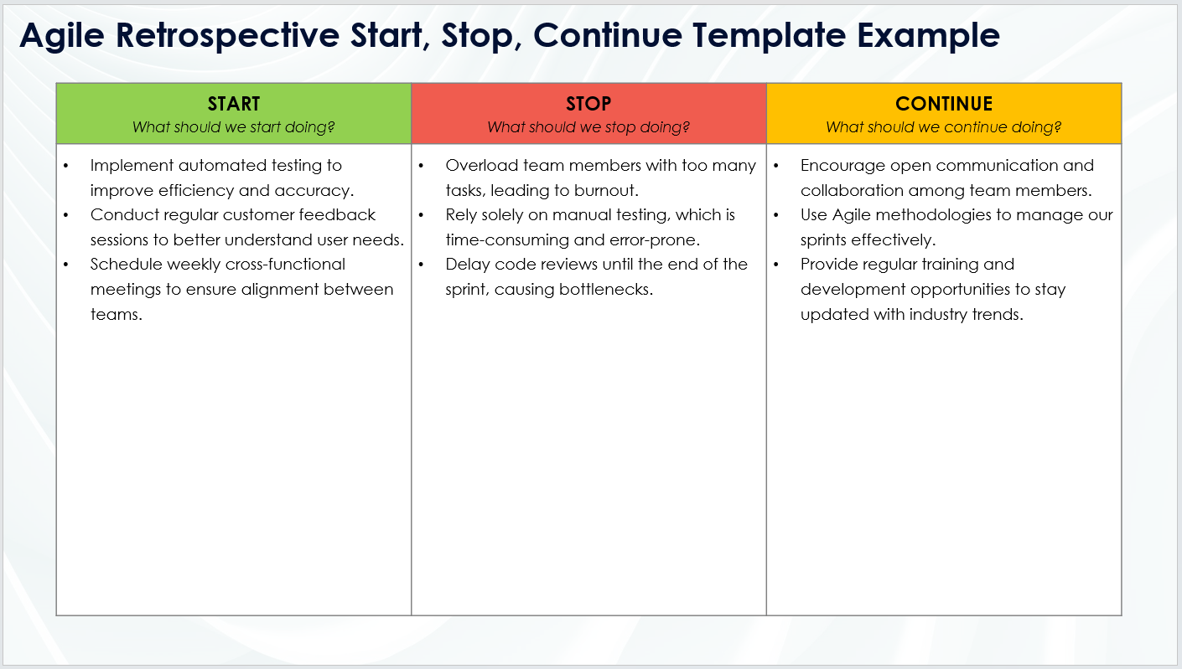
Agile Retrospective Start, Stop, Continue Template
When To Use This Template:
Use this Agile retrospective start, stop, continue template during sprint retrospectives to discuss new actions to start, activities to stop, and practices to continue. It helps the team identify actionable steps for continuous improvement.
Notable Templates Features:
This template includes three columns for easy Agile retrospectives: Start, Stop, and Continue, facilitating focused discussions on new initiatives, areas to cease, and ongoing practices that add value. This template promotes clear, actionable feedback and fosters team alignment on improvements.

Slide 2
Agile Retrospective Start, Stop, Continue Template
START What should we start doing? | STOP What should we stop doing? | CONTINUE What should we continue doing?
Start doing 1 Start doing 2 Start doing 3 | Stop doing 1 Stop doing 2 Stop doing 3 | Continue doing 1 Continue doing 2 Continue doing 3

Slide 3
DISCLAIMER Any articles, templates, or information provided by Smartsheet on the website are for reference only. While we strive to keep the information up to date and correct, we make no representations or warranties of any kind, express or implied, about the completeness, accuracy, reliability, suitability, or availability with respect to the website or the information, articles, templates, or related graphics contained on the website. Any reliance you place on such information is therefore strictly at your own risk.

